Slide 1
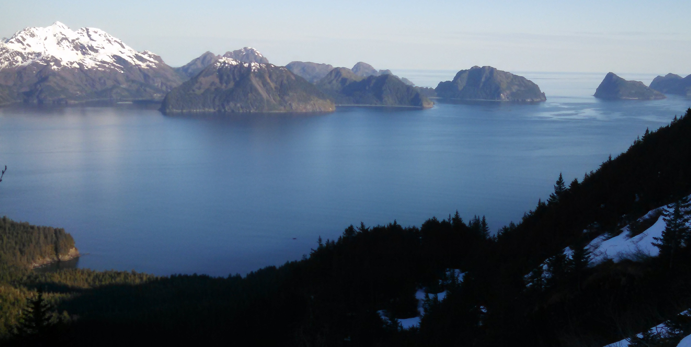
Reconciling Spatial Scales for Effective Conservation
The Kenai Bird Habitat Assessment Protocol
Ben Sullender, Erika Knight, and Melanie Smith
Audubon Alaska
Alaska Bird Conference
December 7, 2016
Cordova, AK

Slide 2
Goal
Which areas in the Kenai Peninsula are particularly important for birds?
Fine-scale assessment
Stewardship / monitoring
Notes:
Central question
Although this is nothing new, what’s different is the spatial scale and target audience

Slide 3
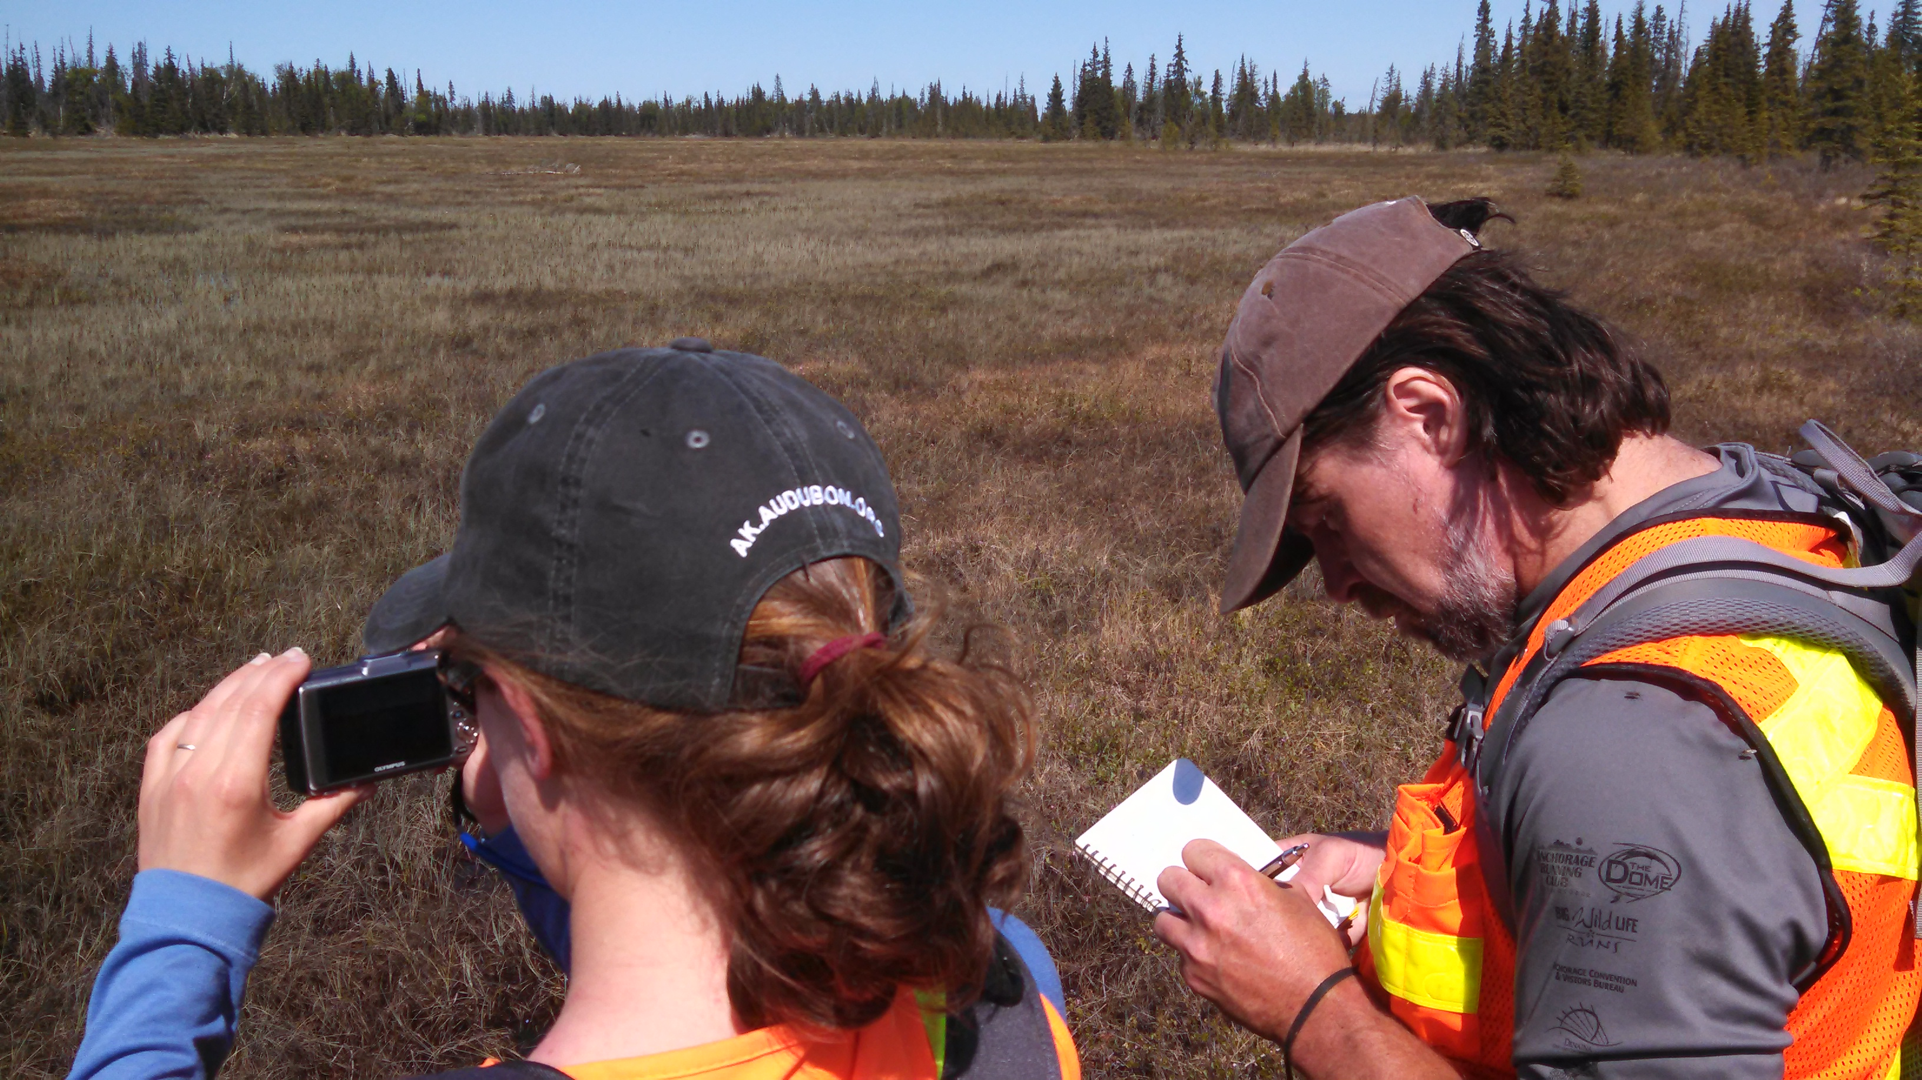
Overview
The Issue of Spatial Scales
Modeling Methods
Suitability and Predicted Occurrence
WatchList Habitat Associations
Watershed Checklist
Limitations
Takeaways and Next Steps

Slide 4
Collaborative Effort
2012: Kachemak Heritage Land Trust (KHLT) and Audubon Alaska begin partnership
2014: Kenai Decision Support Tool launched
2015: Kenai Mountains to Sea strategic plan released
Audubon Alaska:
  Erika Knight
  Melanie Smith
  Nathan Walker
Kachemak Heritage Land Trust:
  Mandy Bernard
  Joel Cooper
  Marie McCarty
Notes:
Start out by acknowledging everyone
I’m just talking through a process that was a team effort

Slide 5
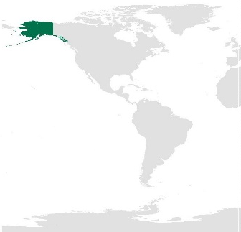

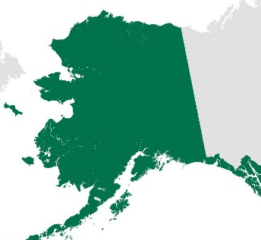
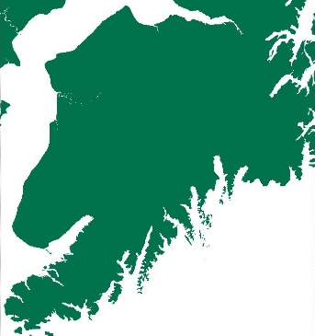
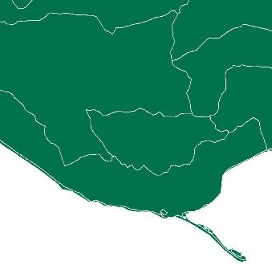
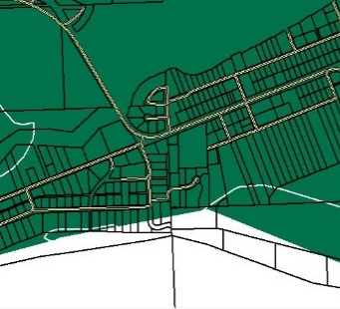

SCALE
TYPICAL SCALE OF OPERATION
Global
1:10⁸
Flyway /
Continental
1:5x10⁷
Landscape
1:10⁷
Regional
1:10⁶
Kenai Bird
Habitat Assessment
Protocol
Watershed
1:10⁵
Parcel
1:10⁴
Notes:
Expertise and resources
Land trusts: stewardship, parcel easement, ownership, monitoring, assessment
Enviro org: scientific data

Slide 6
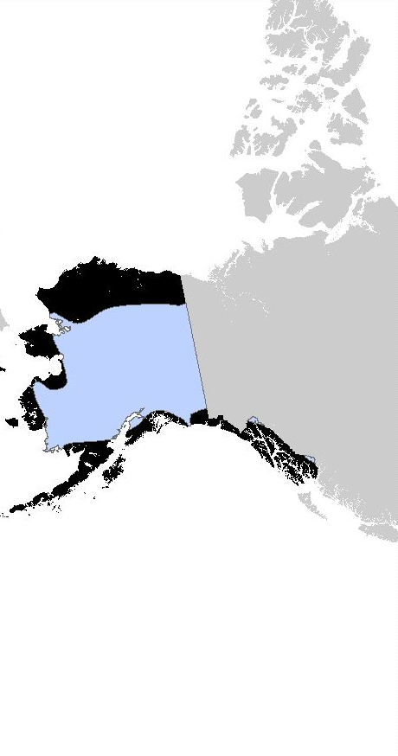
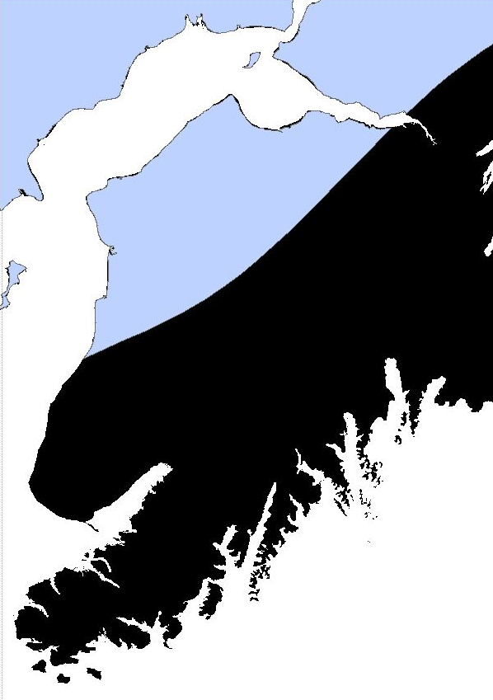
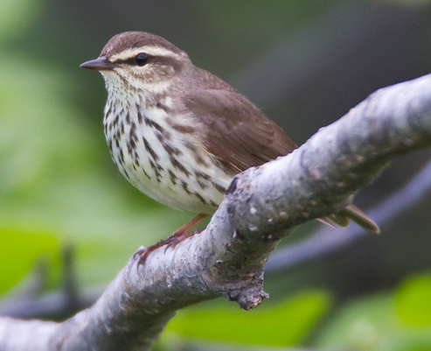
Spatial Scale
Range maps
Photo: Milo Burcham
Notes:
Northern Waterthrush

Slide 7
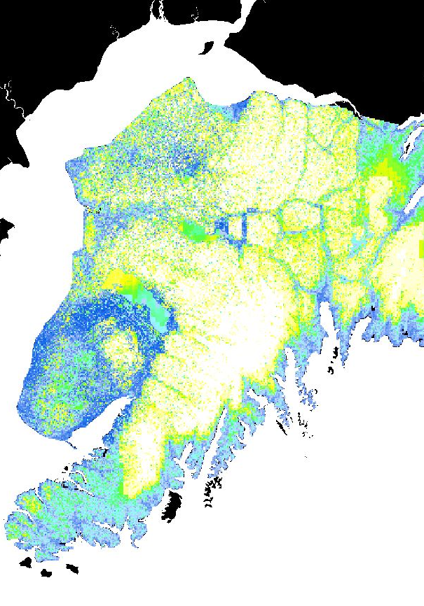
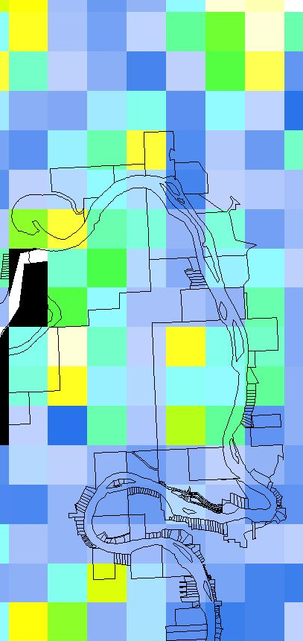
Spatial Scale
Kenai National Wildlife Refuge species distribution data
Magness et al. 2008, Applications of Computational Intelligence in Biology
Notes:
resolution

Slide 8
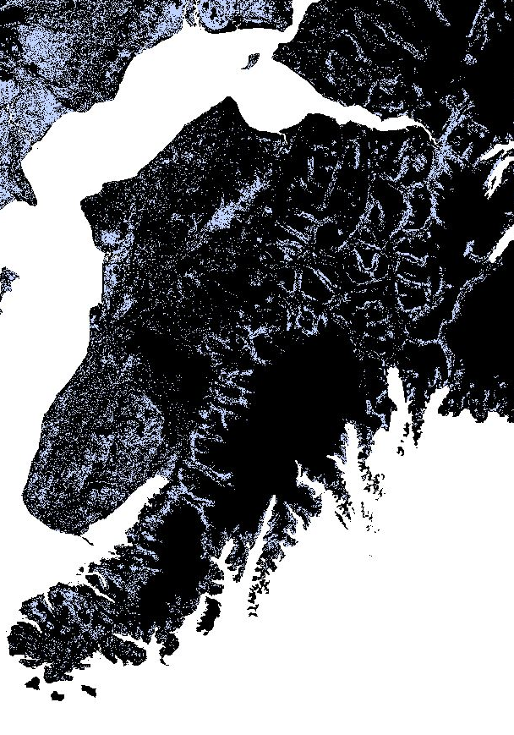
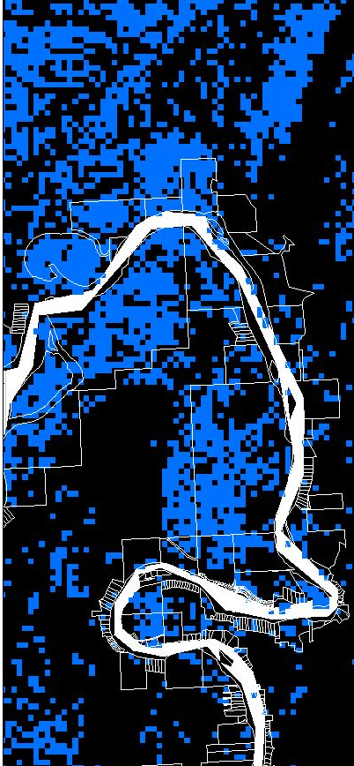
Spatial Scale
Alaska Natural Heritage Program
Gotthardt et al. 2013, University of Alaska-Anchorage
Notes:
Input data
566,597 observations of 266 bird species
3 years, $1.2

Slide 9
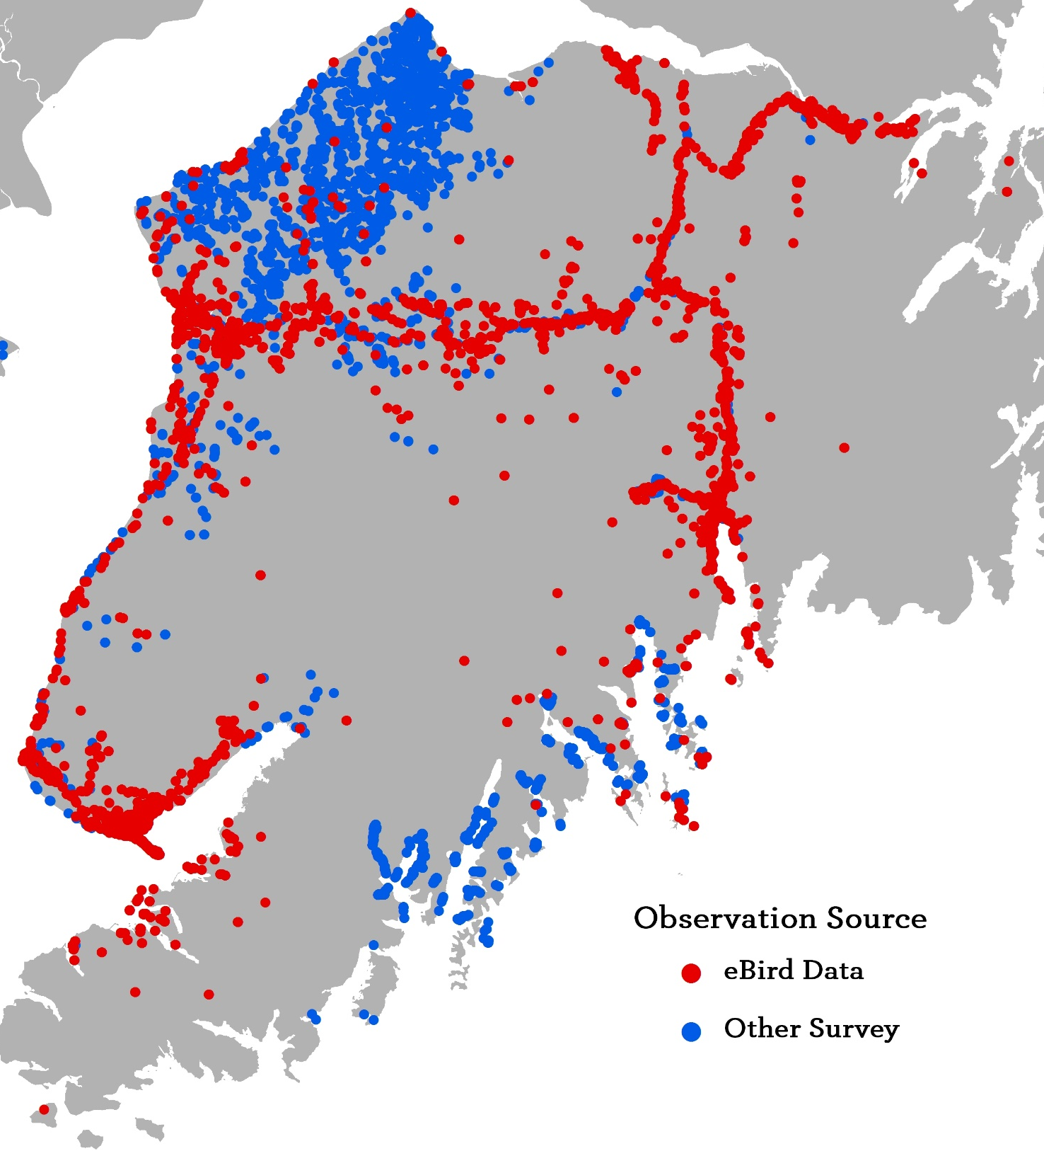
Bird Data
159,525 observations
179 species (340 species before filtering)
Biased towards road system and Kenai National Wildlife Refuge surveys
Notes:
AK NHP:
566,597 observations of 266 species
159,525 observations of 179 species (started with 340 species)

Slide 10
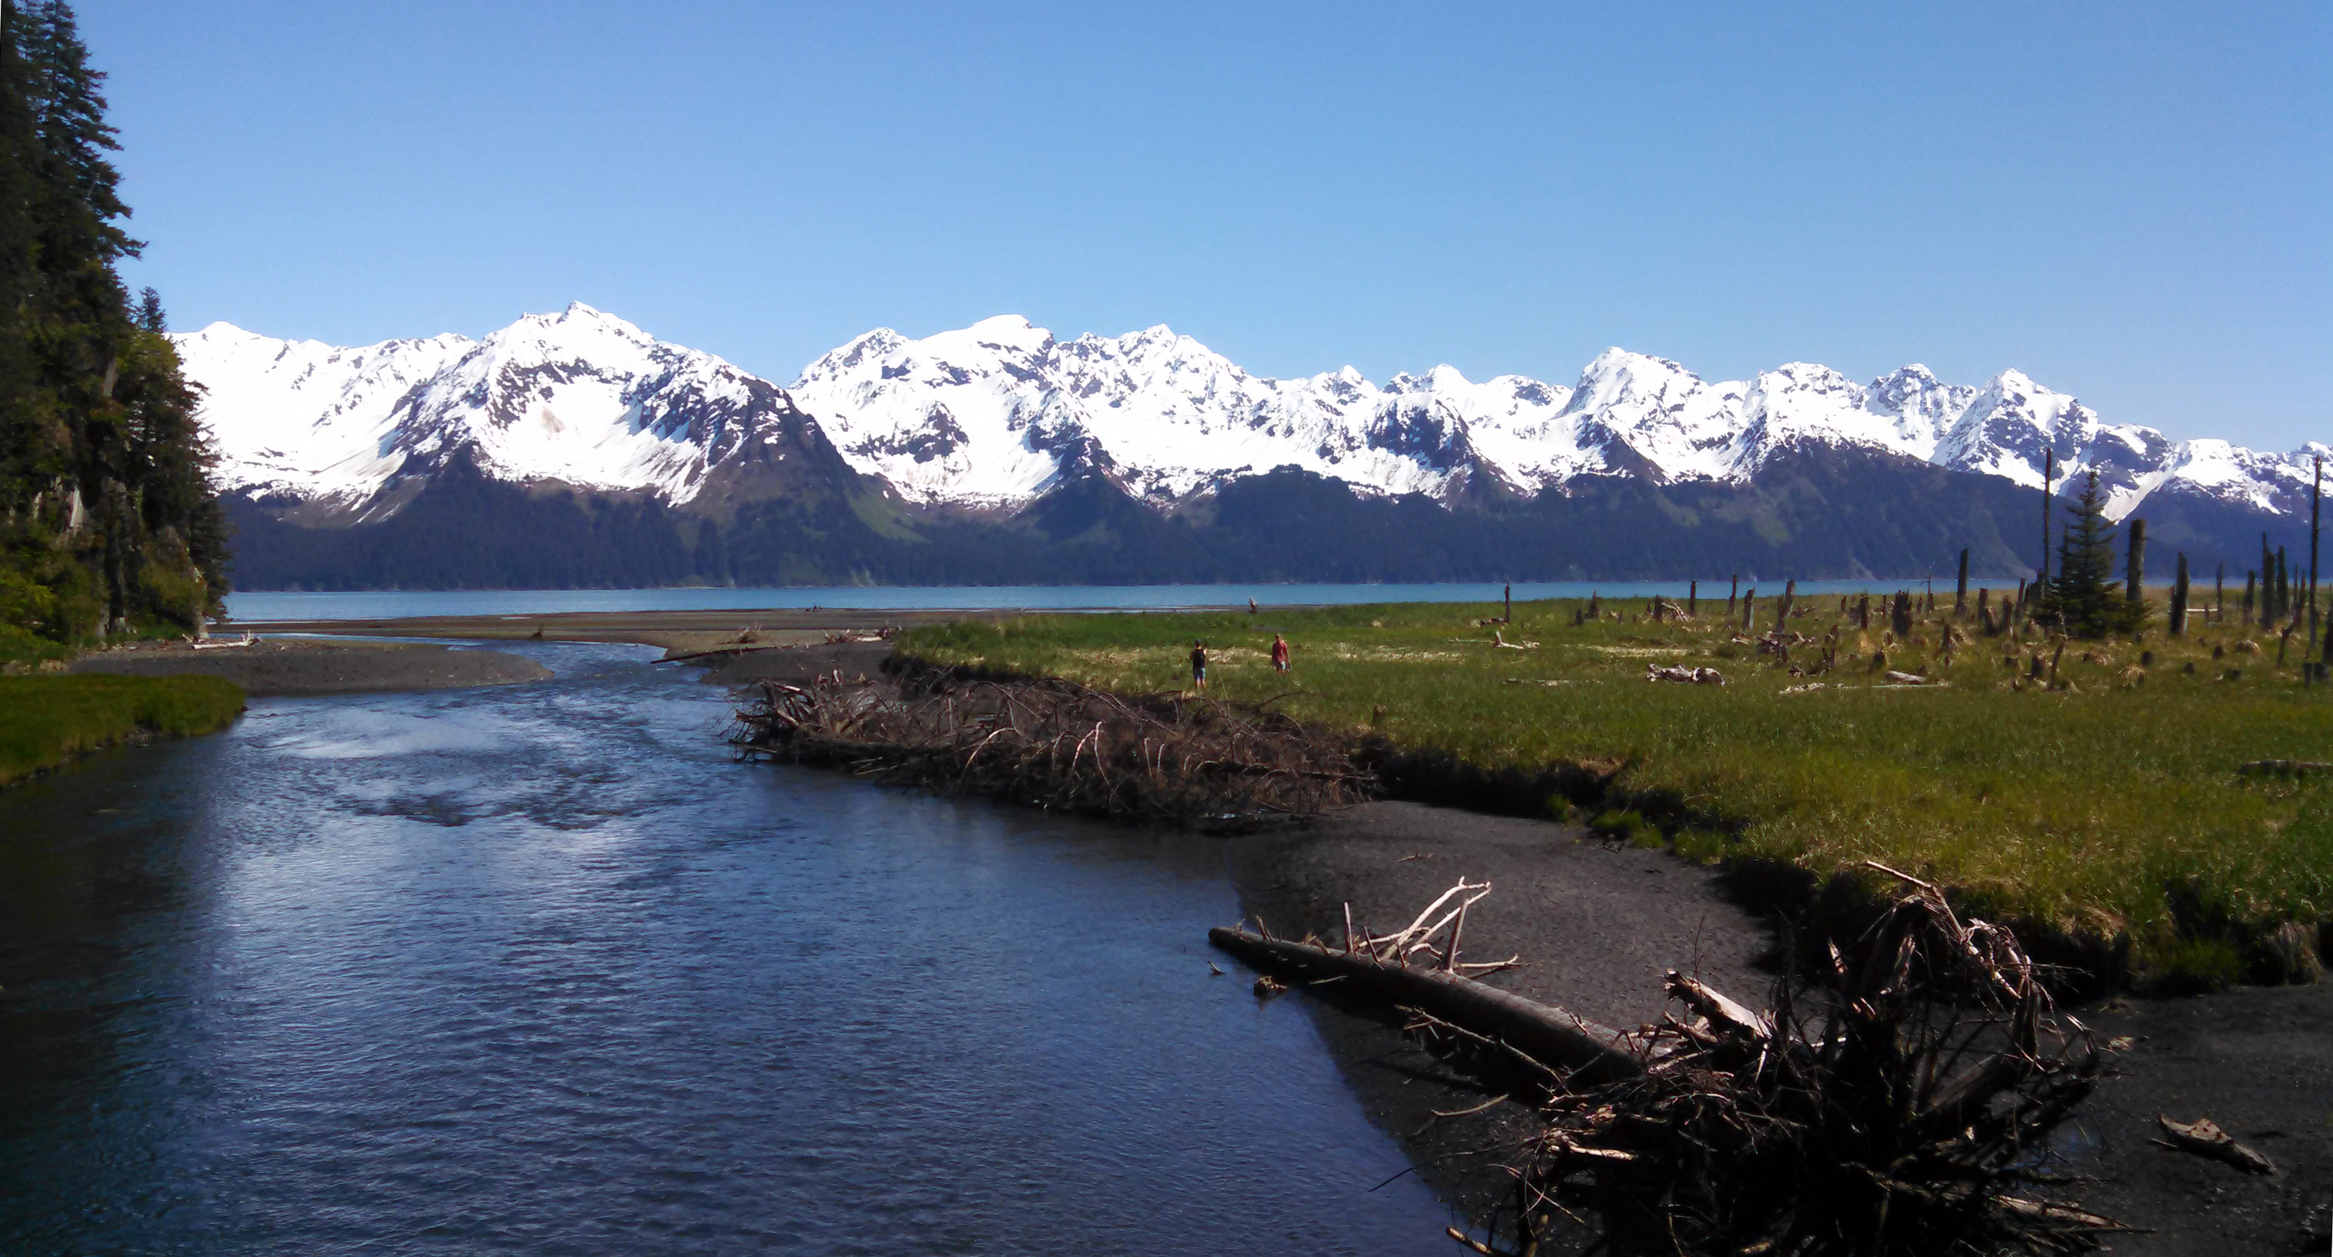
Modeling Methods
Species distribution modeling (SDM)
Accounts for poorly distributed observations
Inputs: observations and environmental variables
Outputs: predicted habitat suitability
Guisan and Zimmerman 2000, Ecological Modelling
Notes:
Identify key variables
Quantify importance of different variables (coefficients)
Extrapolate based on those relationships

Slide 11
Modeling Methods
Maximum entropy
Environmental variables
  Land cover, elevation, canopy coverage, bedrock, surface geology, wetland density, aspect, mean temperature, temperature seasonality, mean annual precipitation, distance to nearest river, distance to coastline
Separate model for each bird species
Iterative regression to select most relevant variables
Phillips et al. 2006, Ecological Modelling
Liu et al. 2013, Journal of Biogeography
Notes:
12 variables
179 species
Only selected variable with >5% contribution to overall model
(358 models)

Slide 12
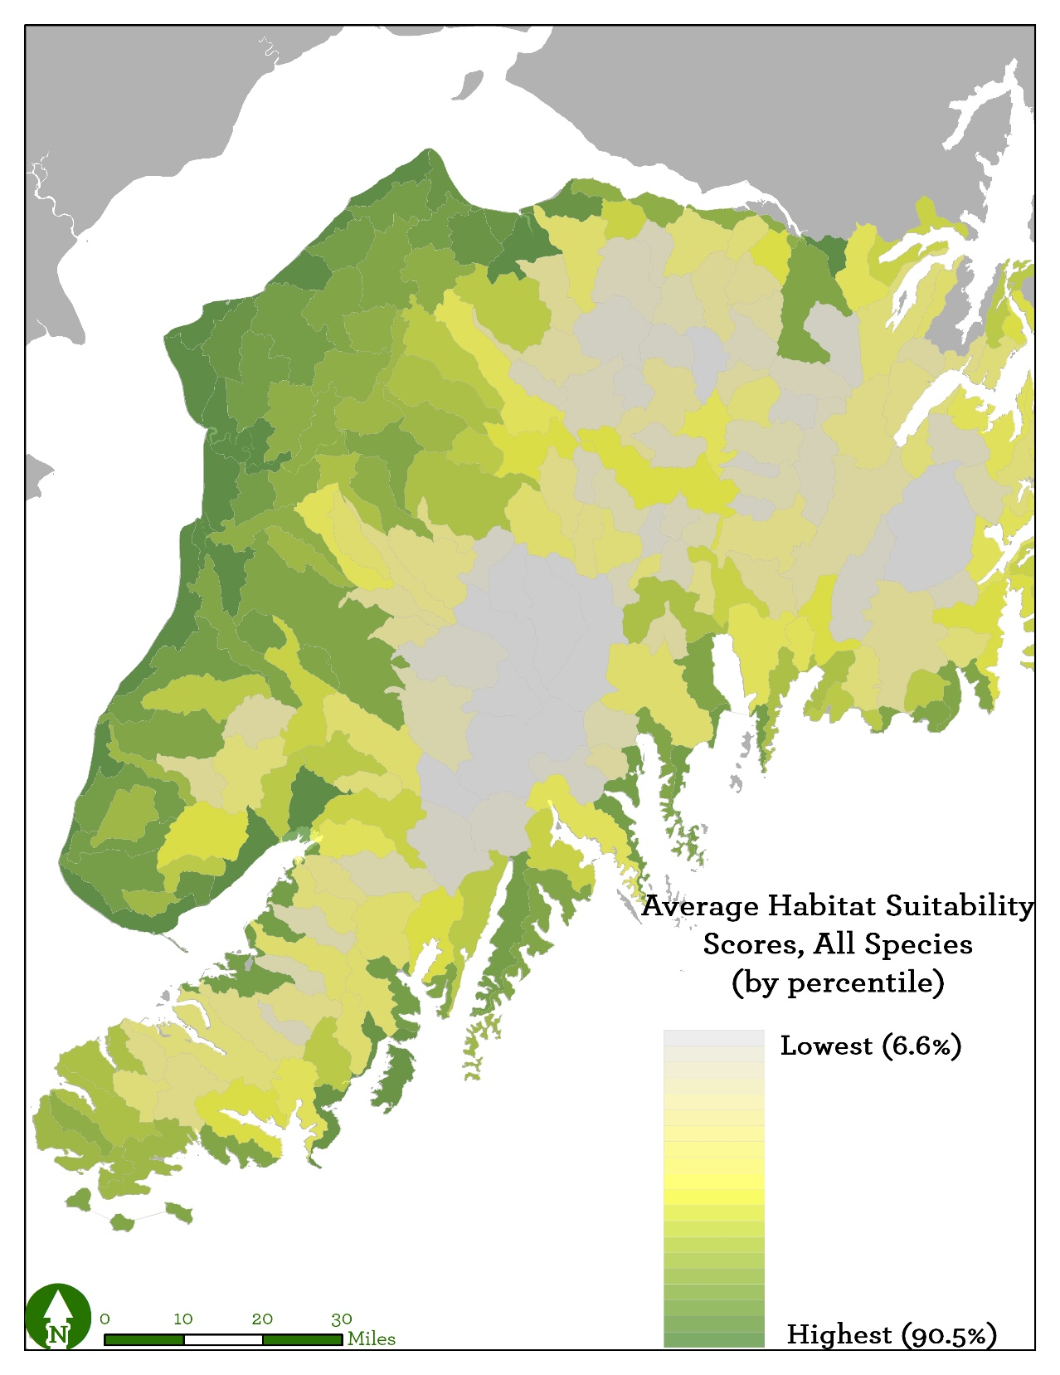
Suitability
Aggregated for all 179 species
Adjusted into percentiles to rank watersheds
Notes:
Ice fields = no birds
Coasts hold up, particularly fjords and west coast

Slide 13
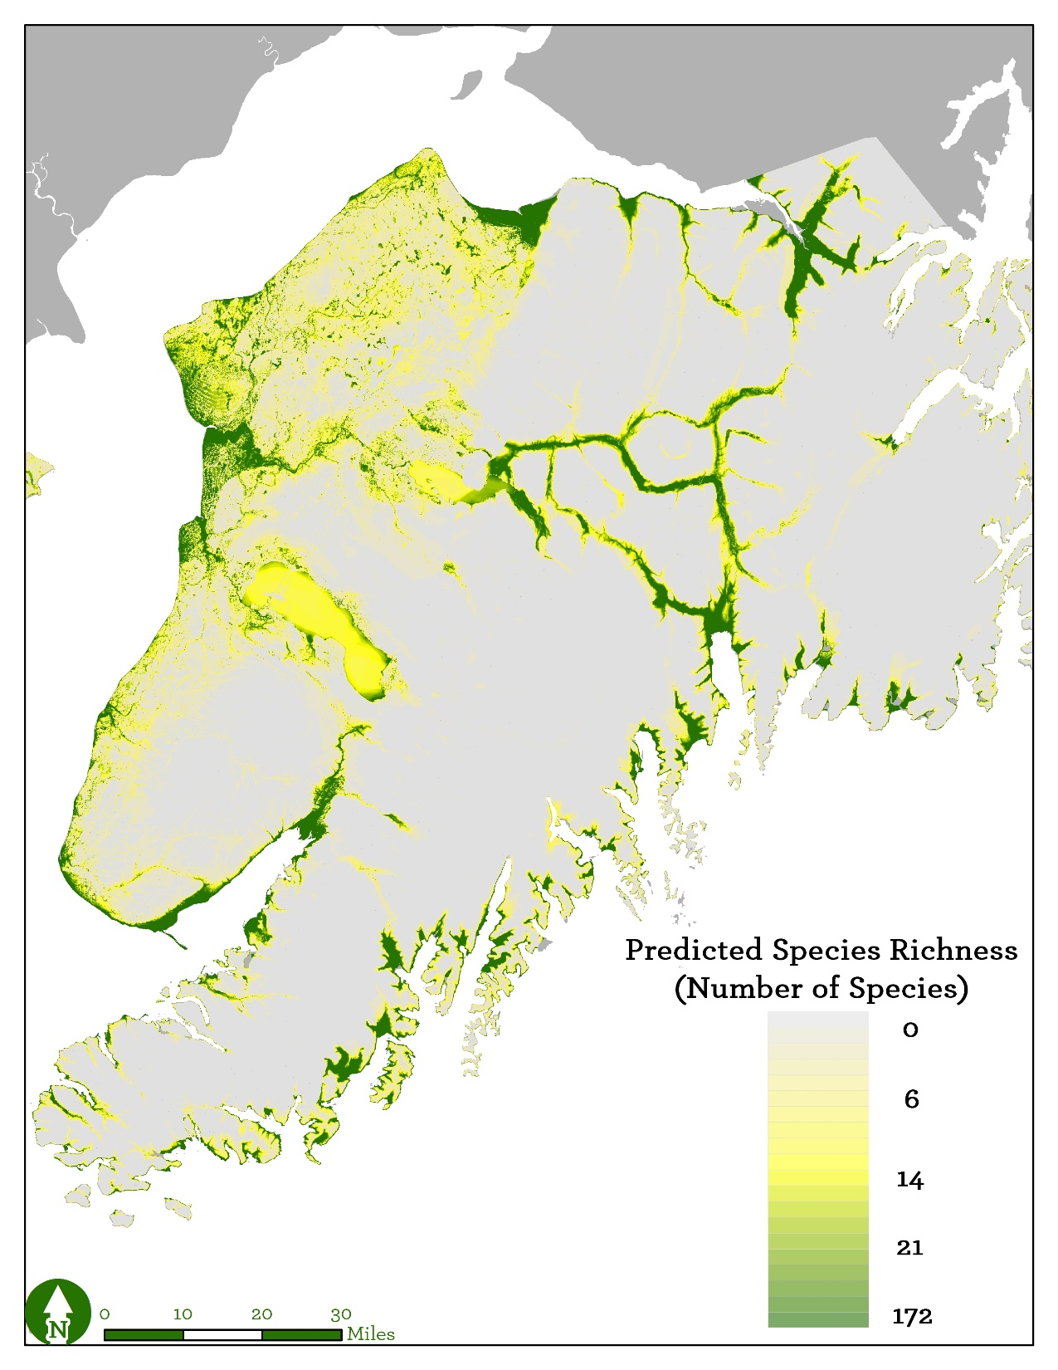
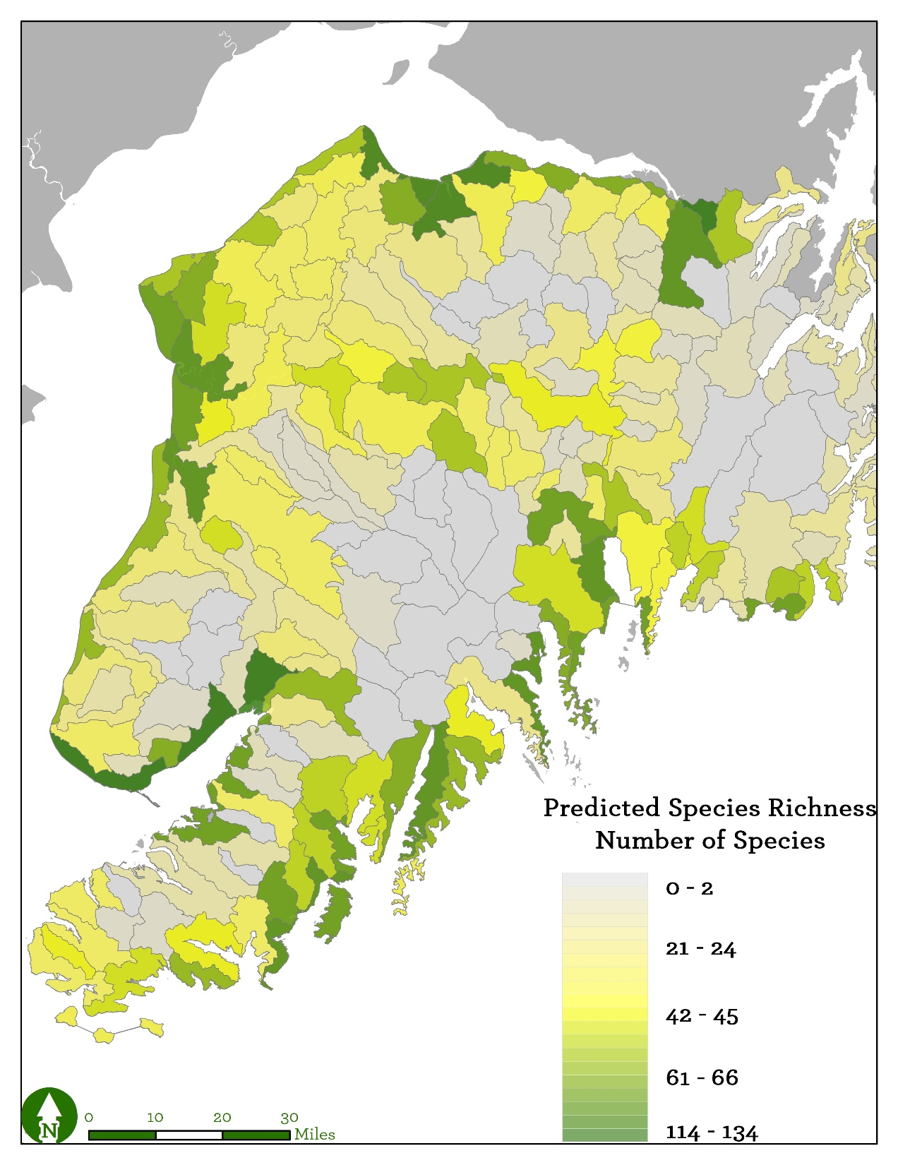
Predicted Occurrence
Notes:
Used the average value of confirmed occurrences as the threshold for presence
Any watershed with >1% area as predicted presence, classified as species present
Aggregated all species
Four watersheds hold >100 species of birds: Chickaloon Bay Frontage, Lower Fox River, Portage Creek, and North Kachemak Bay Frontage

Slide 14
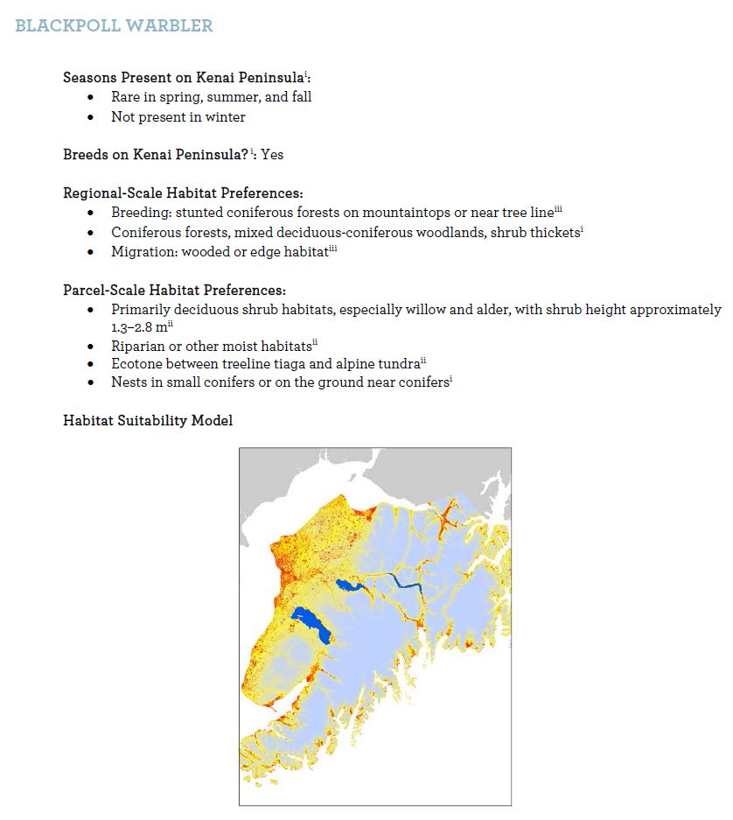
WatchList Habitat Associations
Seasonality
Regional- and parcel-scale
Based on best available science
Includes suitability map
Notes:
Site-scale
Breeding

Slide 15
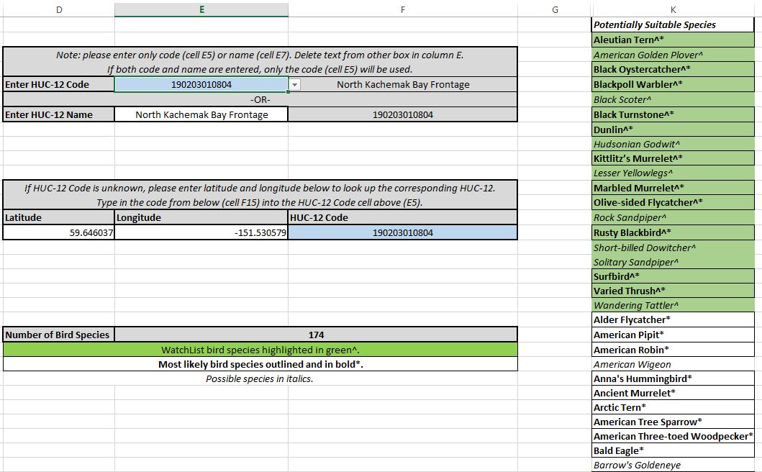
Watershed Checklist

Slide 16
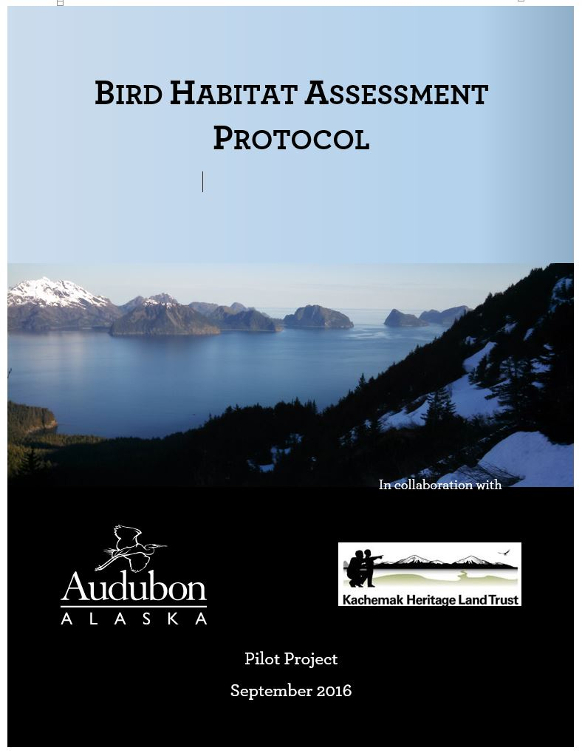
Kenai Aggregate
Suitability
Regional
1:10⁶
Kenai Species
Richness
Watershed
1:10⁵
Watershed
Checklist
Parcel
WatchList Habitat
Associations
1:10⁴

Slide 17
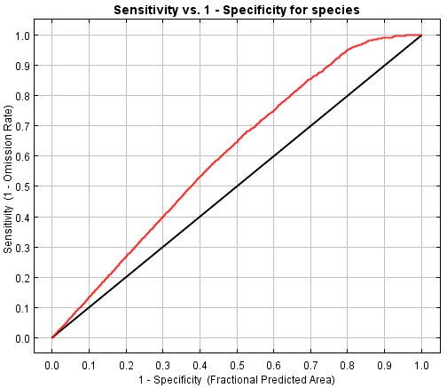
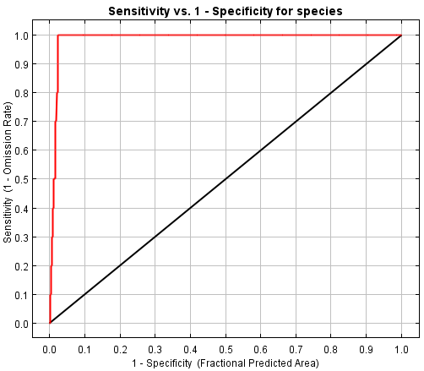
Limitations
Ecological
  Habitat use: nesting vs. stopover
  Seasonality
Statistical
  Accuracy assessment: cross-validation
  Environmental variables: correlation, resolution
Coastal over-prediction
Notes:
Didn’t check for correlated variables – e.g. ice fields at high elevations
Variables themselves were not evenly distributed – e.g. lots more forested rivers and lakes on west coast, east coast mostly ice fields
Due to time constraints, used the same training data to check for accuracy, rather than using k-fold cross validation
Need for finer-scale variables – lots of the environmental variables were resampled to finer resolution; it’d be better to have them at the scale of analysis
Coast showed up all over the place

Slide 18
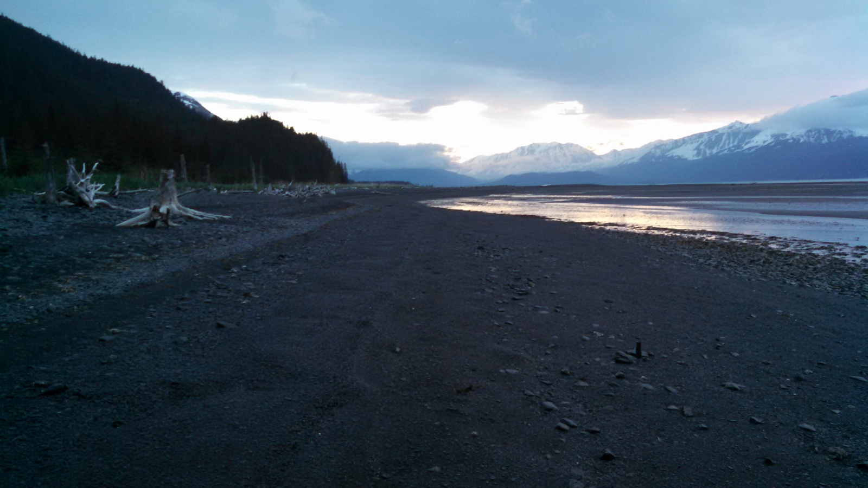
Take-aways and Next Steps
Dynamic, scale-able tool bridging scale gap
Easy-to-use
Translating between technical scientific world into ground-level conservation
Case study for more NGOs
Modeling code is open source

Slide 19

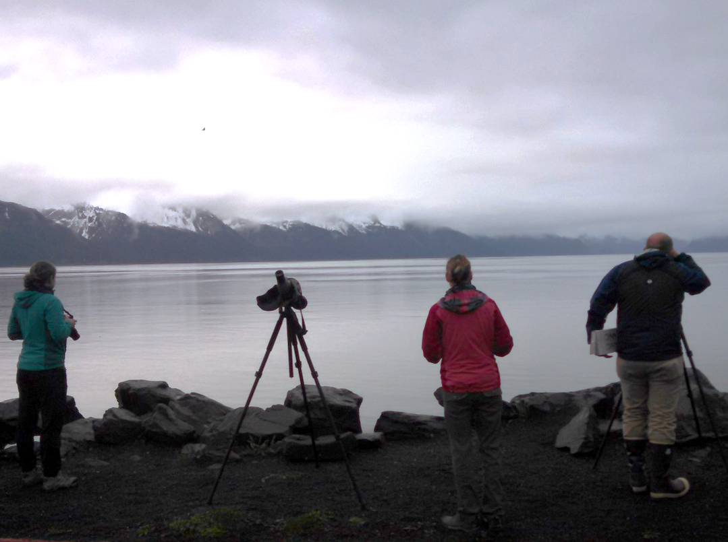
Thank you!

