Slide 1

Using Spatial Climate Change Data to Assess Vulnerability across Alaska
Melanie A. Smith & Nathan J. Walker

Slide 2
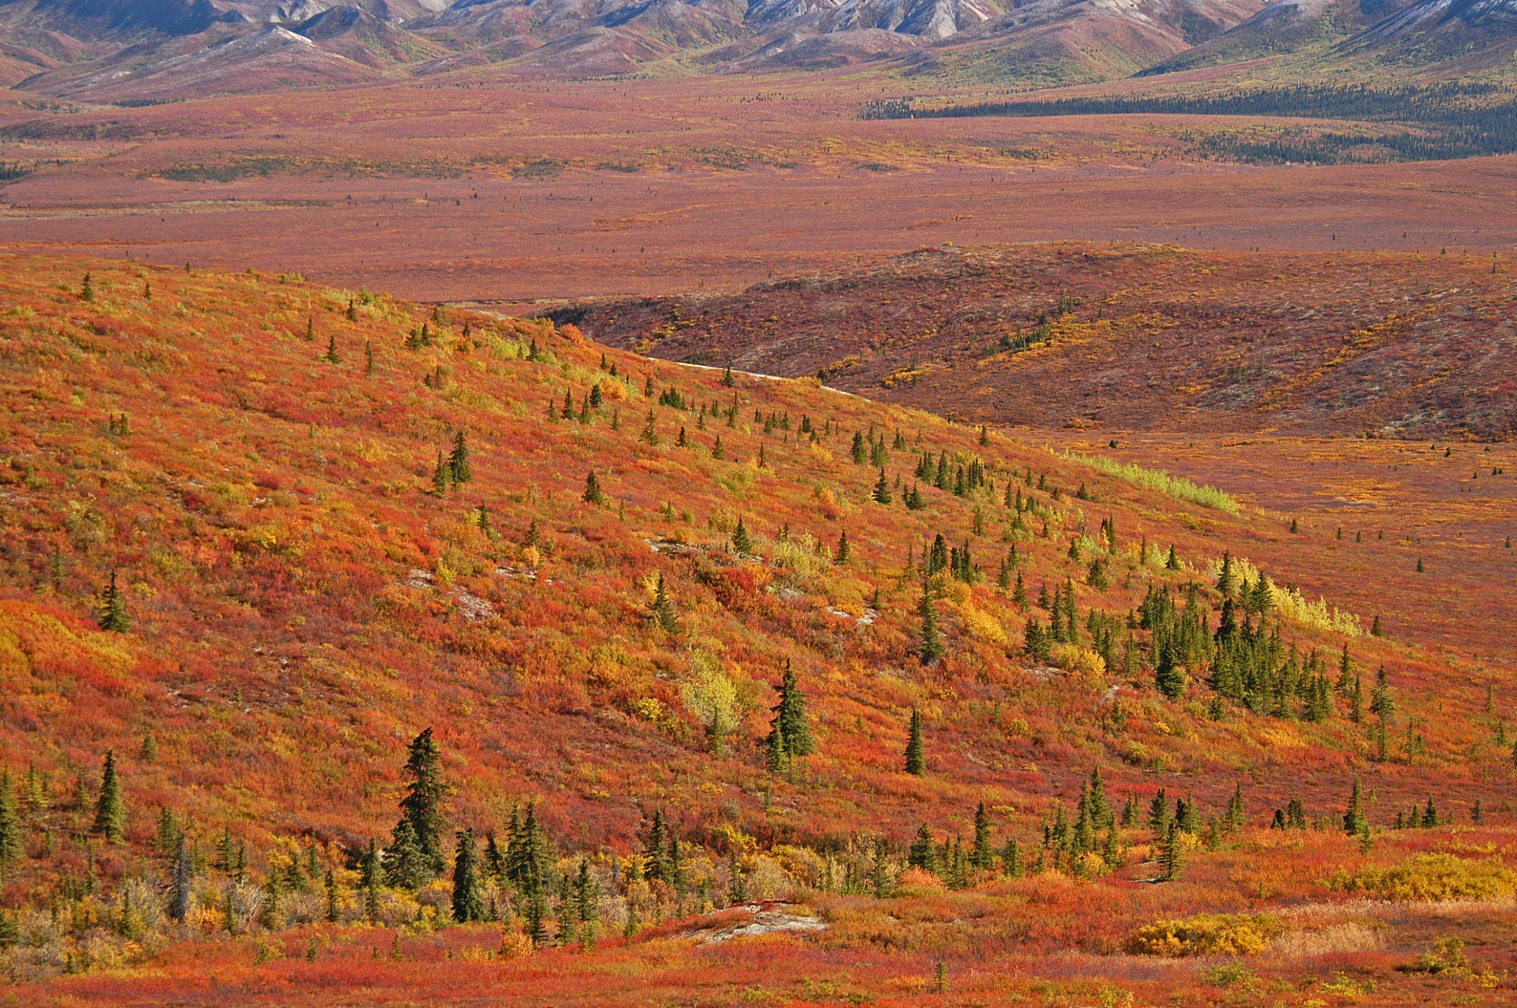
Introduction
Image: John Schoen
Notes:
SNAP downscales global model outputs to the local level, scaling from 2.5 degree GCMs (Global Climate Models) for precipitation to a 2 kilometer downscaled GCM precipitation model. SNAP selects 5 GCMs that perform best in Alaska and the Arctic, and then downscales these datasets using PRISM data to account for local land features.
GIPL1 model simulates permafrost dynamics and the depth of maximum depth of summer [warm period of time] seasonal thaw in perennially frozen ground and depth of seasonal frost penetration in permafrost free areas). The official definition of the active layer thickness (ALT) is: "the layer of ground that is subject to annual thawing and freezing in areas underlain by permafrost". It means permafrost are beneath the active layer. But GIPL1 model does not provide us with information what we have beneath the active layer (no temperature profile), because it is equilibrium model. If we have negative value of ALT it is means we have seasonally frozen layer during the winter time. The negative and positive values I used only for the mapping purposes to distinguish seasonal frost and active layer (seasonally thawed layer).
Parameter-elevation Regressions on Independent Slopes Model: Moving--window regression of climate/weather values vs. elevation or climatology for each grid cell; Uses nearby station observations

Slide 3
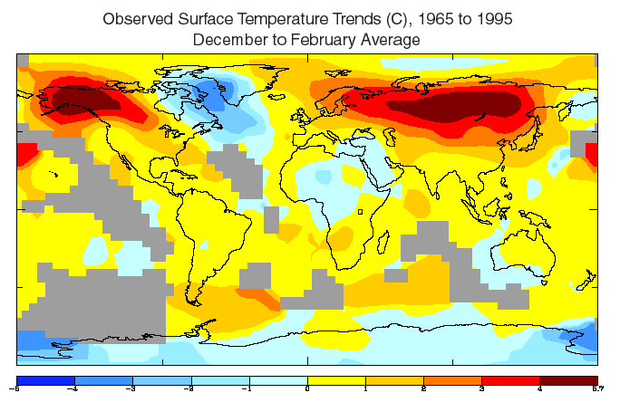
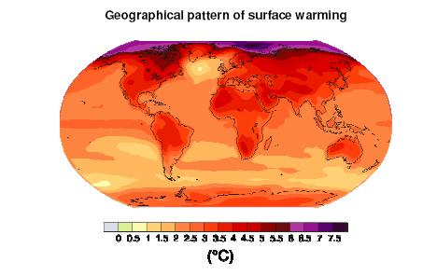
Introduction
Globally, climate change is not equally distributed
Observed and predicted changes in AK are extreme
Change varies across the state
Observed
Projected
http://www.giss.nasa.gov/staff/dshindell/surfT.gif
http://web.mit.edu/12.000/www/m2011/finalwebsite/graphics/BAU/img4.png
Notes:
SNAP downscales global model outputs to the local level, scaling from 2.5 degree GCMs (Global Climate Models) for precipitation to a 2 kilometer downscaled GCM precipitation model. SNAP selects 5 GCMs that perform best in Alaska and the Arctic, and then downscales these datasets using PRISM data to account for local land features.
GIPL1 model simulates permafrost dynamics and the depth of maximum depth of summer [warm period of time] seasonal thaw in perennially frozen ground and depth of seasonal frost penetration in permafrost free areas). The official definition of the active layer thickness (ALT) is: "the layer of ground that is subject to annual thawing and freezing in areas underlain by permafrost". It means permafrost are beneath the active layer. But GIPL1 model does not provide us with information what we have beneath the active layer (no temperature profile), because it is equilibrium model. If we have negative value of ALT it is means we have seasonally frozen layer during the winter time. The negative and positive values I used only for the mapping purposes to distinguish seasonal frost and active layer (seasonally thawed layer).
Parameter-elevation Regressions on Independent Slopes Model: Moving--window regression of climate/weather values vs. elevation or climatology for each grid cell; Uses nearby station observations

Slide 4
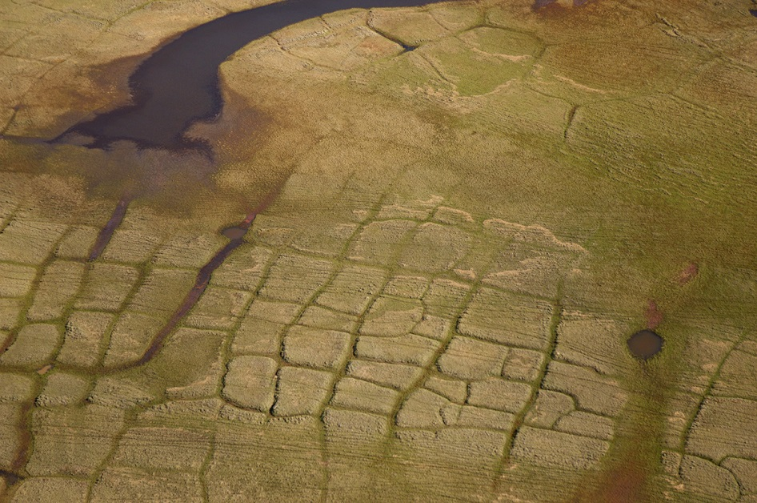

Introduction
Goals
  Better understand the spatial patterns of climate change
  Identify places that are most vulnerable to change
  And inform future wildlife habitat conservation efforts
Image: Gerrit Vyn
Image: Milo Burcham
Notes:
SNAP downscales global model outputs to the local level, scaling from 2.5 degree GCMs (Global Climate Models) for precipitation to a 2 kilometer downscaled GCM precipitation model. SNAP selects 5 GCMs that perform best in Alaska and the Arctic, and then downscales these datasets using PRISM data to account for local land features.
GIPL1 model simulates permafrost dynamics and the depth of maximum depth of summer [warm period of time] seasonal thaw in perennially frozen ground and depth of seasonal frost penetration in permafrost free areas). The official definition of the active layer thickness (ALT) is: "the layer of ground that is subject to annual thawing and freezing in areas underlain by permafrost". It means permafrost are beneath the active layer. But GIPL1 model does not provide us with information what we have beneath the active layer (no temperature profile), because it is equilibrium model. If we have negative value of ALT it is means we have seasonally frozen layer during the winter time. The negative and positive values I used only for the mapping purposes to distinguish seasonal frost and active layer (seasonally thawed layer).
Parameter-elevation Regressions on Independent Slopes Model: Moving--window regression of climate/weather values vs. elevation or climatology for each grid cell; Uses nearby station observations

Slide 5
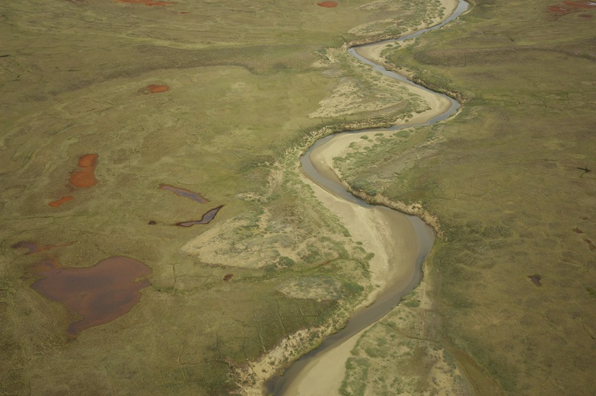
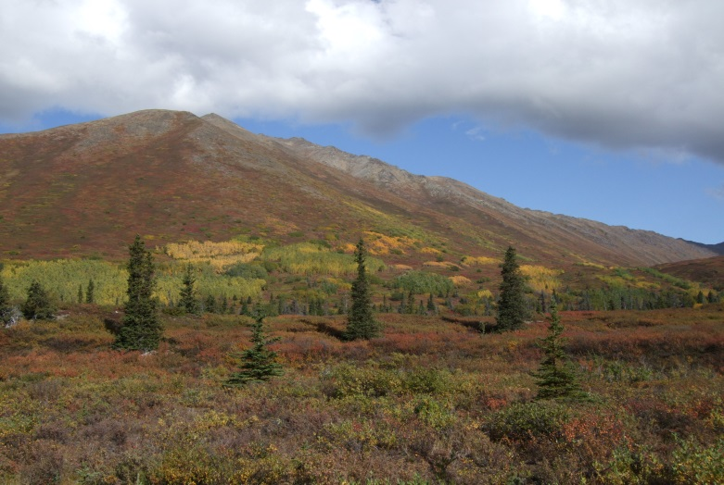
Introduction
Objectives
  Use readily available layers to assess statewide change
  Compare multiple kinds of physical changes on an equal scale
  Summarize relative vulnerability across the state
Image: Gerrit Vyn
Image: Melanie Smith
Notes:
SNAP downscales global model outputs to the local level, scaling from 2.5 degree GCMs (Global Climate Models) for precipitation to a 2 kilometer downscaled GCM precipitation model. SNAP selects 5 GCMs that perform best in Alaska and the Arctic, and then downscales these datasets using PRISM data to account for local land features.
GIPL1 model simulates permafrost dynamics and the depth of maximum depth of summer [warm period of time] seasonal thaw in perennially frozen ground and depth of seasonal frost penetration in permafrost free areas). The official definition of the active layer thickness (ALT) is: "the layer of ground that is subject to annual thawing and freezing in areas underlain by permafrost". It means permafrost are beneath the active layer. But GIPL1 model does not provide us with information what we have beneath the active layer (no temperature profile), because it is equilibrium model. If we have negative value of ALT it is means we have seasonally frozen layer during the winter time. The negative and positive values I used only for the mapping purposes to distinguish seasonal frost and active layer (seasonally thawed layer).
Parameter-elevation Regressions on Independent Slopes Model: Moving--window regression of climate/weather values vs. elevation or climatology for each grid cell; Uses nearby station observations

Slide 6
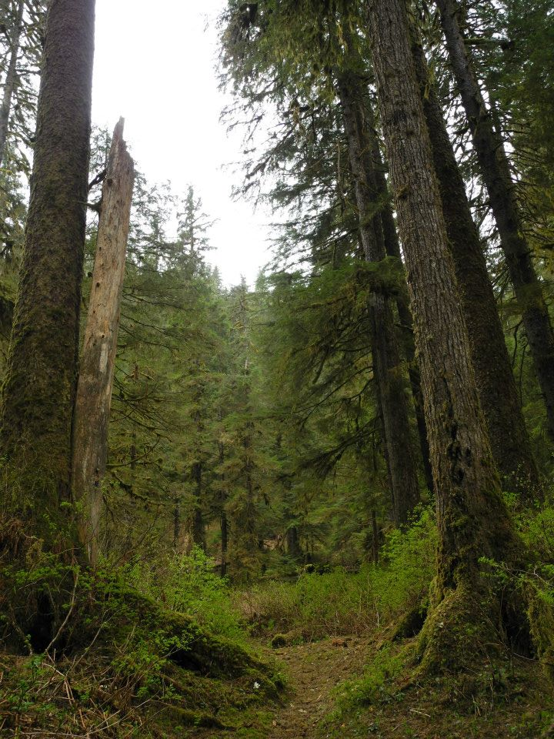
Alaska’s Spatial Climate Change Data
UAF Scenarios Network for Alaska & Arctic Planning (SNAP)
  Precipitation (pr)
  Temperature at surface (tas)
  Fraction of precip falling as snow (fs)
  Active layer thickness (alt)
  Length of growing season (logs)
Composite models, A1B
Image: Melanie Smith
Notes:
SNAP downscales global model outputs to the local level, scaling from 2.5 degree GCMs (Global Climate Models) for precipitation to a 2 kilometer downscaled GCM precipitation model. SNAP selects 5 GCMs that perform best in Alaska and the Arctic, and then downscales these datasets using PRISM data to account for local land features.
GIPL1 model simulates permafrost dynamics and the depth of maximum depth of summer [warm period of time] seasonal thaw in perennially frozen ground and depth of seasonal frost penetration in permafrost free areas). The official definition of the active layer thickness (ALT) is: "the layer of ground that is subject to annual thawing and freezing in areas underlain by permafrost". It means permafrost are beneath the active layer. But GIPL1 model does not provide us with information what we have beneath the active layer (no temperature profile), because it is equilibrium model. If we have negative value of ALT it is means we have seasonally frozen layer during the winter time. The negative and positive values I used only for the mapping purposes to distinguish seasonal frost and active layer (seasonally thawed layer).
Parameter-elevation Regressions on Independent Slopes Model: Moving--window regression of climate/weather values vs. elevation or climatology for each grid cell; Uses nearby station observations

Slide 7
Methods
Image: Nick Jans
Notes:
SNAP downscales global model outputs to the local level, scaling from 2.5 degree GCMs (Global Climate Models) for precipitation to a 2 kilometer downscaled GCM precipitation model. SNAP selects 5 GCMs that perform best in Alaska and the Arctic, and then downscales these datasets using PRISM data to account for local land features.
GIPL1 model simulates permafrost dynamics and the depth of maximum depth of summer [warm period of time] seasonal thaw in perennially frozen ground and depth of seasonal frost penetration in permafrost free areas). The official definition of the active layer thickness (ALT) is: "the layer of ground that is subject to annual thawing and freezing in areas underlain by permafrost". It means permafrost are beneath the active layer. But GIPL1 model does not provide us with information what we have beneath the active layer (no temperature profile), because it is equilibrium model. If we have negative value of ALT it is means we have seasonally frozen layer during the winter time. The negative and positive values I used only for the mapping purposes to distinguish seasonal frost and active layer (seasonally thawed layer).
Parameter-elevation Regressions on Independent Slopes Model: Moving--window regression of climate/weather values vs. elevation or climatology for each grid cell; Uses nearby station observations

Slide 8
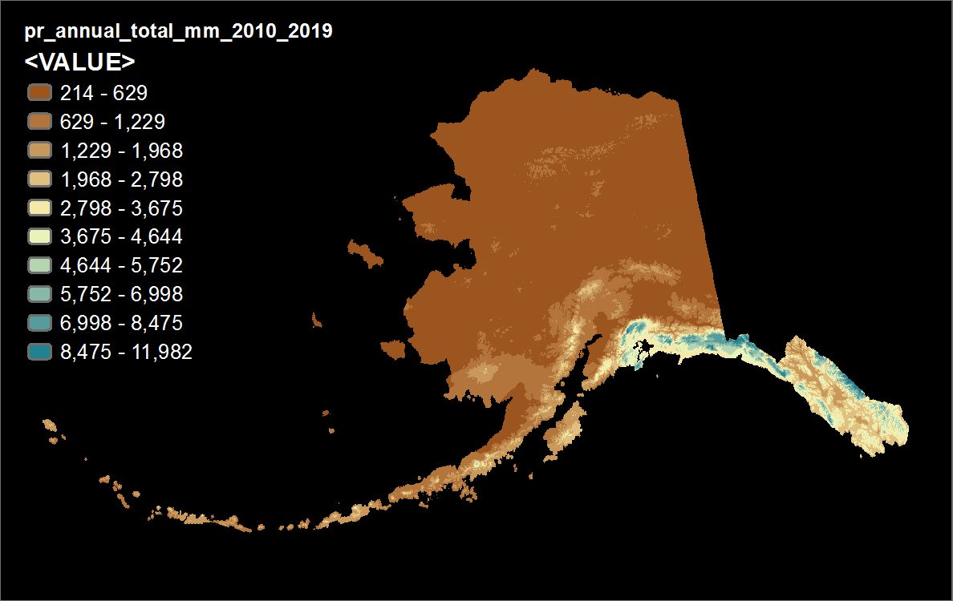
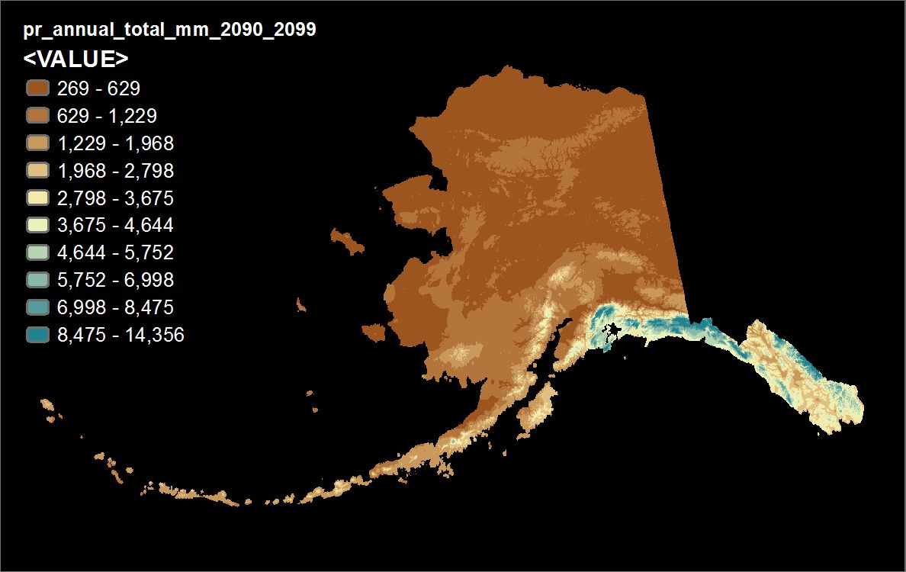
Methods
Collected data for each variable for current and future decades
Historical baseline data varied in timing, resolution, accessibility
Used the current time period 2010-2019 as the baseline
Precipitation 2010-2019
Precipitation 2090-2099

Slide 9
Methods
We explored different methods for comparing data from Time 1 to Time 2
Complications:
  Absolute difference
  Different measures
  Different scales
  Percent difference
Wanted to ID areas of significant change from normal
Precipitation 2010-2019
Precipitation 2090-2099

Slide 10
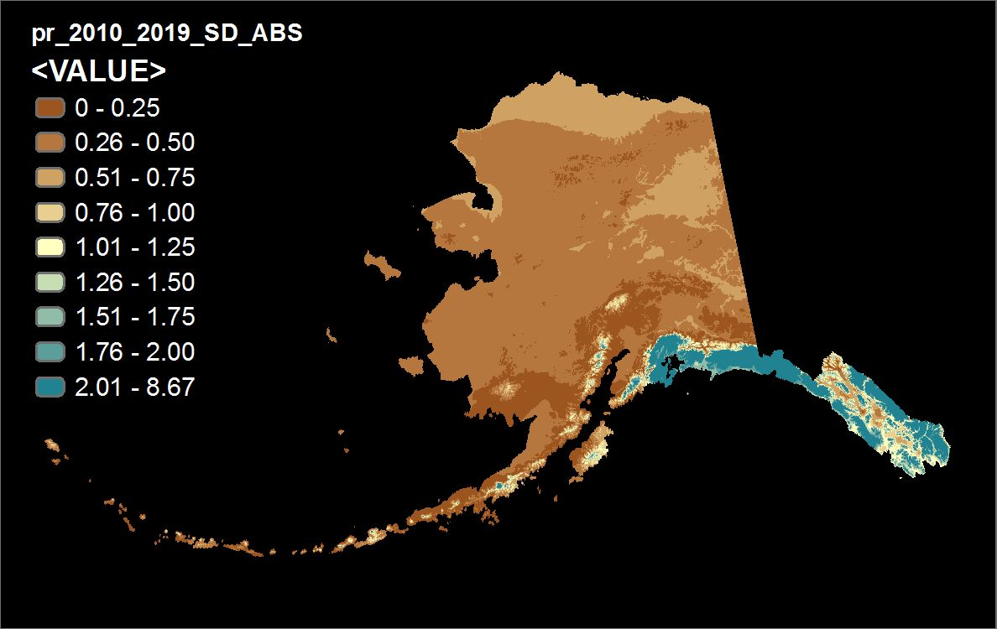
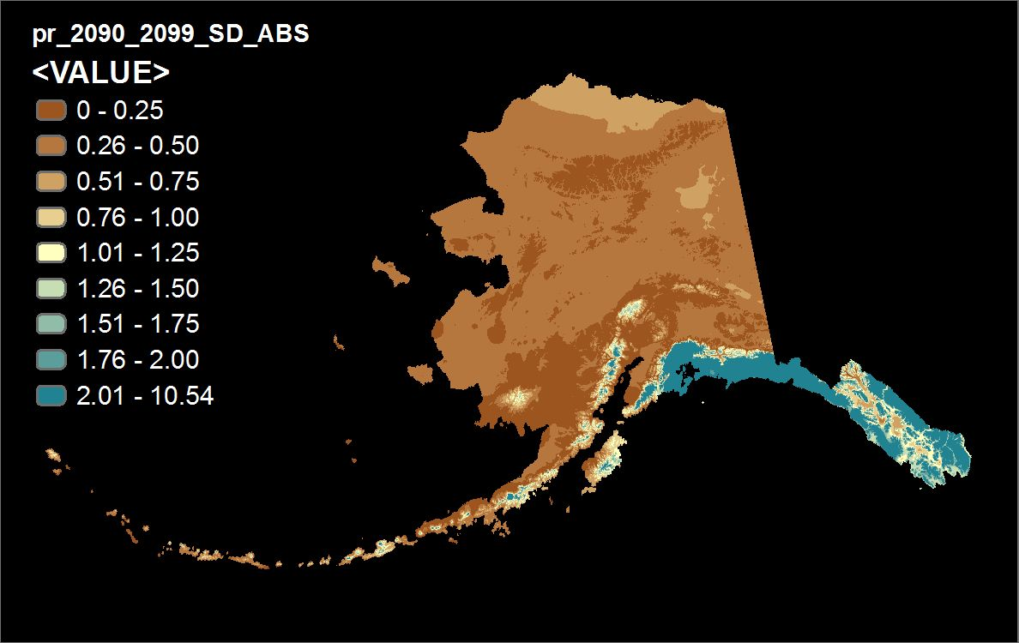
Methods
Mapped baseline conditions (Time 1), as SD from the statewide mean
µ = 966, 𝜎 = 1271
(value_{T1} - µ_{T1})/ 𝜎_{T1} = normal value
Mapped future conditions (Time 2) as SD from the baseline mean/SD
(value_{T2} - µ_{T1})/ 𝜎_{T1} - (value_{T1} - µ_{T1})/ 𝜎_{T1} = change value
Precipitation 𝜎_{T1 (2010-2019)}
Precipitation 𝜎_{T2 (2090-2099)}

Slide 11
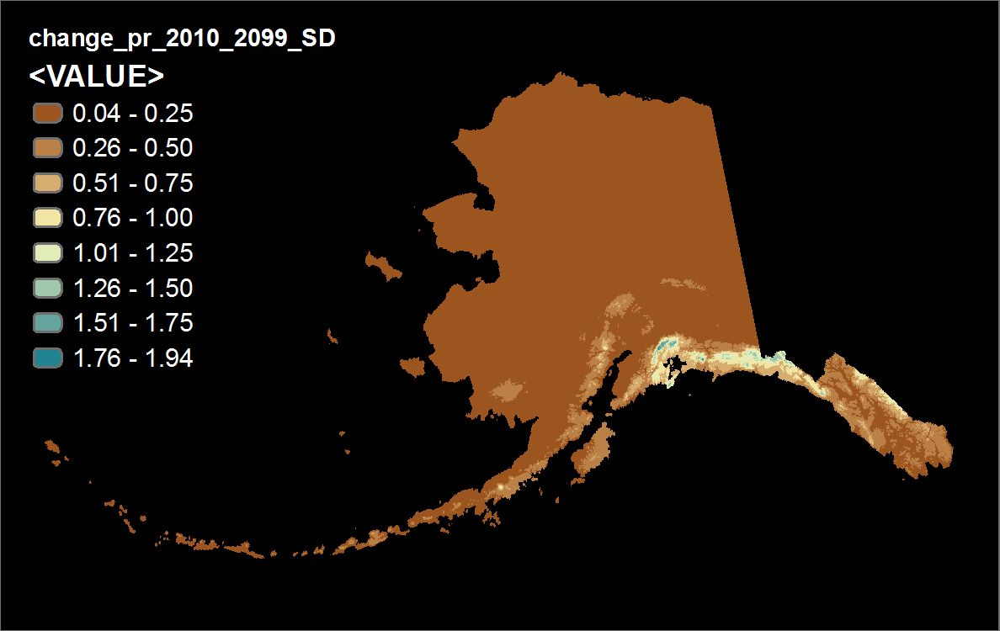

Methods
Simple math: Time 2 – Time 1
Yields the change from the normal deviation from the statewide mean
Deviations can be positive or negative
Absolute value of the change in standard deviation from Time 1 to Time 2
| (value_{T2} - µ_{T1})/ 𝜎_{T1} - (value_{T1} - µ_{T1})/ 𝜎_{T1} |
P$recipitation$

Slide 12
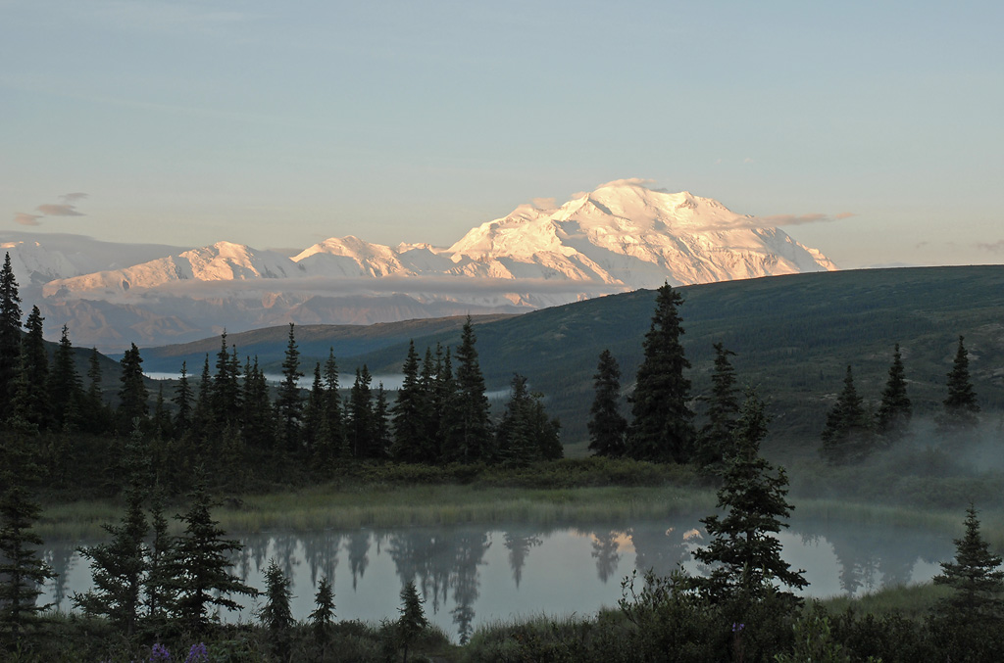
Results
Image: John Schoen
Notes:
SNAP downscales global model outputs to the local level, scaling from 2.5 degree GCMs (Global Climate Models) for precipitation to a 2 kilometer downscaled GCM precipitation model. SNAP selects 5 GCMs that perform best in Alaska and the Arctic, and then downscales these datasets using PRISM data to account for local land features.
GIPL1 model simulates permafrost dynamics and the depth of maximum depth of summer [warm period of time] seasonal thaw in perennially frozen ground and depth of seasonal frost penetration in permafrost free areas). The official definition of the active layer thickness (ALT) is: "the layer of ground that is subject to annual thawing and freezing in areas underlain by permafrost". It means permafrost are beneath the active layer. But GIPL1 model does not provide us with information what we have beneath the active layer (no temperature profile), because it is equilibrium model. If we have negative value of ALT it is means we have seasonally frozen layer during the winter time. The negative and positive values I used only for the mapping purposes to distinguish seasonal frost and active layer (seasonally thawed layer).
Parameter-elevation Regressions on Independent Slopes Model: Moving--window regression of climate/weather values vs. elevation or climatology for each grid cell; Uses nearby station observations

Slide 13

∆ Precipitation
P$recipitation$

Slide 14
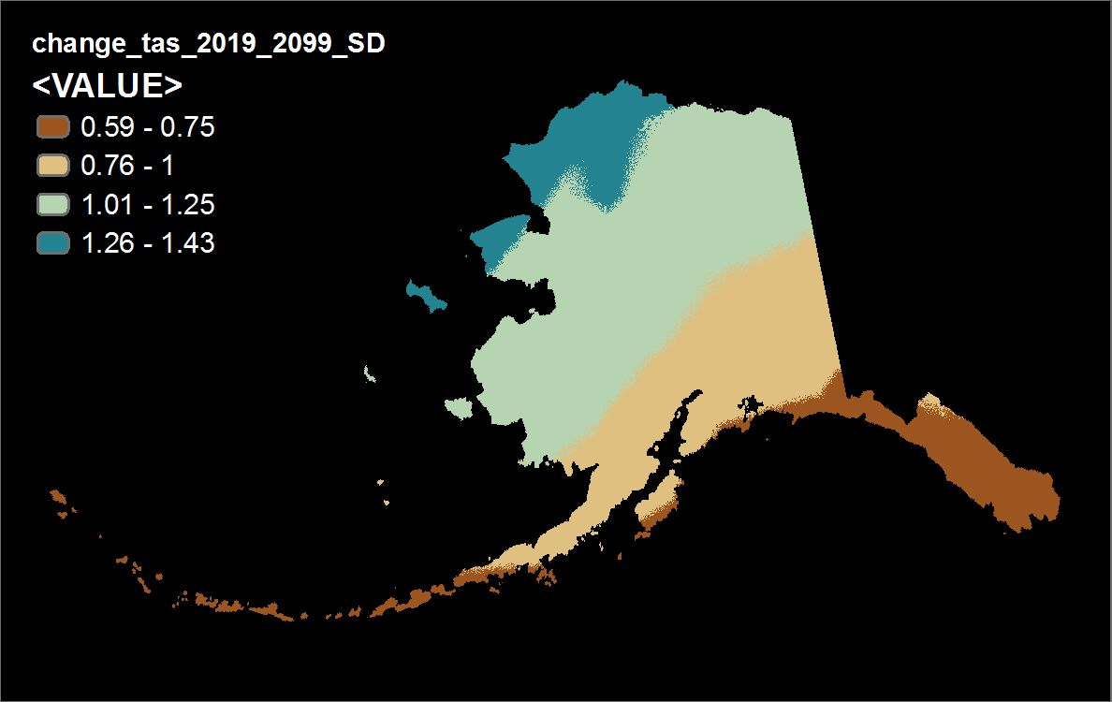
∆ Temperature
Temperature at surface

Slide 15

∆ Snow Fraction
Fraction precip falling as snow

Slide 16
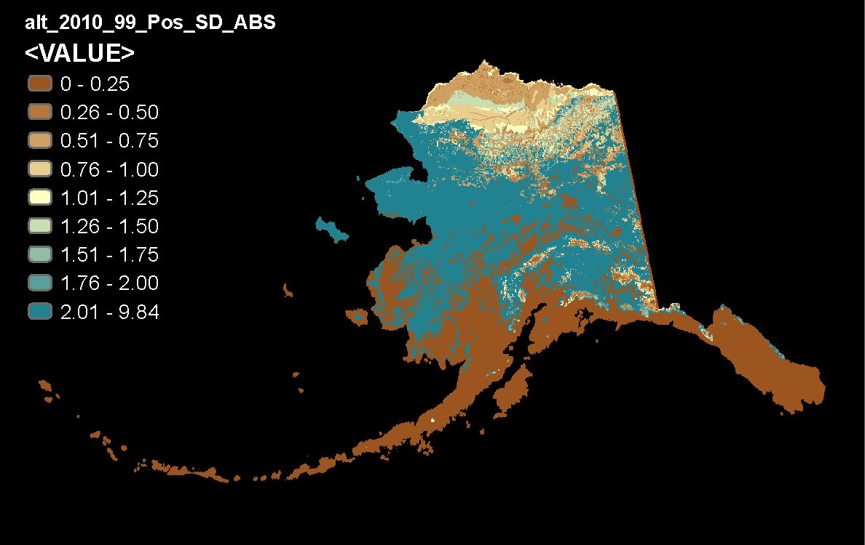
∆ Active Layer
Active layer thickness

Slide 17

∆ Growing Season
Length of growing season

Slide 18
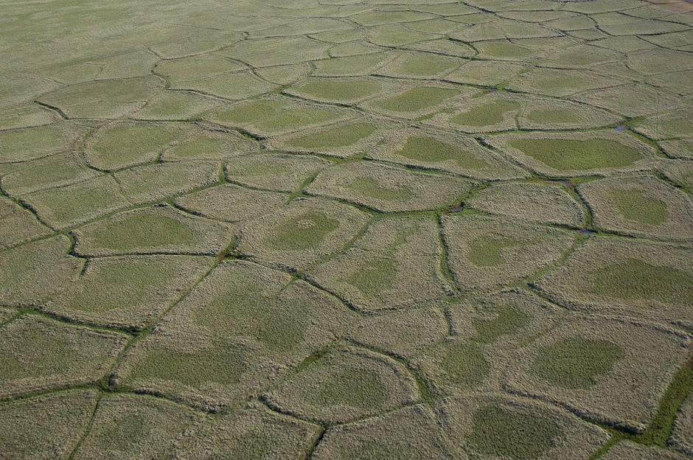
What Does This Tell Us?
How do we make use of this information?
  Choose summary boundaries
    Ranking
    Thresholds
    Weighting?
  Prioritization
  Identifying areas with multiple kinds of significant change
Image: Milo Burcham

Slide 19

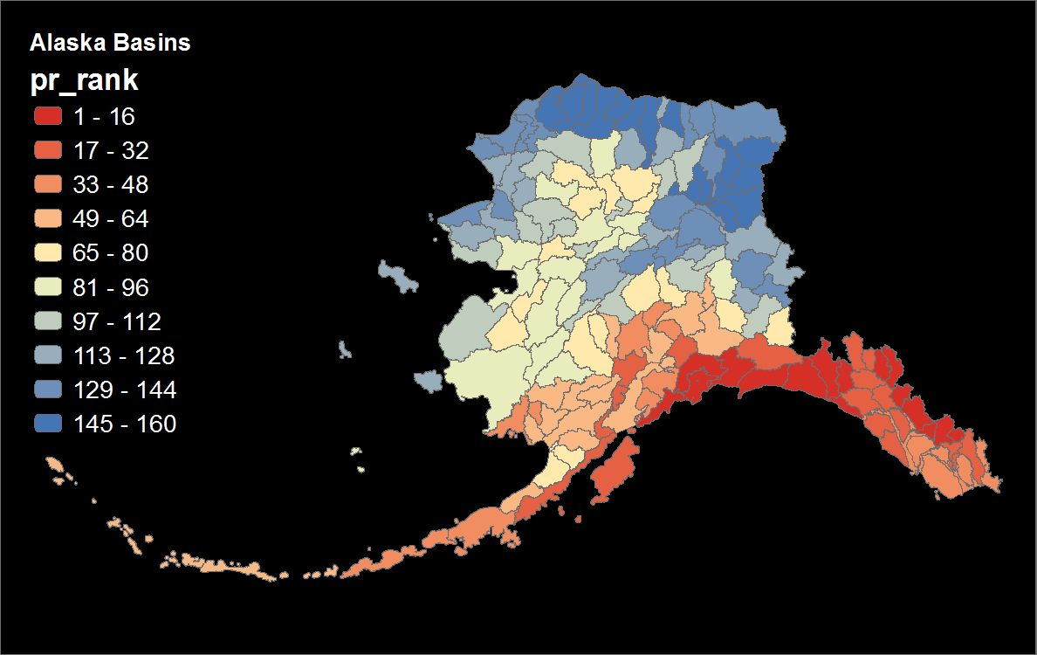
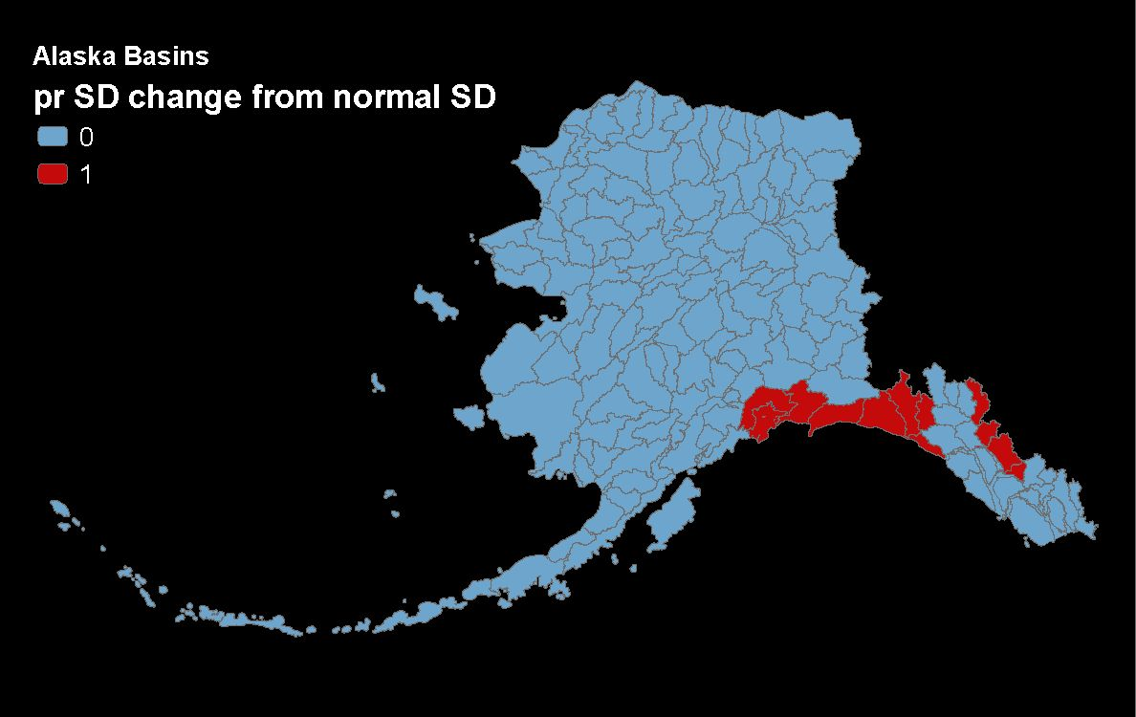
Ranking
∆ Precipitation
Threshold

Slide 20

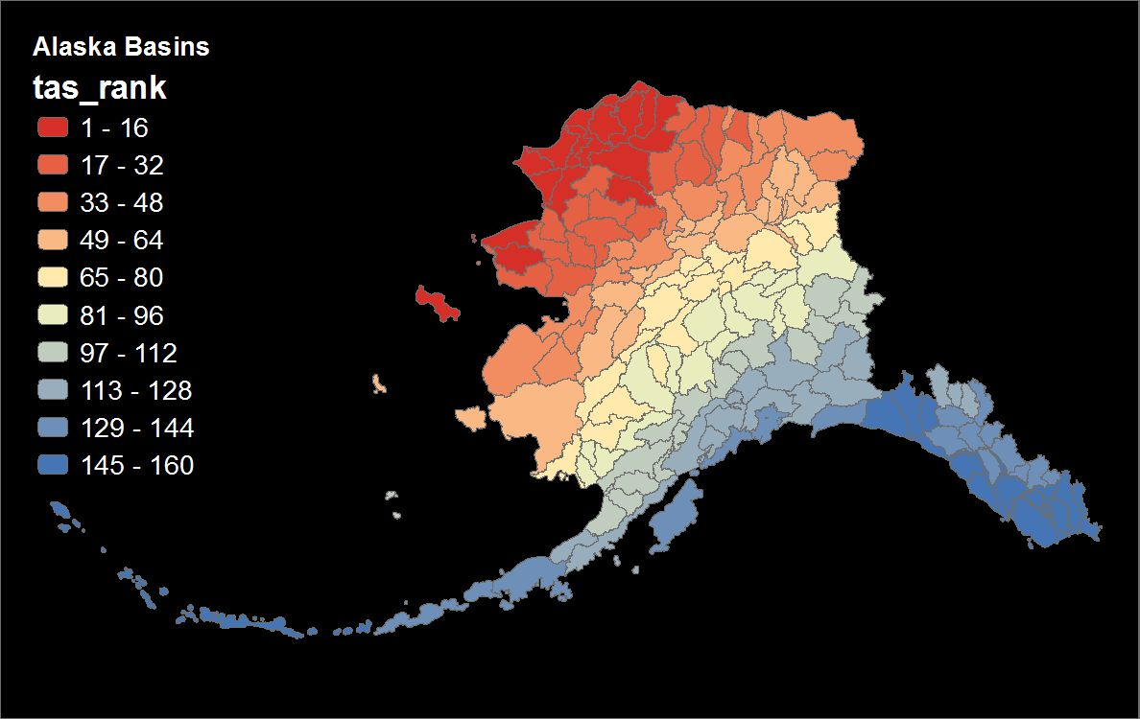
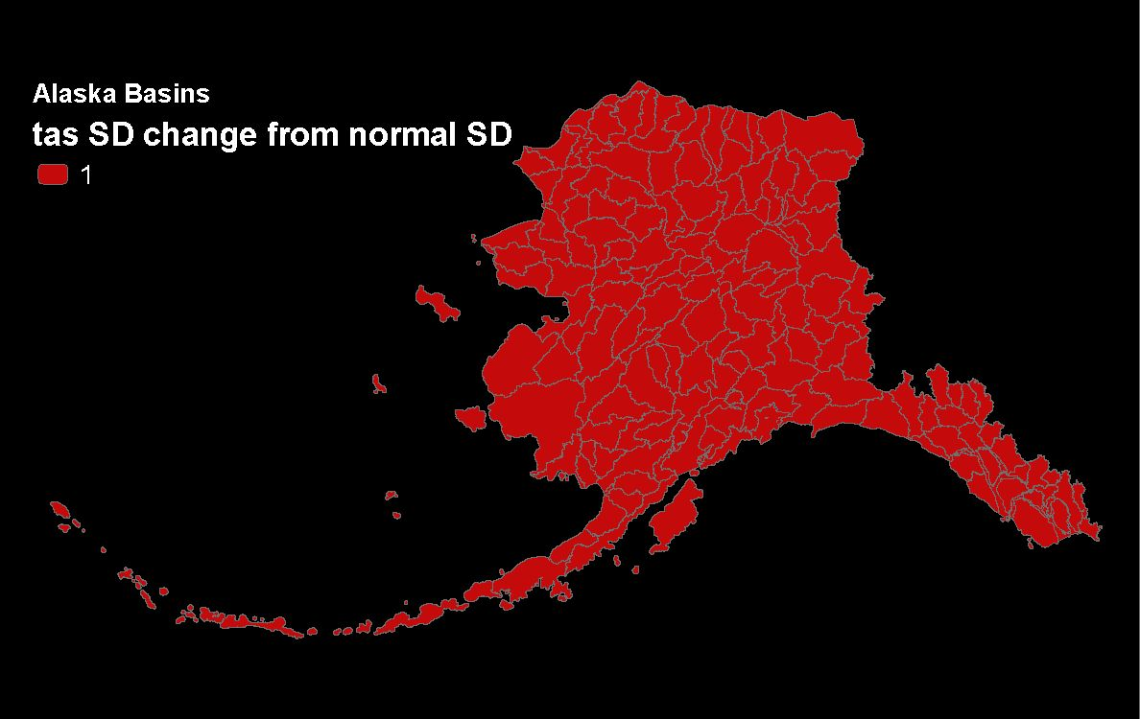
Ranking
∆ Temperature
Threshold

Slide 21

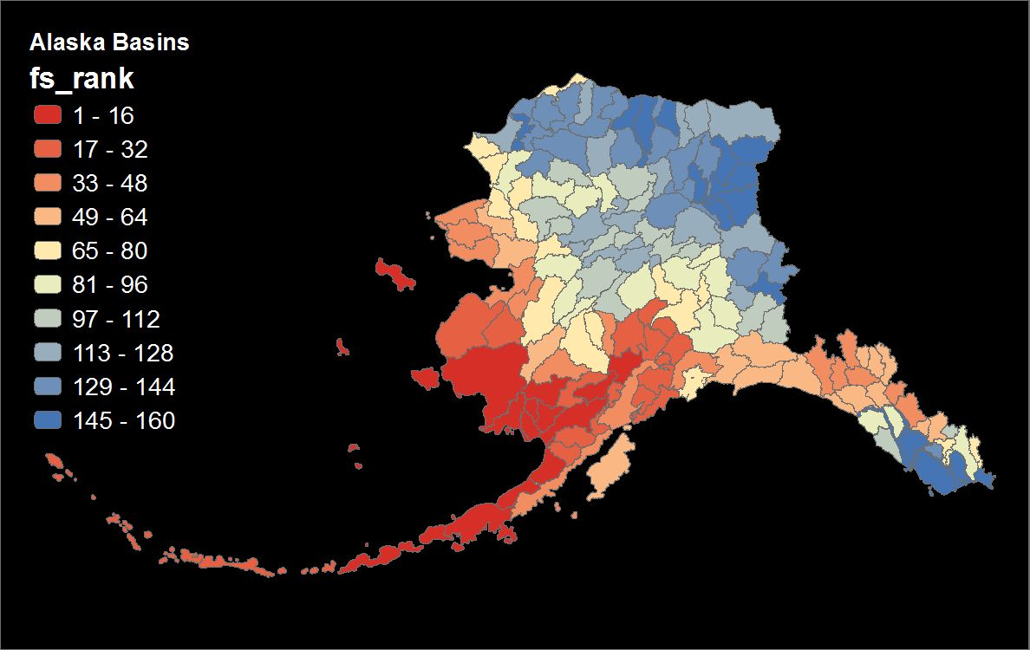
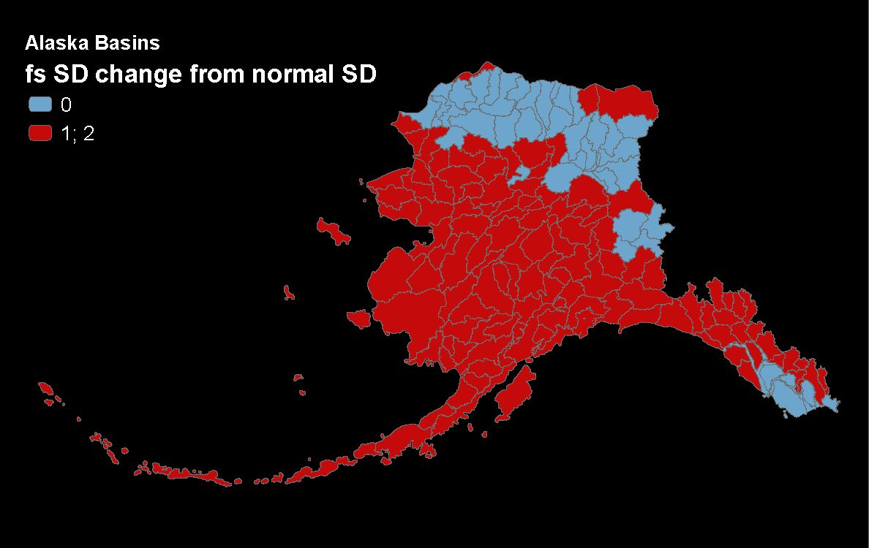
Ranking
∆ Snow Fraction
Threshold

Slide 22

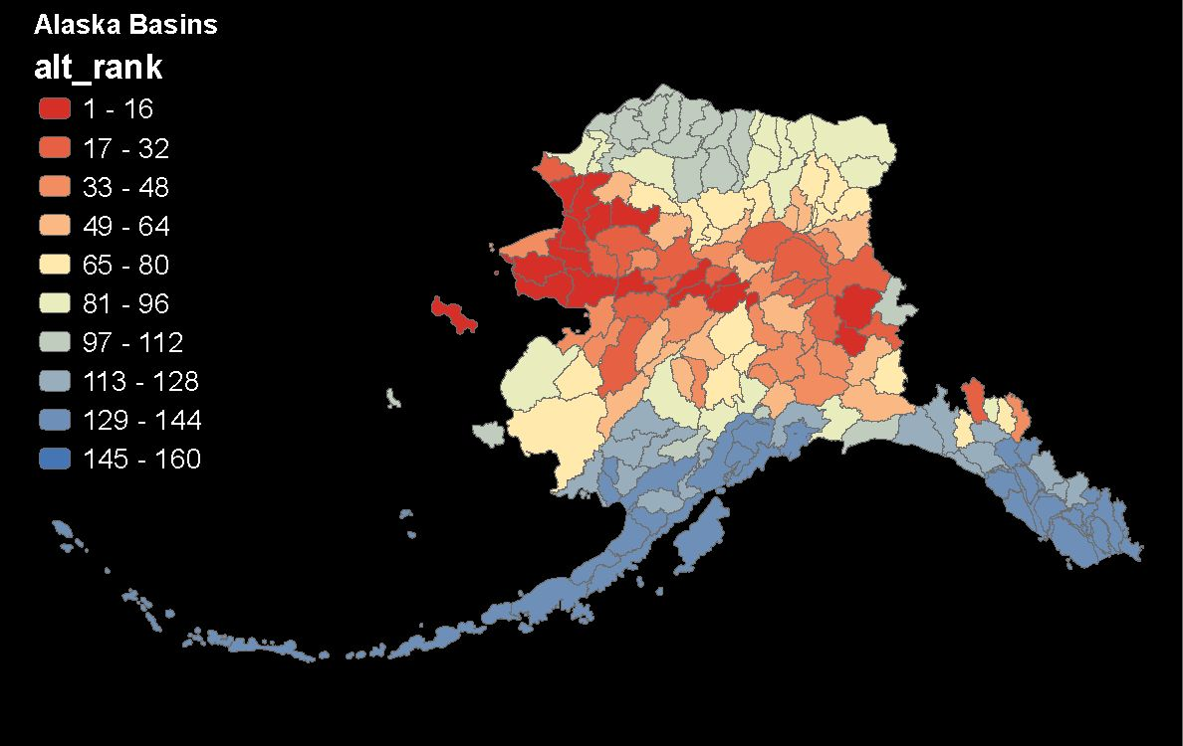
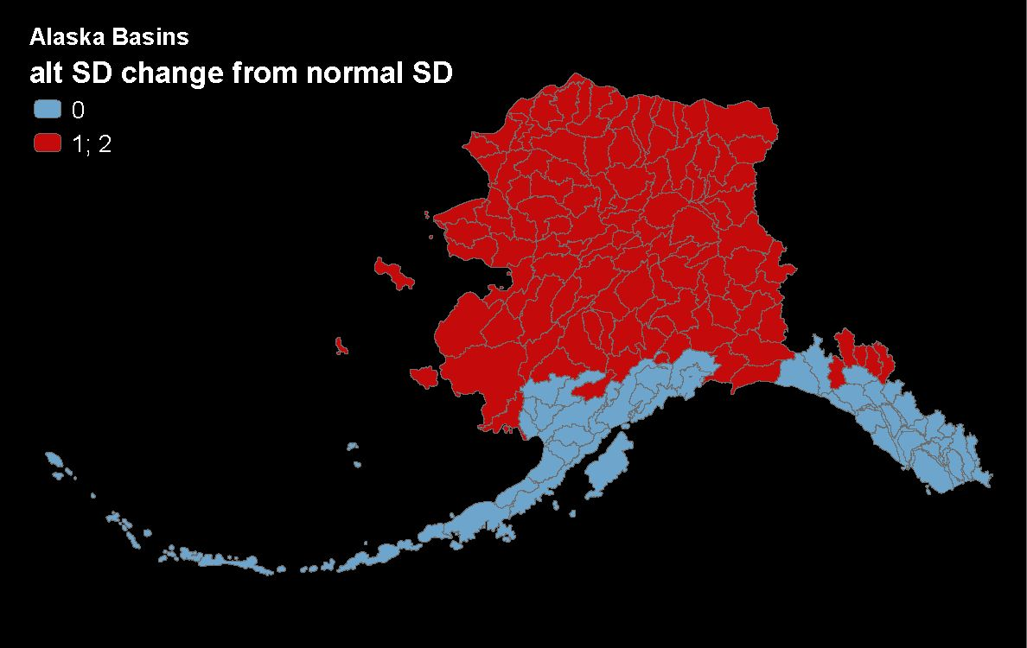
Ranking
∆ Active Layer
Threshold

Slide 23

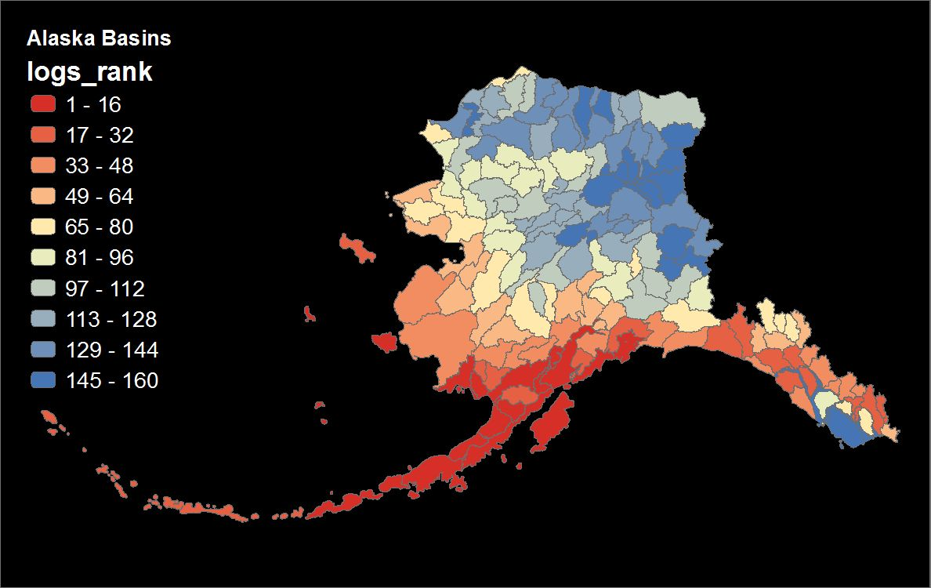
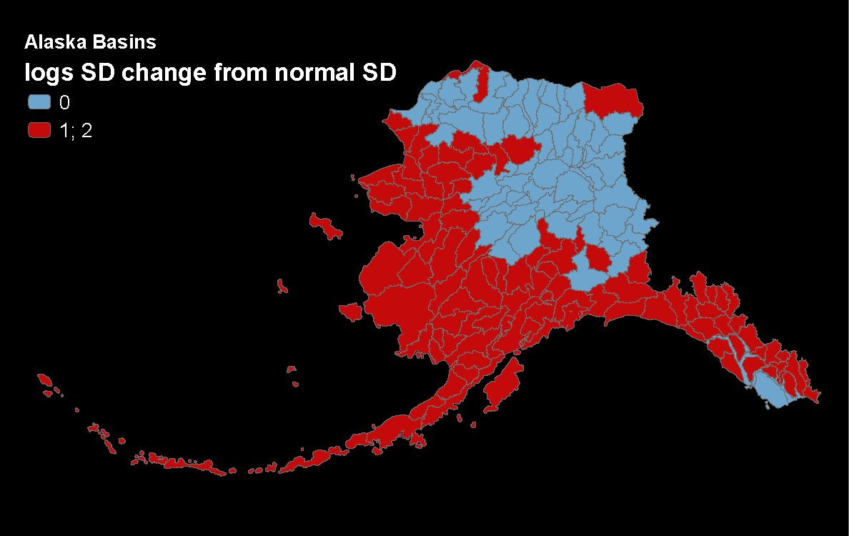
Ranking
∆ Growing Season
Threshold

Slide 24
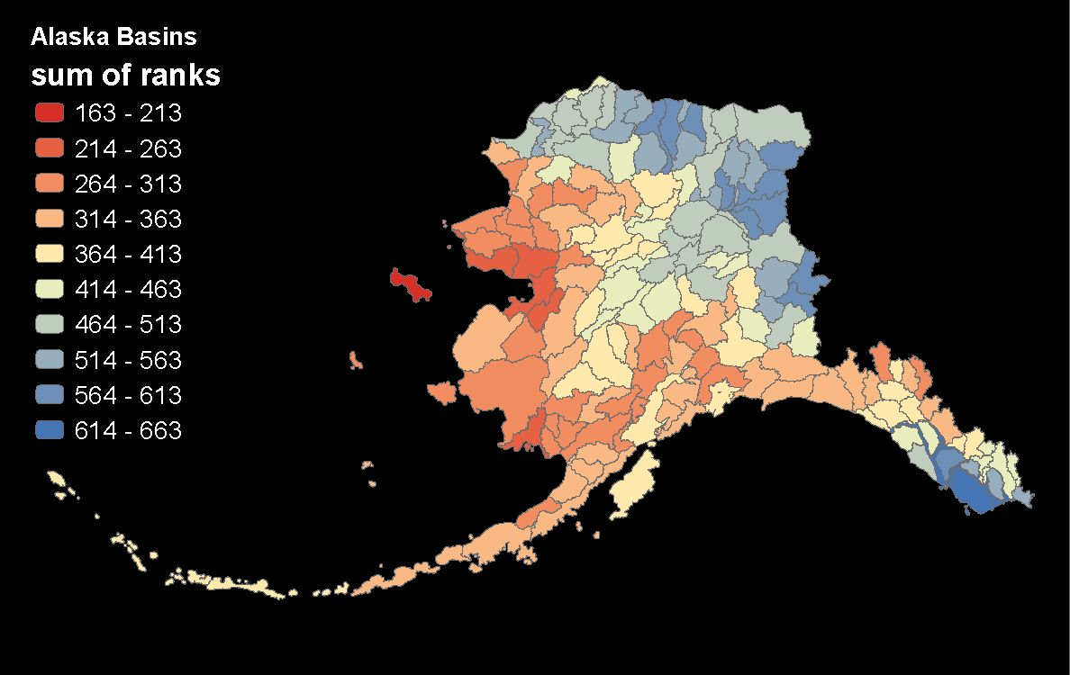
Prioritization – by Ranking

Slide 25
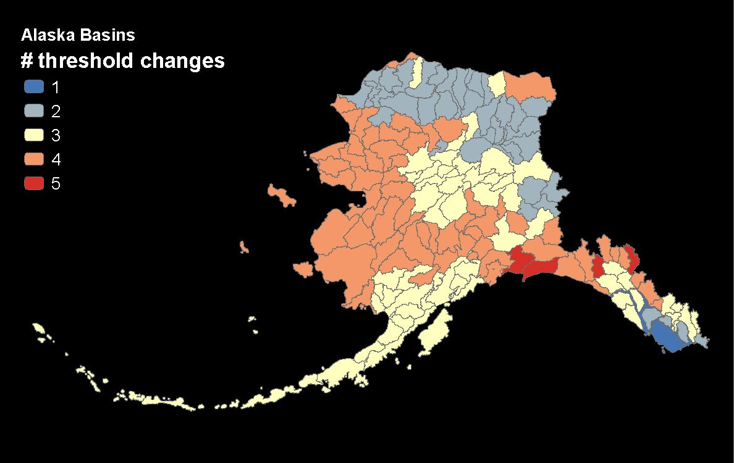
Prioritization – by Thresholds

Slide 26
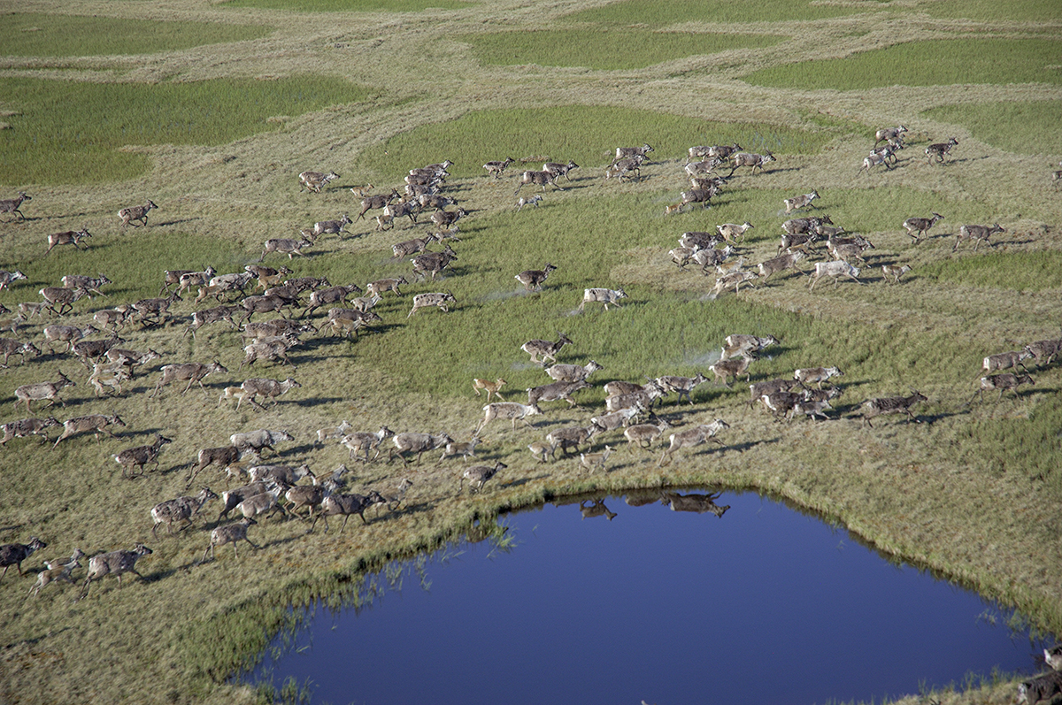
Discussion
Image: Gerrit Vyn
Notes:
SNAP downscales global model outputs to the local level, scaling from 2.5 degree GCMs (Global Climate Models) for precipitation to a 2 kilometer downscaled GCM precipitation model. SNAP selects 5 GCMs that perform best in Alaska and the Arctic, and then downscales these datasets using PRISM data to account for local land features.
GIPL1 model simulates permafrost dynamics and the depth of maximum depth of summer [warm period of time] seasonal thaw in perennially frozen ground and depth of seasonal frost penetration in permafrost free areas). The official definition of the active layer thickness (ALT) is: "the layer of ground that is subject to annual thawing and freezing in areas underlain by permafrost". It means permafrost are beneath the active layer. But GIPL1 model does not provide us with information what we have beneath the active layer (no temperature profile), because it is equilibrium model. If we have negative value of ALT it is means we have seasonally frozen layer during the winter time. The negative and positive values I used only for the mapping purposes to distinguish seasonal frost and active layer (seasonally thawed layer).
Parameter-elevation Regressions on Independent Slopes Model: Moving--window regression of climate/weather values vs. elevation or climatology for each grid cell; Uses nearby station observations

Slide 27
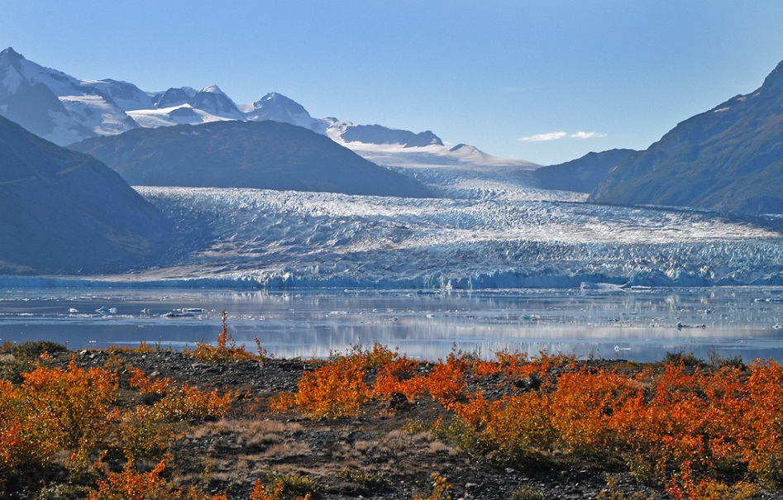
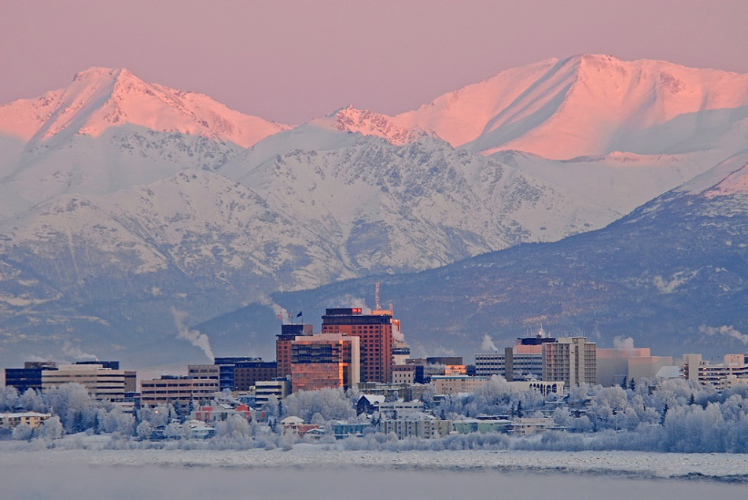
Discussion
Each major region of Alaska ranks high for at least one of the five variables assessed
Much of the state will undergo multiple concurrent changes
Ranking and threshold show a general pattern of most vulnerability in Western and Southcentral Alaska
Image: John Schoen
Image: John Schoen
Notes:
SNAP downscales global model outputs to the local level, scaling from 2.5 degree GCMs (Global Climate Models) for precipitation to a 2 kilometer downscaled GCM precipitation model. SNAP selects 5 GCMs that perform best in Alaska and the Arctic, and then downscales these datasets using PRISM data to account for local land features.
GIPL1 model simulates permafrost dynamics and the depth of maximum depth of summer [warm period of time] seasonal thaw in perennially frozen ground and depth of seasonal frost penetration in permafrost free areas). The official definition of the active layer thickness (ALT) is: "the layer of ground that is subject to annual thawing and freezing in areas underlain by permafrost". It means permafrost are beneath the active layer. But GIPL1 model does not provide us with information what we have beneath the active layer (no temperature profile), because it is equilibrium model. If we have negative value of ALT it is means we have seasonally frozen layer during the winter time. The negative and positive values I used only for the mapping purposes to distinguish seasonal frost and active layer (seasonally thawed layer).
Parameter-elevation Regressions on Independent Slopes Model: Moving--window regression of climate/weather values vs. elevation or climatology for each grid cell; Uses nearby station observations

Slide 28
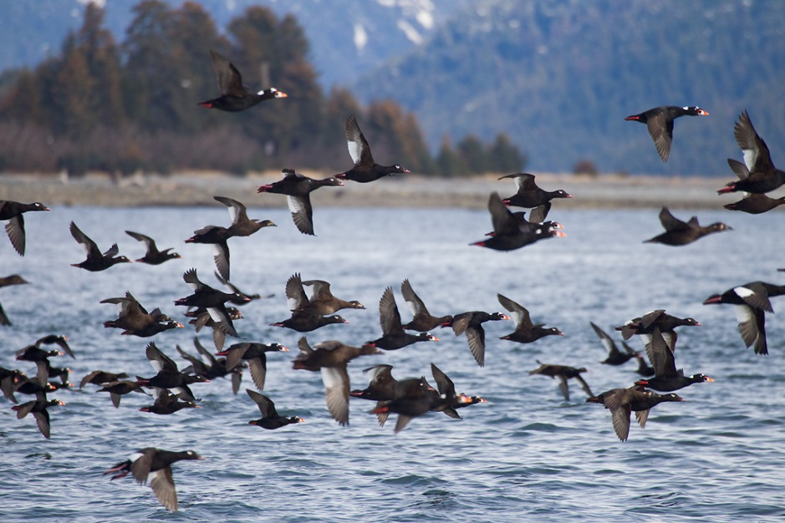
Next Steps
The information can be summarized for other management units
  Ecoregions
  Bird Conservation Regions
  Important Bird Areas
Using the information to identify IBAs most at risk statewide
Working with ABSI LCC & IOOS to apply methods to marine data
Image: Gerrit Vyn
Notes:
SNAP downscales global model outputs to the local level, scaling from 2.5 degree GCMs (Global Climate Models) for precipitation to a 2 kilometer downscaled GCM precipitation model. SNAP selects 5 GCMs that perform best in Alaska and the Arctic, and then downscales these datasets using PRISM data to account for local land features.
GIPL1 model simulates permafrost dynamics and the depth of maximum depth of summer [warm period of time] seasonal thaw in perennially frozen ground and depth of seasonal frost penetration in permafrost free areas). The official definition of the active layer thickness (ALT) is: "the layer of ground that is subject to annual thawing and freezing in areas underlain by permafrost". It means permafrost are beneath the active layer. But GIPL1 model does not provide us with information what we have beneath the active layer (no temperature profile), because it is equilibrium model. If we have negative value of ALT it is means we have seasonally frozen layer during the winter time. The negative and positive values I used only for the mapping purposes to distinguish seasonal frost and active layer (seasonally thawed layer).
Parameter-elevation Regressions on Independent Slopes Model: Moving--window regression of climate/weather values vs. elevation or climatology for each grid cell; Uses nearby station observations

Slide 29
Using Spatial Climate Change Data to Assess Vulnerability across Alaska
QUESTIONS?
Melanie A. Smith & Nathan J. Walker

