Slide 1
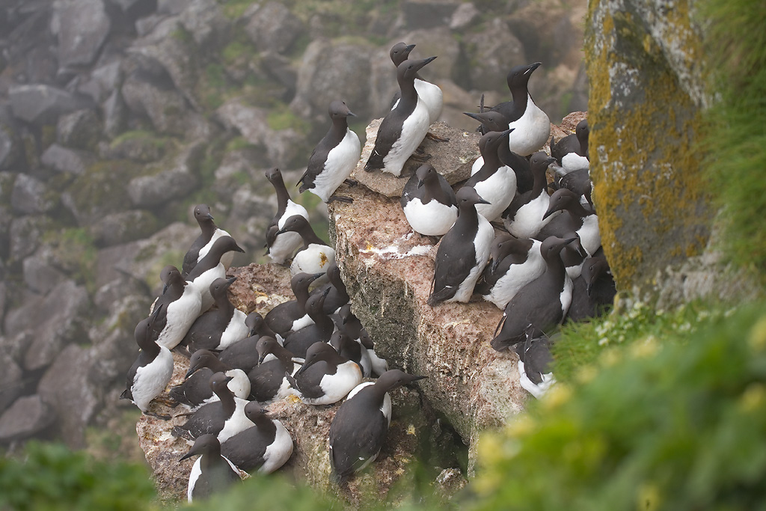
Building Better Bird Maps
The 2017 Ecological Atlas of the
Bering, Chukchi, and Beaufort Seas
Melanie Smith, Max Goldman, Erika Knight, Daniel Huffman, and Ben Sullender
image: Milo Burcham

Slide 2
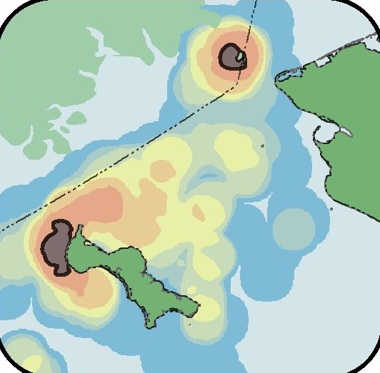
Data to Design
Data Gathering
Identify available data
Acquire and organize
Data Synthesis
Spatial analysis
Composite data layers
Conservation Design
Annual cycle maps
Ecological patterns
Conservation planning

Slide 3
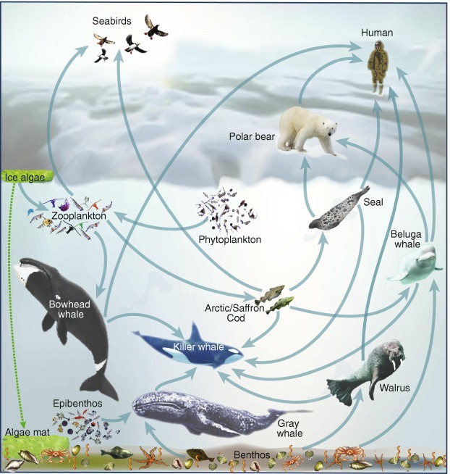
Parts of an Ecological Atlas
1 Science
2 Data
3 Maps
4 Patterns
image: Moore and Stabeno 2015

Slide 4


Parts of an Ecological Atlas
1 Science
2 Data
3 Maps
4 Patterns
images: www.jisc.ac.uk, https://www.themarketingtechnologist.co/the-ceddl-a-data-layer-standard-that-never-was/

Slide 5
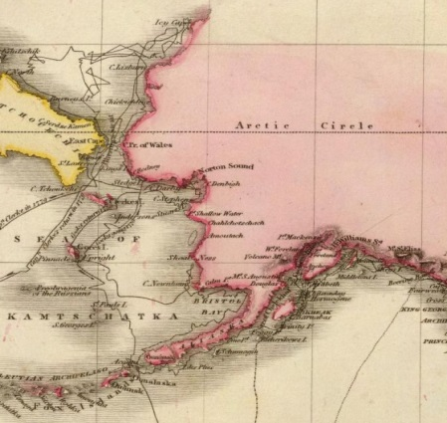

Parts of an Ecological Atlas
1 Science
2 Data
3 Maps
4 Patterns
Images: David Rumsey Map Collection , inhabit.com

Slide 6
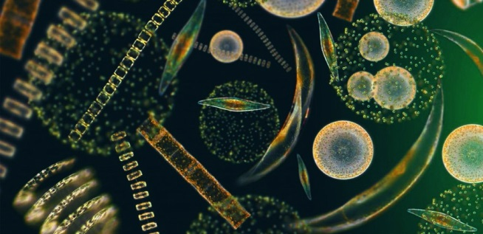
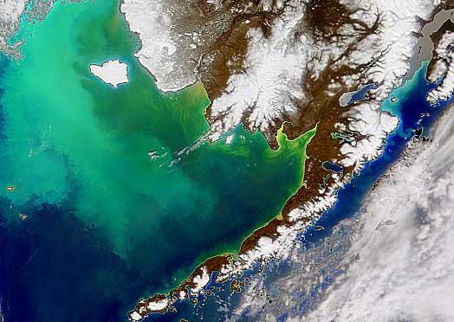
Parts of an Ecological Atlas
1 Science
2 Data
3 Maps
4 Patterns
Images: prn.fm, afsc.noaa.gov

Slide 7
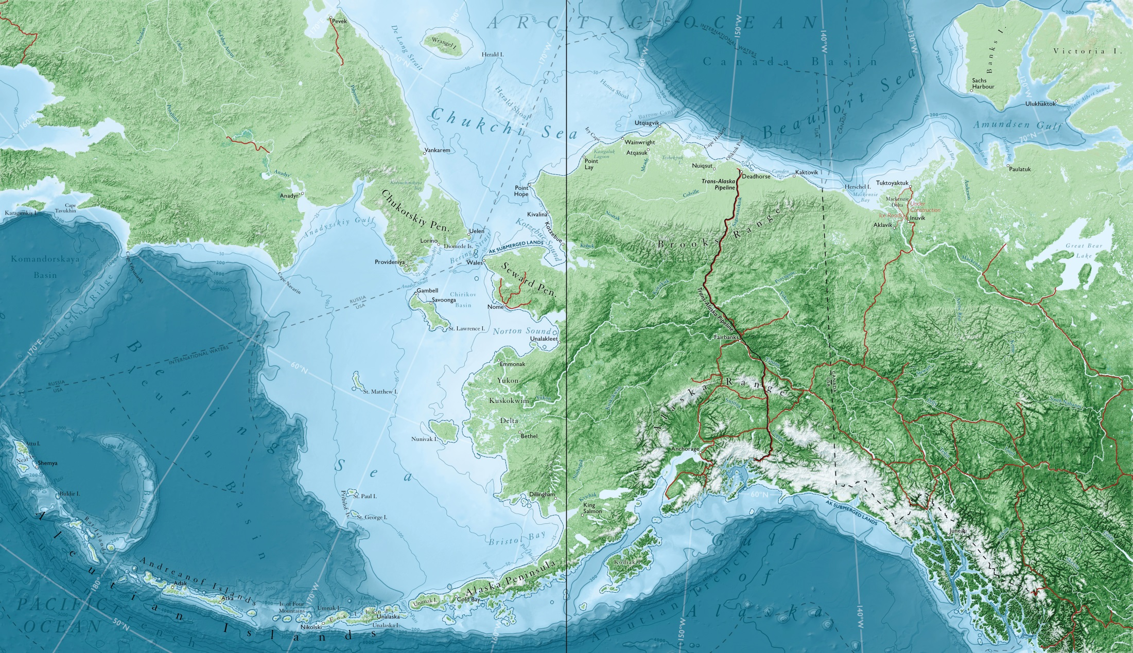
Project Area

Slide 8


Chapters
1 Physical Setting
2 Biological Setting
3 Fish
4 Birds
5 Mammals
6 Human Uses

Slide 9
Data to Design
Data Gathering
Identify available data
Acquire and organize
Data Synthesis
Spatial analysis
Composite data layers
Conservation Design
Annual cycle maps
Ecological patterns
Conservation planning

Slide 10

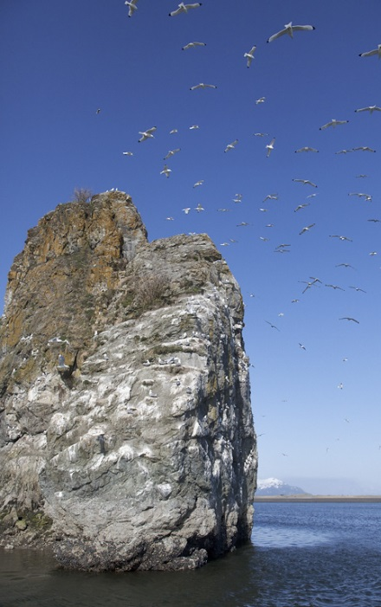
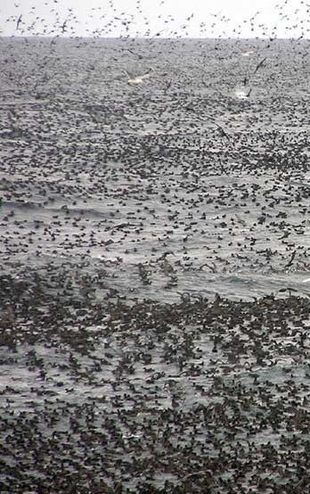
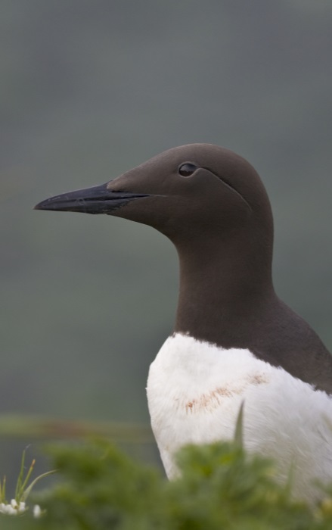
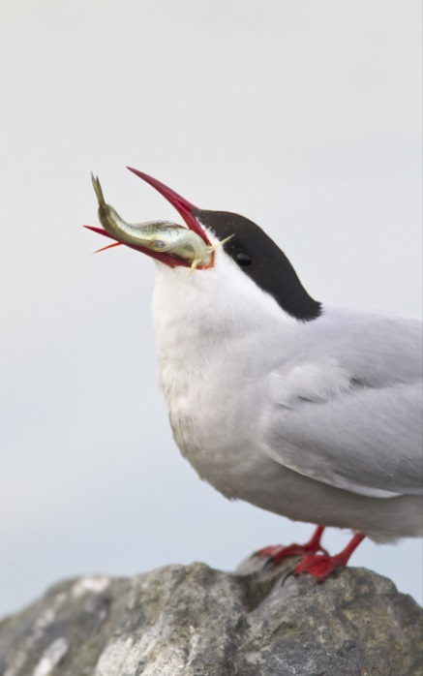
Main Data Types for Birds
:)
Colony
Census count
Survey Transects
At-sea
Aerial
Telemetry
GPS
Geolocator
Etc.
Expert
Local knowledge
Traditional knowledge
eBird
images: Milo Burcham, USFWS

Slide 11
Data to Design
Data Gathering
Identify available data
Acquire and organize
Data Synthesis
Spatial analysis
Composite data layers
Conservation Design
Annual cycle maps
Ecological patterns
Conservation planning

Slide 12
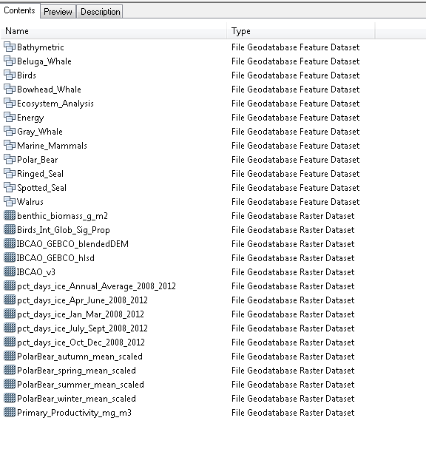
Acquire and Organize
Survey Transect
Telemetry
Colony
:)
Expert

Slide 13
Data to Design
Data Gathering
Identify available data
Acquire and organize
Data Synthesis
Spatial analysis
Composite data layers
Conservation Design
Annual cycle maps
Ecological patterns
Conservation planning

Slide 14
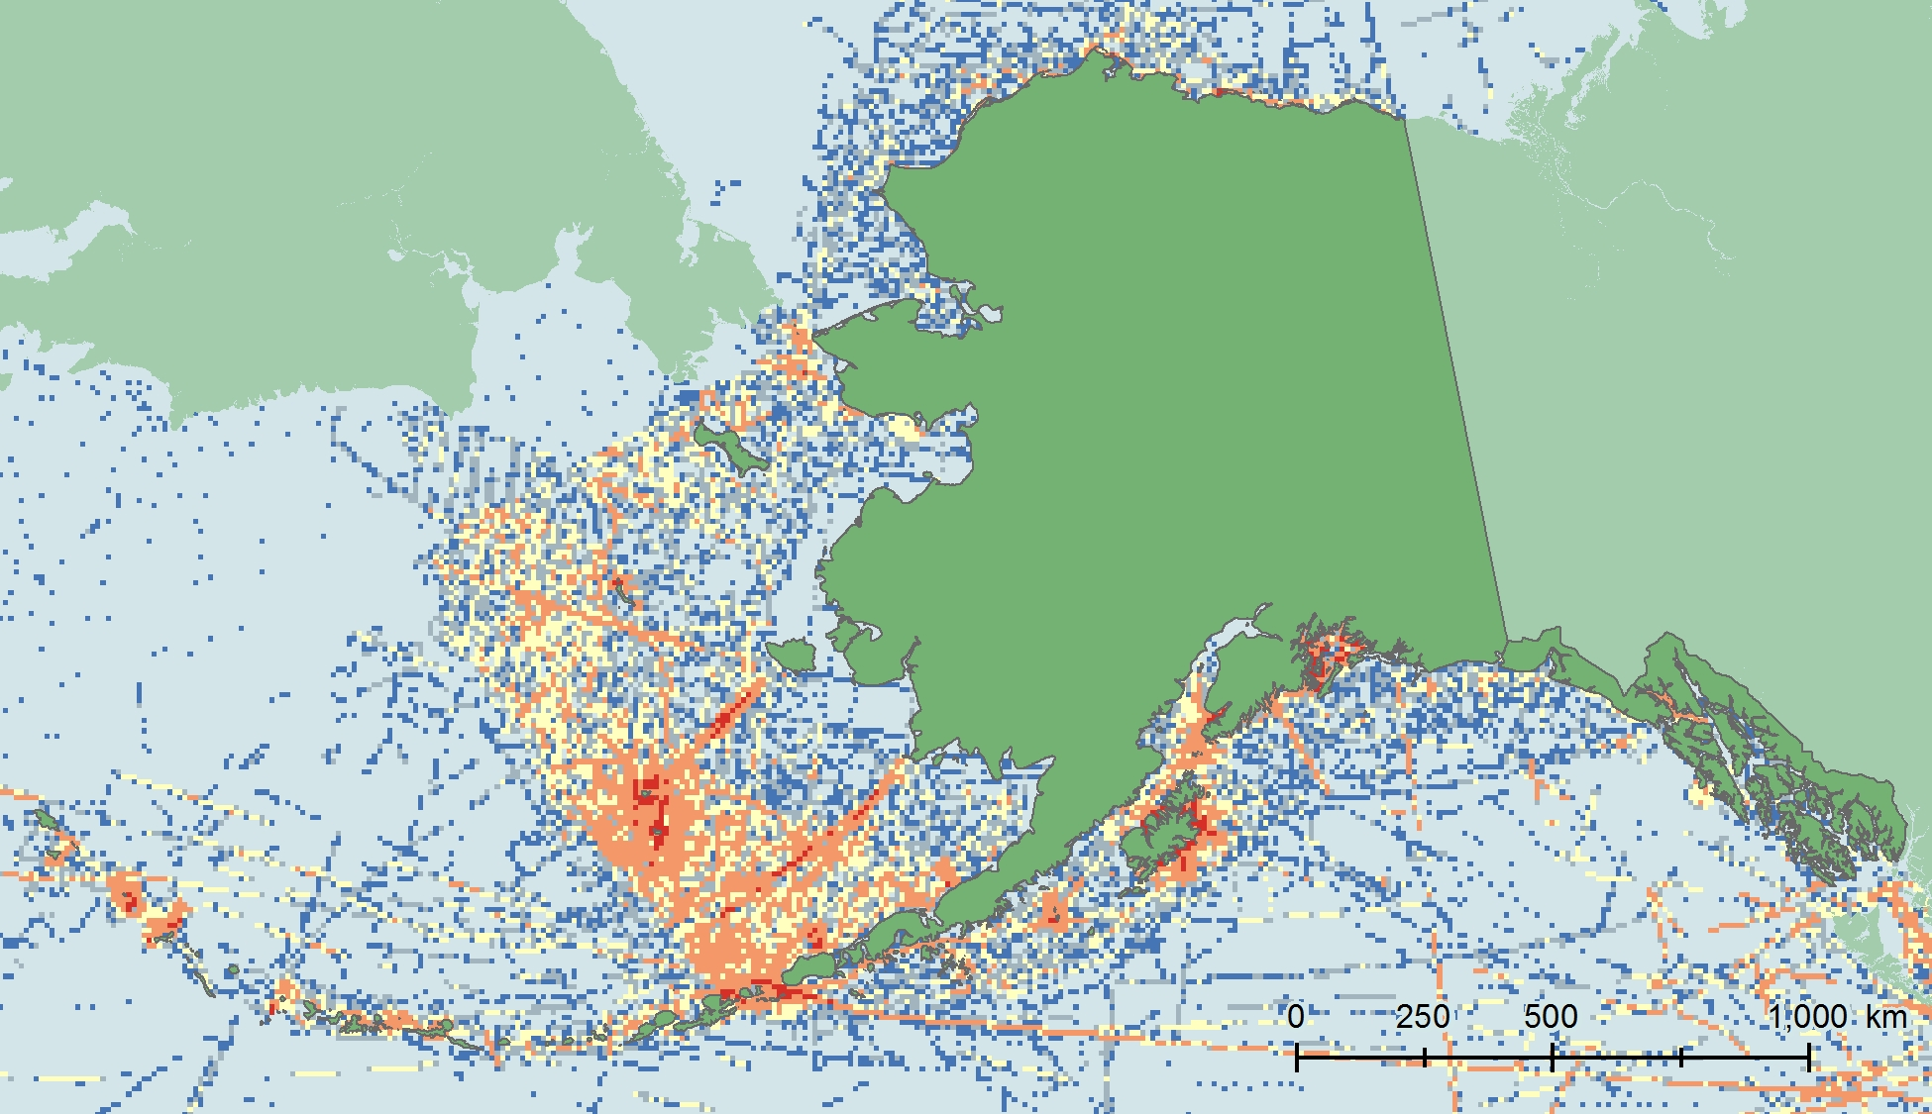

Spatial Analysis
North Pacific Pelagic Seabird Database v2
Survey Effort

Slide 15
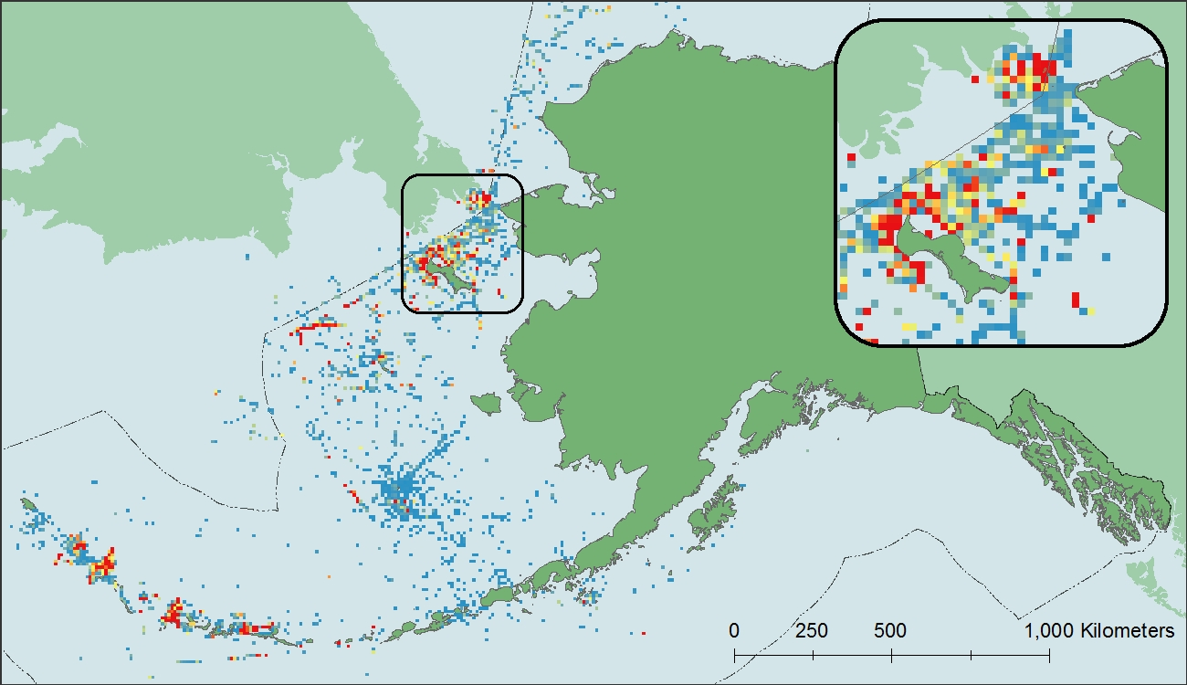
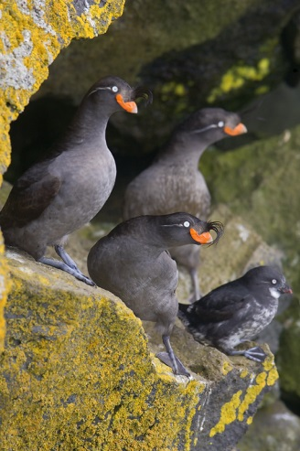
Spatial Analysis
image: Milo Burcham
CRESTED AUKLET DISTRIBUTION
10 x 10 km bins with CRAU present

Slide 16
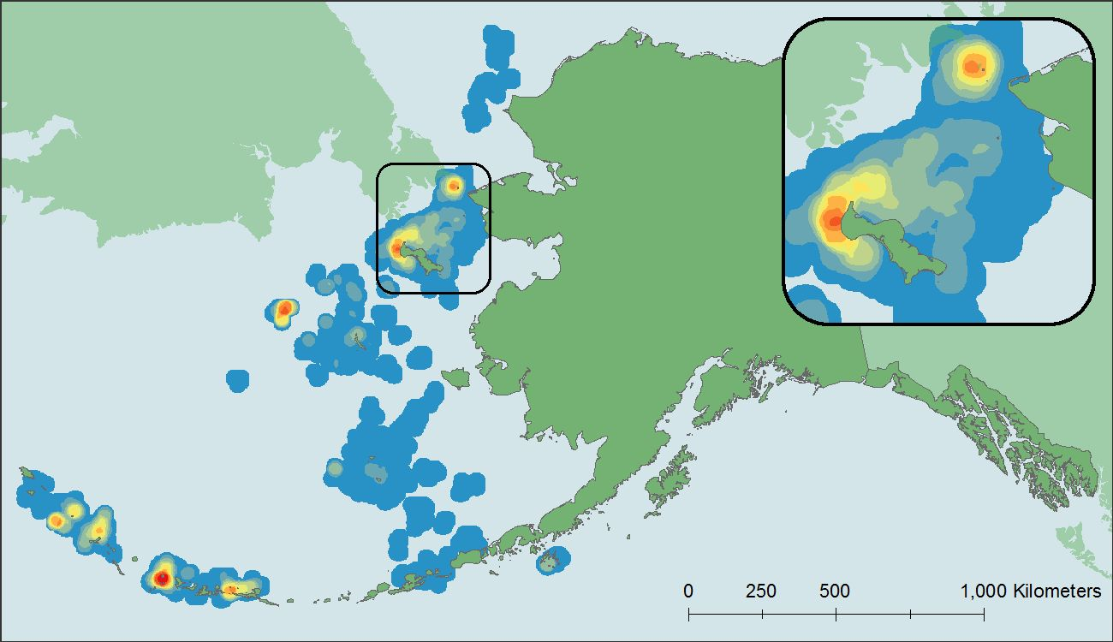
Spatial Analysis
image: Milo Burcham
ANALYZE LOCAL ABUNDANCE
Results of the hotspot analysis for Crested Auklet

Slide 17
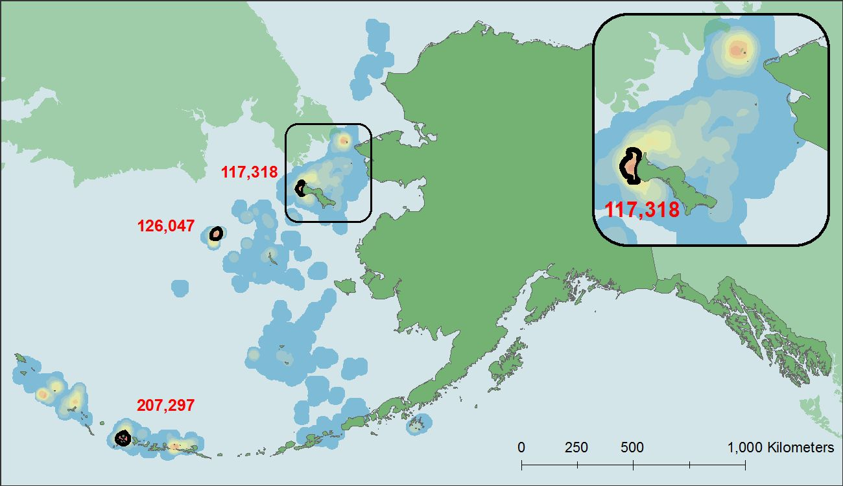
Spatial Analysis
image: Milo Burcham
DELINEATE CORE AREAS
Adequate abundance, repeated high use, multi-year persistence

Slide 18
Data to Design
Data Gathering
Identify available data
Acquire and organize
Data Synthesis
Spatial analysis
Composite data layers
Conservation Design
Annual cycle maps
Ecological patterns
Conservation planning

Slide 19
Composite Data Layers
Multiple Studies
1
2
4
3
3
3

Slide 20
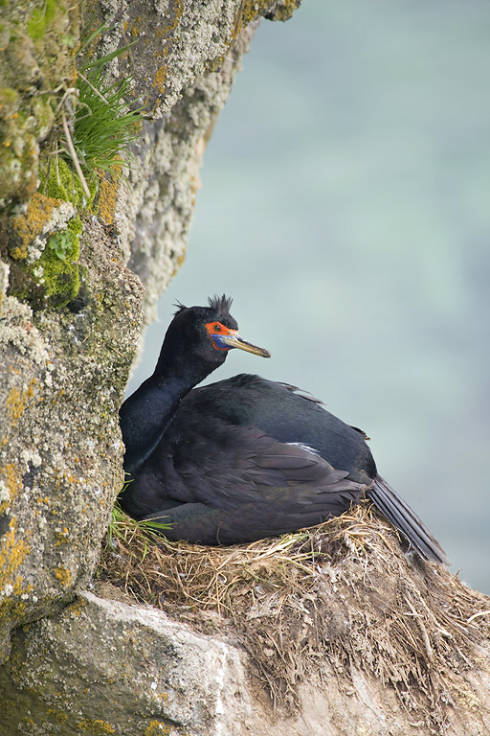
Composite Data Layers
Major Activities of Birds
Breeding
Foraging
Molting
Staging
Wintering
Migrating
image: Milo Burcham

Slide 21
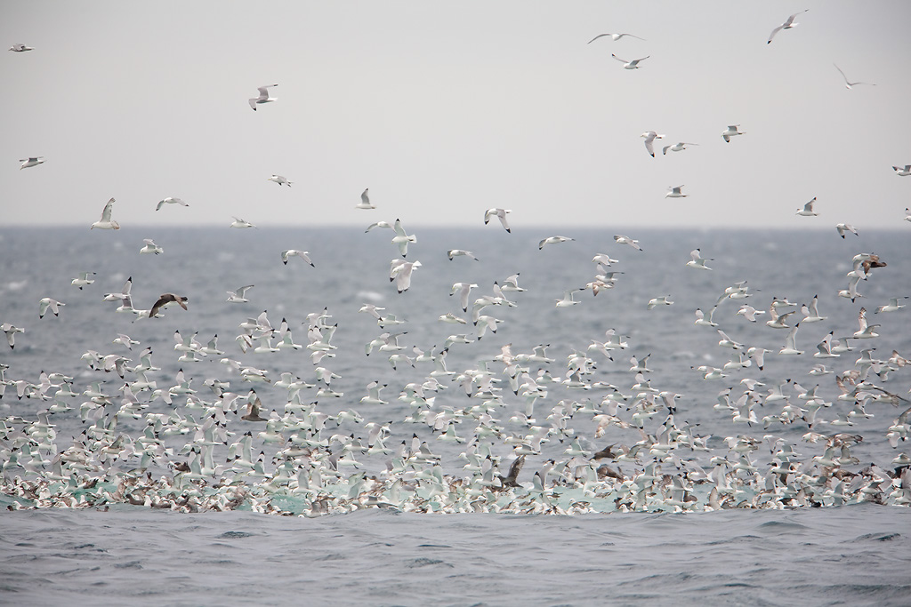
Composite Data Layers
Major Activities of Birds
Breeding
Foraging
Molting
Staging
Wintering
Migrating
image: Milo Burcham

Slide 22
Composite Data Layers
Major Activities of Birds
Breeding
Foraging
Molting
Staging
Wintering
Migrating
image: Milo Burcham

Slide 23
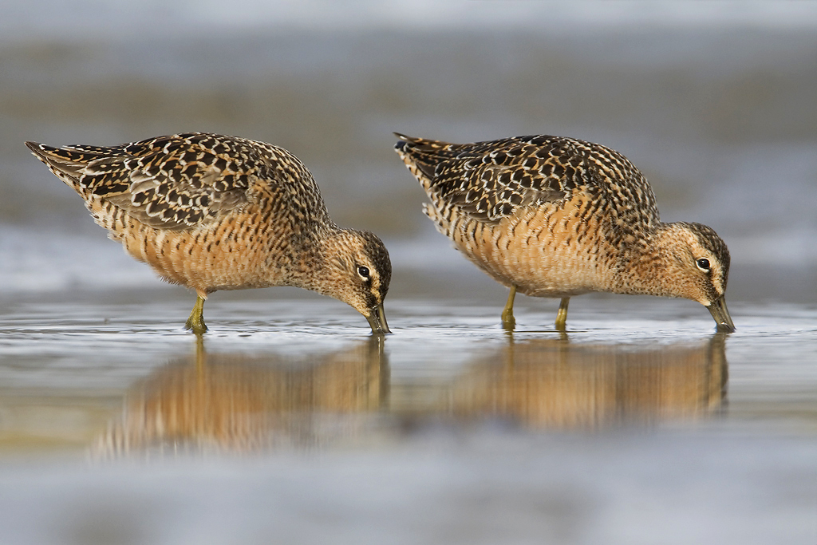
Composite Data Layers
Major Activities of Birds
Breeding
Foraging
Molting
Staging
Wintering
Migrating
image: Milo Burcham

Slide 24
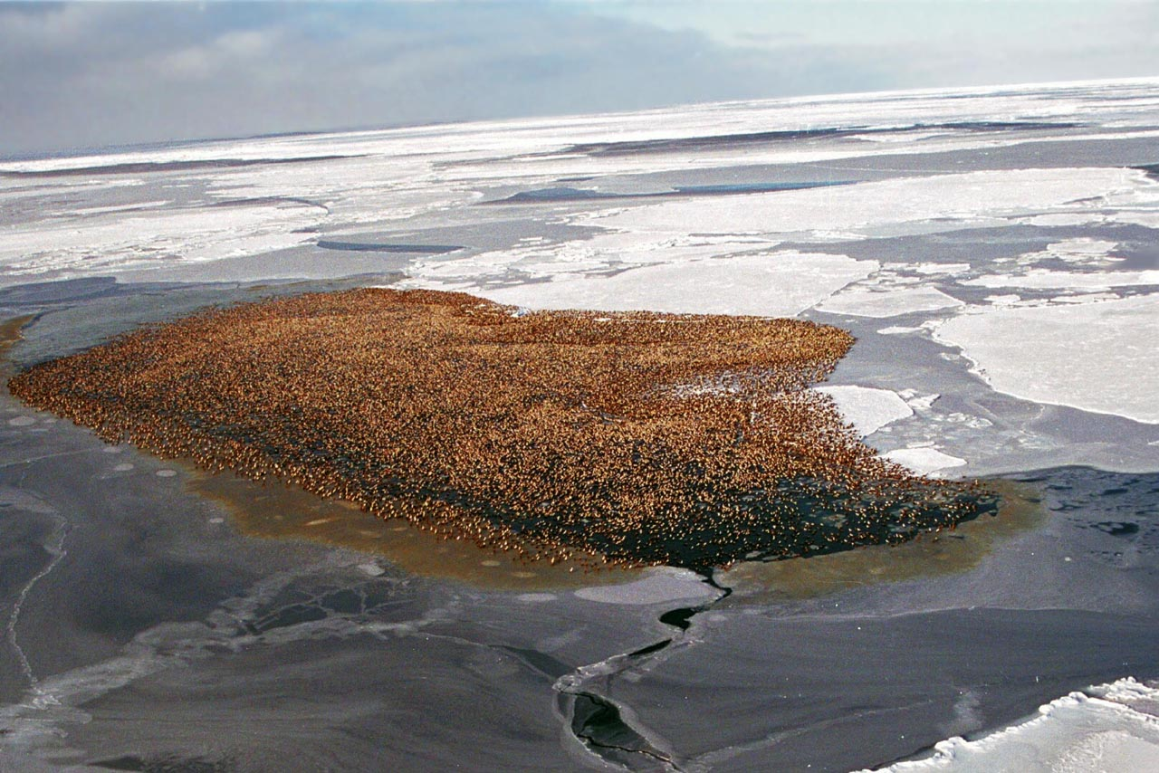
Composite Data Layers
Major Activities of Birds
Breeding
Foraging
Molting
Staging
Wintering
Migrating
image: USFWS

Slide 25
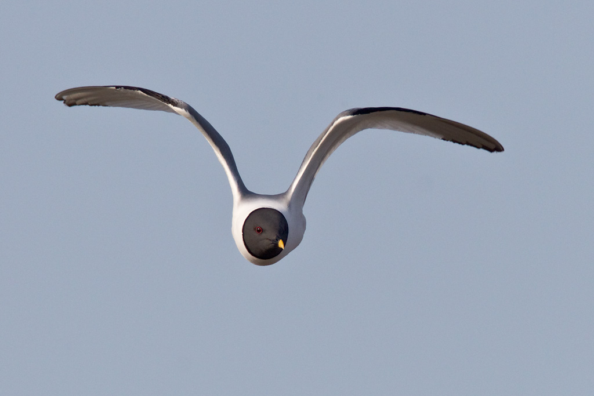
Composite Data Layers
Major Activities of Birds
Breeding
Foraging
Molting
Staging
Wintering
Migrating
image: Milo Burcham

Slide 26
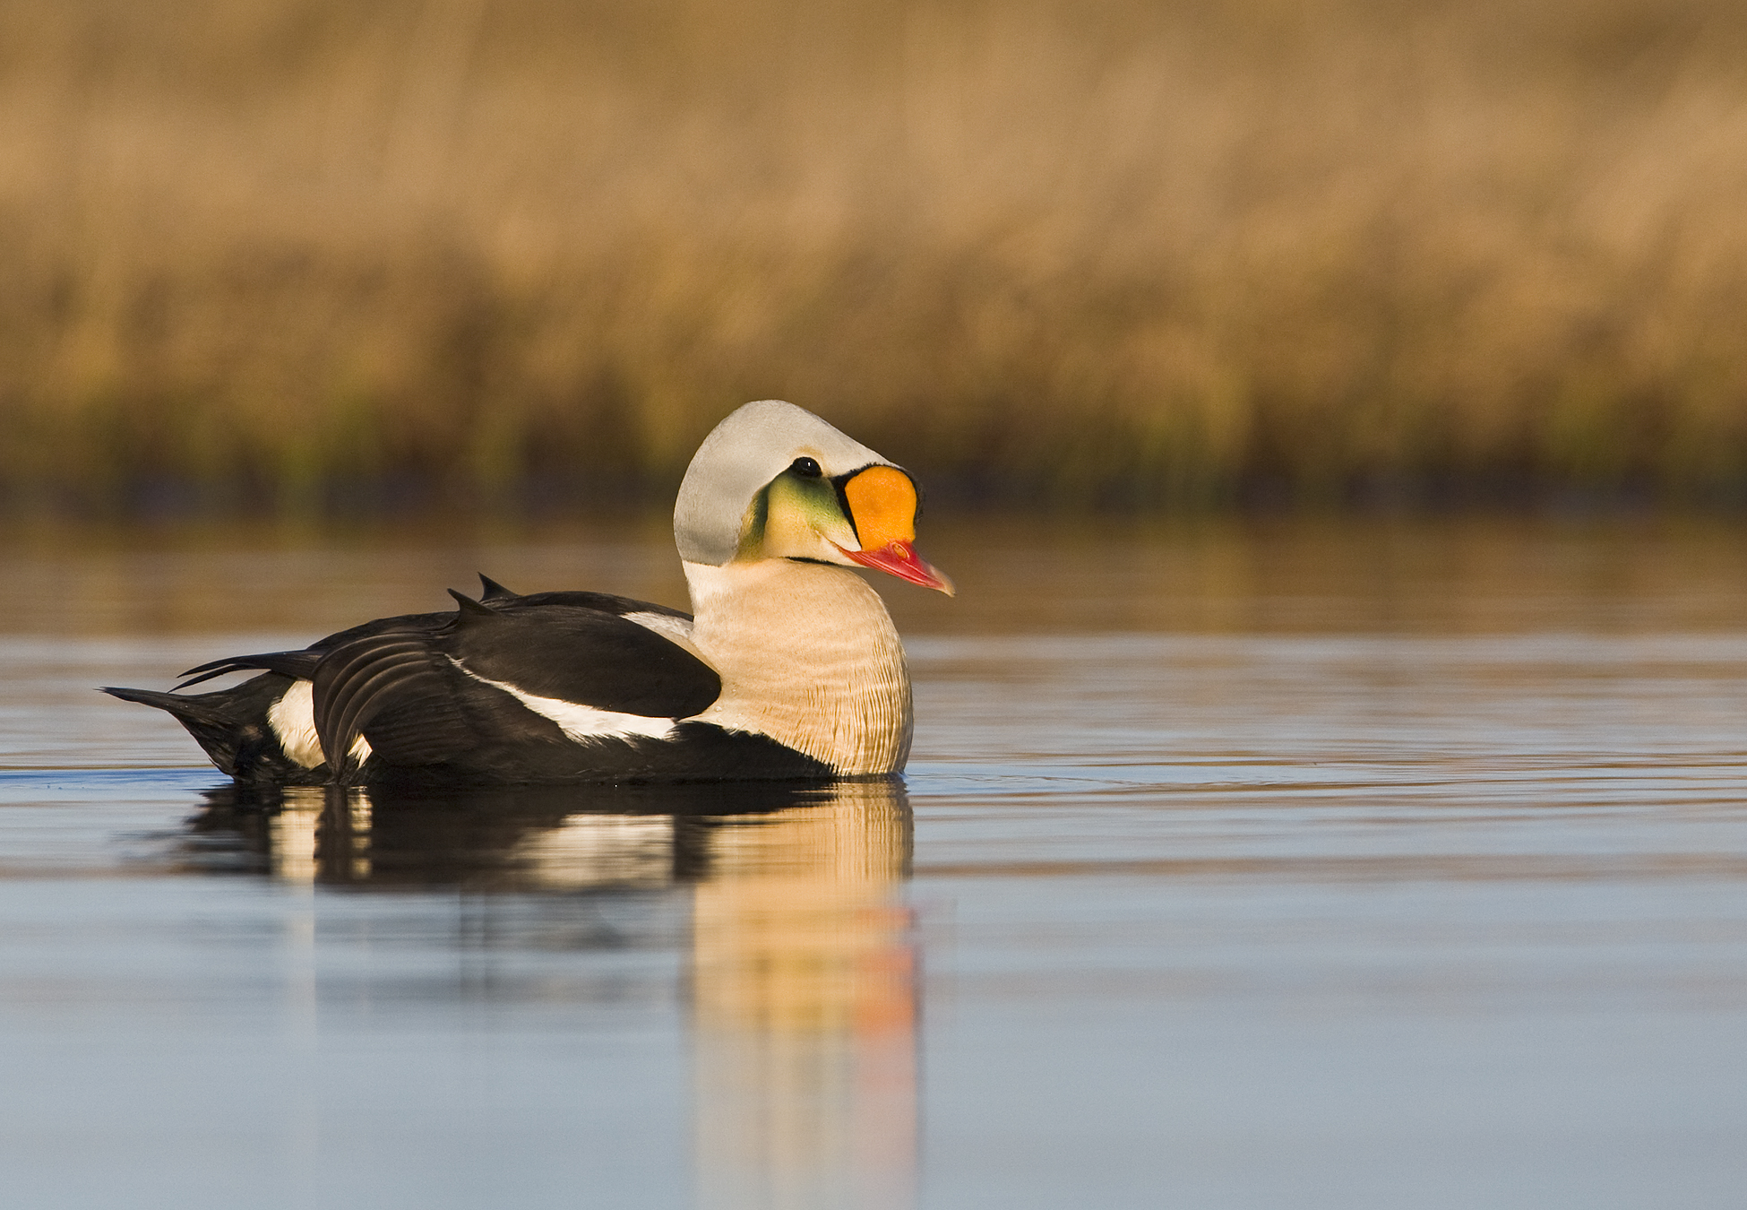
Composite Data Layers
Breeding:
Sea Duck Joint Venture (2016)
Audubon Alaska (2016a) based on Walker and Smith (2014)
Audubon Alaska (2016b) based on Powell and Suydam (2012)
NOAA (1988)
Dickson et al. (1997)
Molting:
NOAA (1988)
Dickson (2012a)
Phillips et al. (2006)
Oppel (2008)
Staging:
Dickson (2012b)
Oppel et al. (2009)
Oppel (2008)
Audubon Alaska (2009)
Wintering:
Sea Duck Joint Venture (2016)
Dickson (2012a)
Phillips et al. (2006)
Oppel (2008)
Migration:
Audubon Alaska (2016c) based on Oppel et al. (2009) and NOAA (1988)
image: Milo Burcham

Slide 27
Data to Design
Data Gathering
Identify available data
Acquire and organize
Data Synthesis
Spatial analysis
Composite data layers
Conservation Design
Annual cycle maps
Ecological patterns
Conservation planning

Slide 28
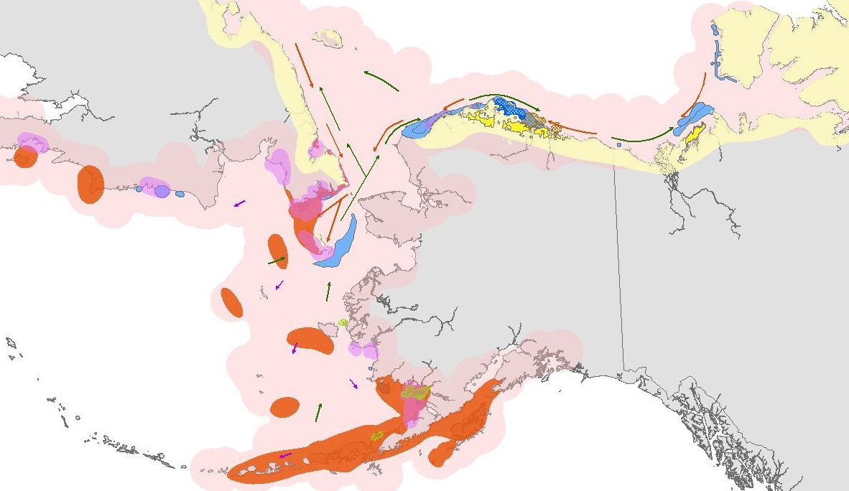
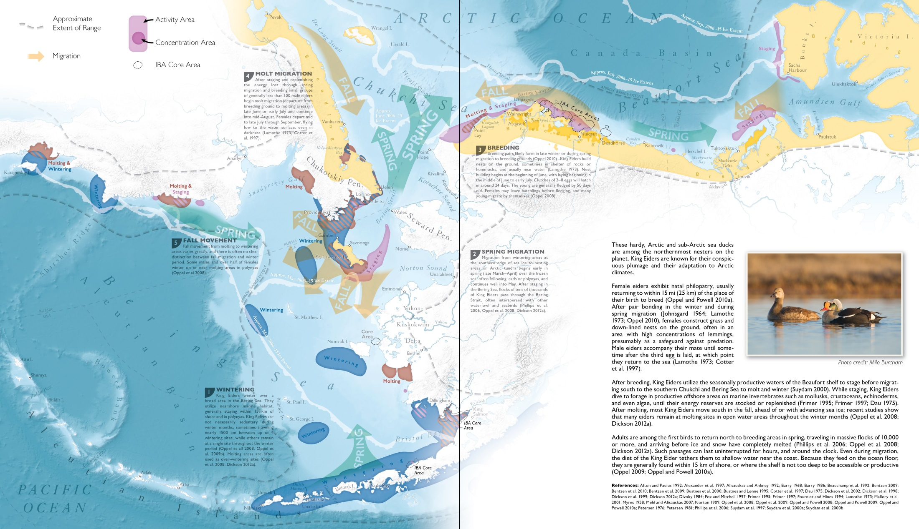
Annual Cycle Maps
King Eider

Slide 29
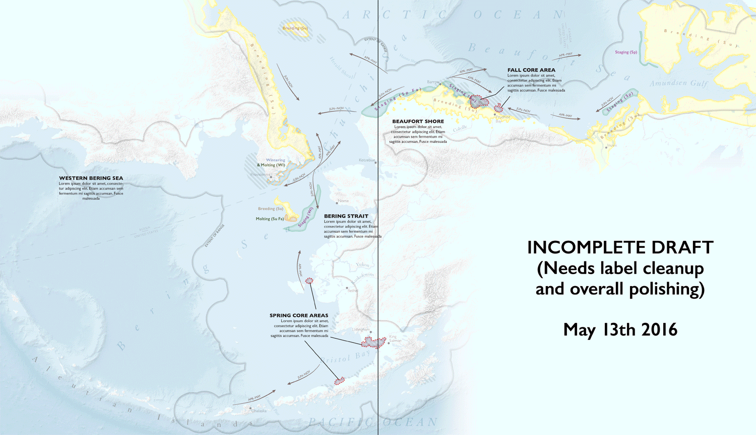
Annual Cycle Maps
King Eider

Slide 30
Annual Cycle Maps
King Eider

Slide 31
Annual Cycle Maps
Intensity
Extent of range
Regular use
Concentration
Core Area (IBA)

Slide 32











Annual Cycle Maps
Activity
Regular use
Concentration
Regular use
Non-Colonial
Colonial
Concentration
Breeding
Molting
Staging
Wintering
Migrating
Breeding
Foraging

Slide 33
Annual Cycle Maps
King Eider

Slide 34
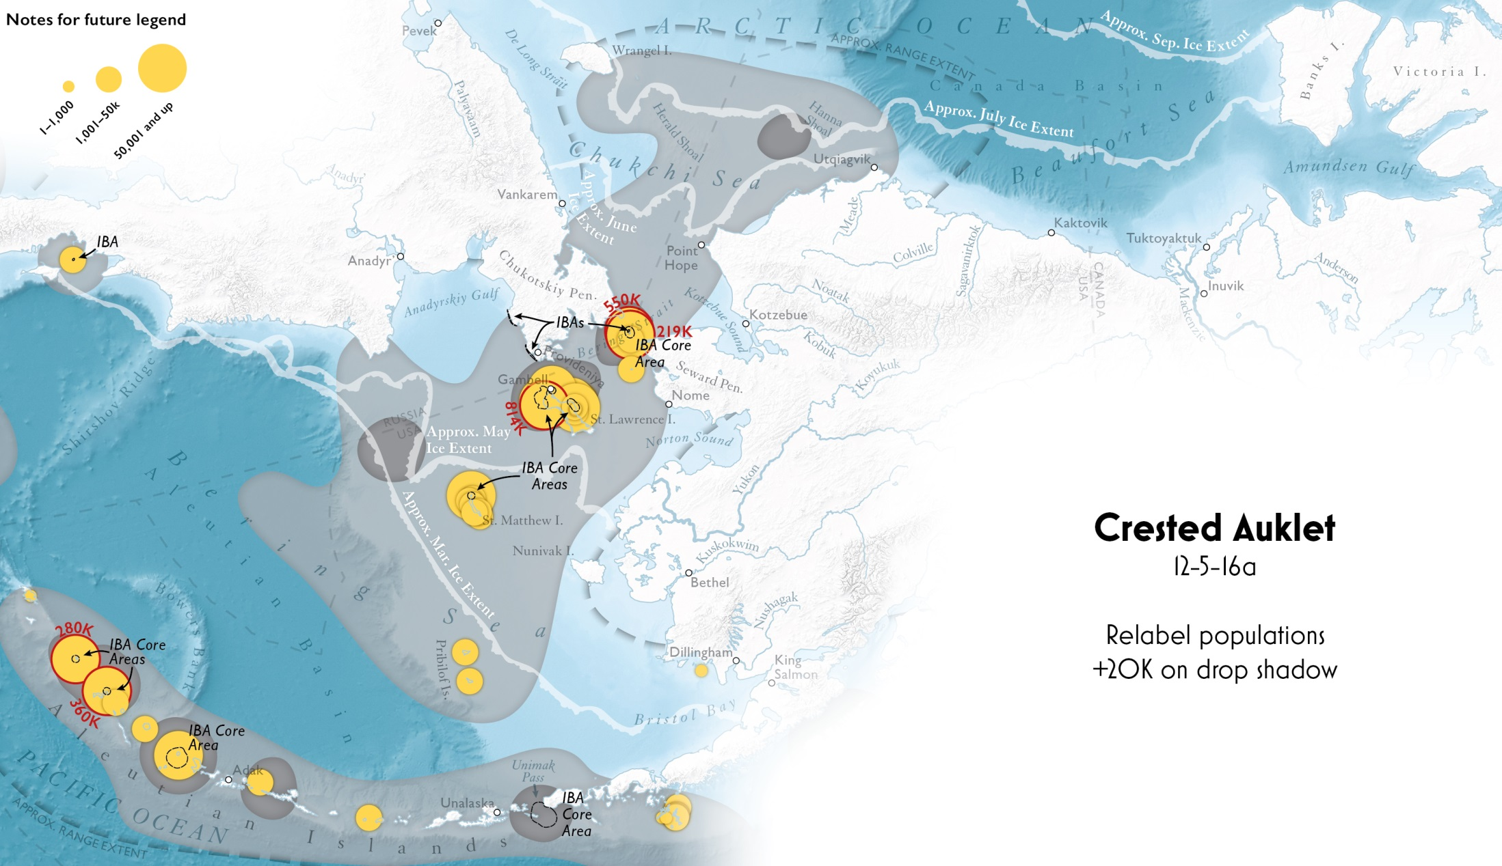
Annual Cycle Maps
Crested Auklet

Slide 35
Data to Design
Data Gathering
Identify available data
Acquire and organize
Data Synthesis
Spatial analysis
Composite data layers
Conservation Design
Annual cycle maps
Ecological patterns
Conservation planning

Slide 36
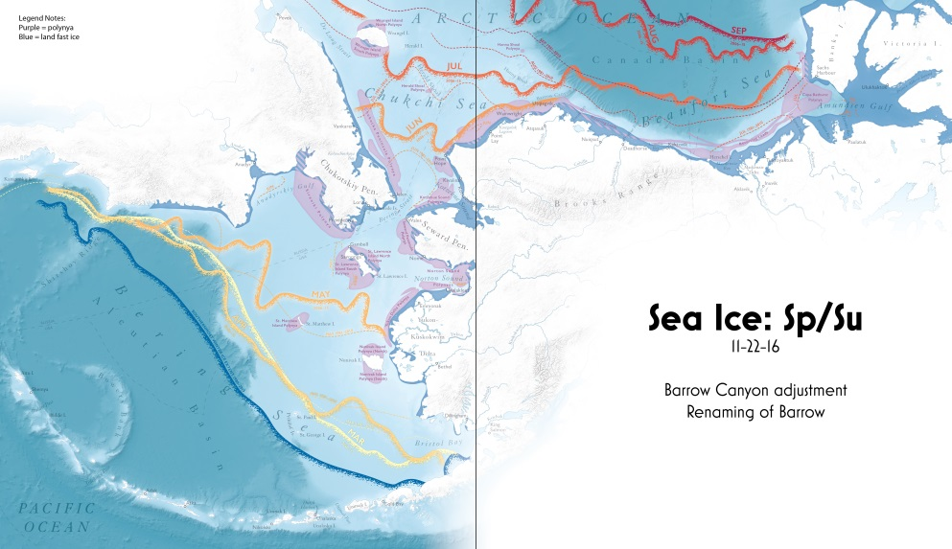
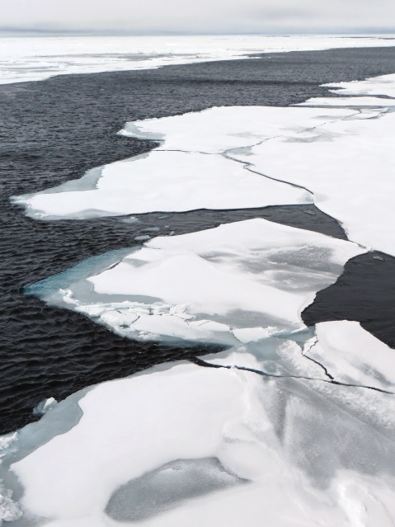
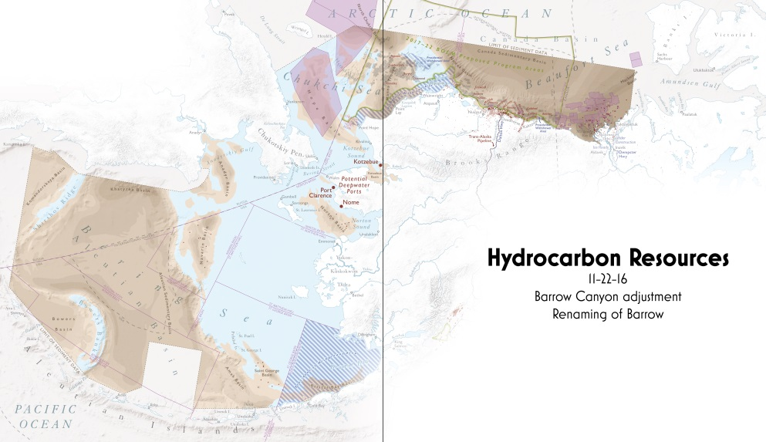
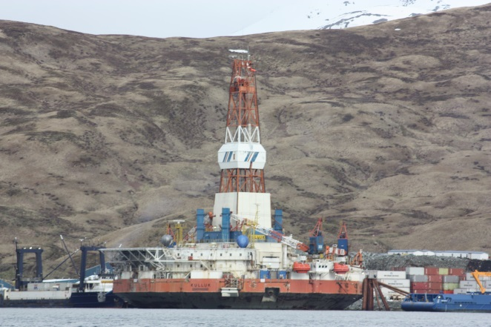
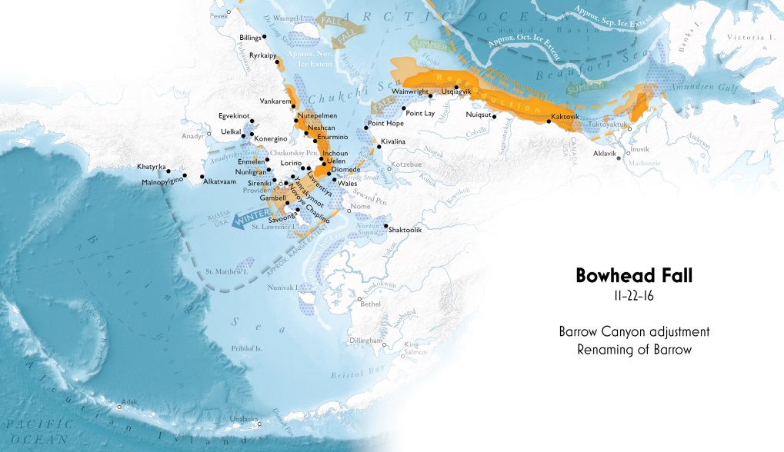
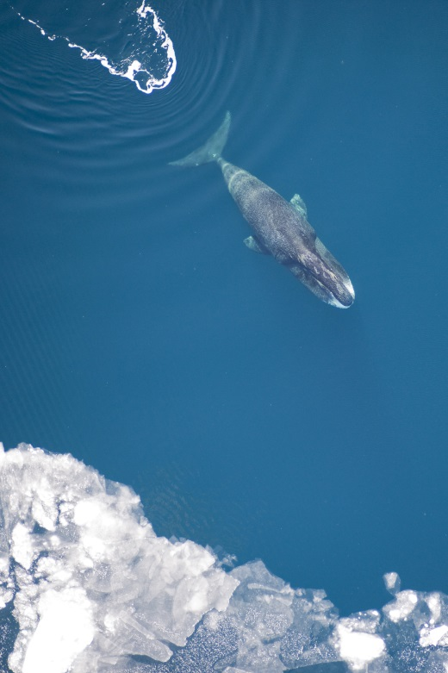
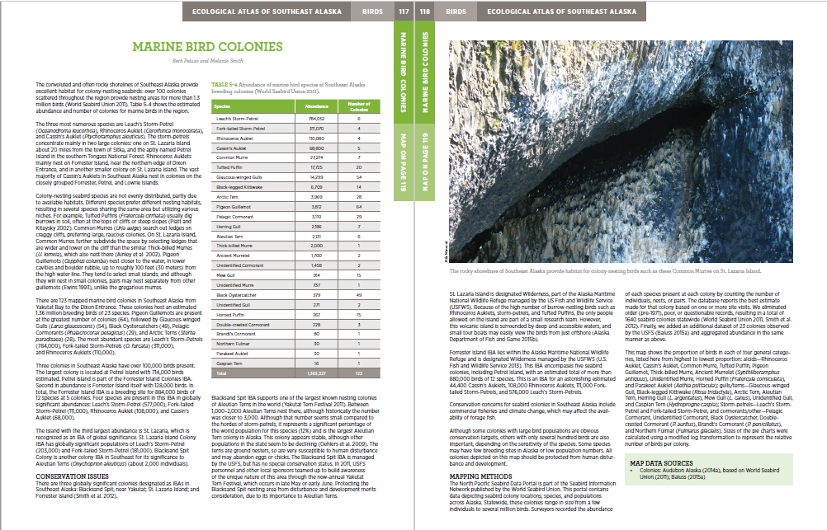
Bringing it all Together
Early 2017 review, mid-2017 publication

Slide 37
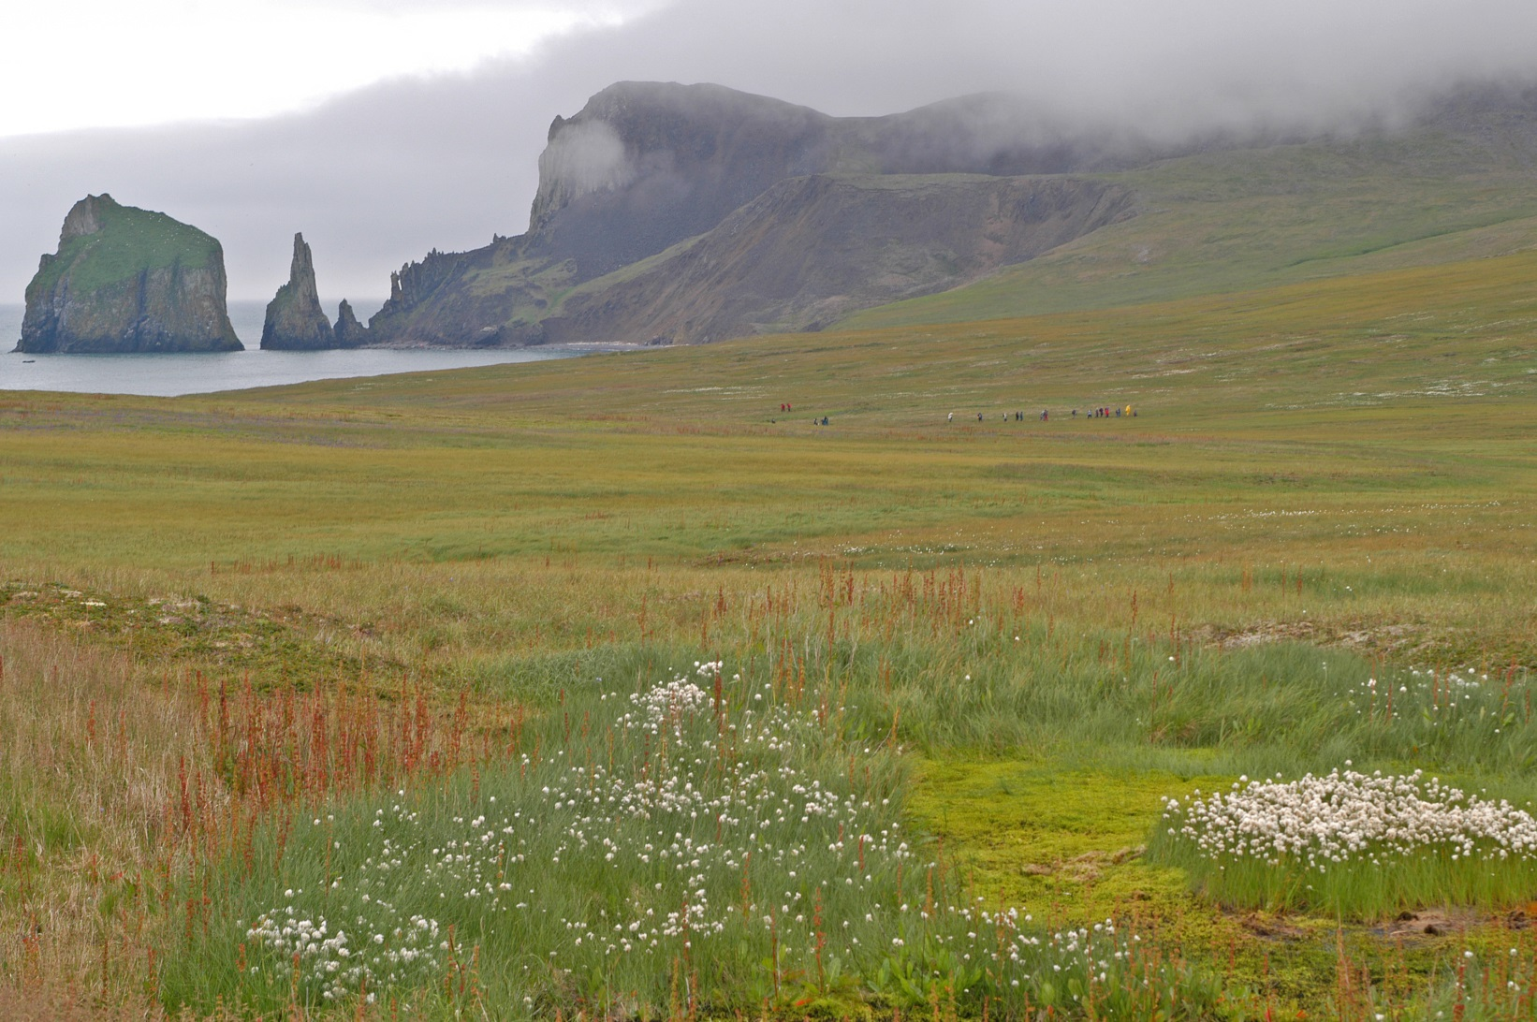
Bringing it all Together
Make data useful and accessible
A holistic picture for species and ecosystems
Inform planning and decisions
A resource for a wide range of users
image: Tim Sullivan

Slide 38
Building Better Bird Maps
The 2017 Ecological Atlas of the
Bering, Chukchi, and Beaufort Seas
Questions?
Melanie Smith, Max Goldman, Erika Knight, Daniel Huffman, and Ben Sullender
image: Milo Burcham

