Slide 1
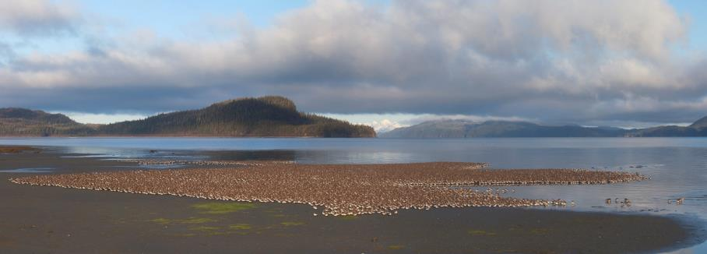
Identifying Important Bird Areas for Waterfowl in Terrestrial and Coastal Alaska Using Aerial Survey Data
Melanie Smith and Nathan Walker
Audubon Alaska
July 11, 2014
Photo Credit: Milo Burcham

Slide 2
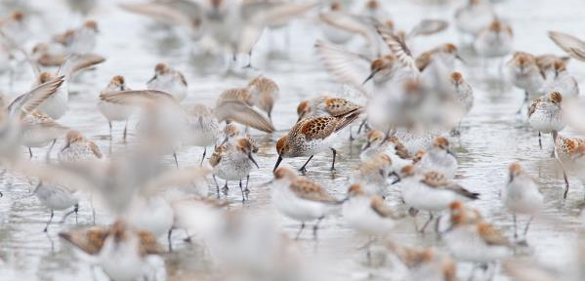

Important Bird Areas
Milo Burcham
Sites that provide essential habitat for breeding, wintering, or migrating birds
Public or Private
A few acres or thousands of acres
Usually discrete sites standing out from the landscape

Slide 3
Important Bird Areas
Milo Burcham
BirdLife International and National Audubon Society have abundance criteria which trigger IBA status
  Areas that regularly hold >1% of the global population, or >1% of the North American population

Slide 4
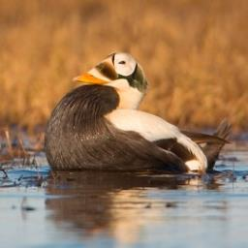
Important Bird Areas focus on:
Milo Burcham
Species of Conservation Concern
Restricted-range Species
Species in unique habitats
Species occurring in high densities

Slide 5
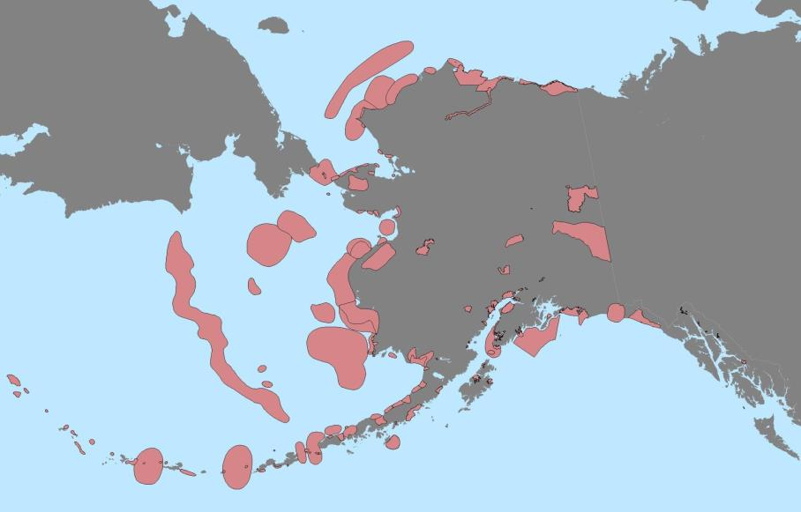
Important Bird Areas, 2009

Slide 6
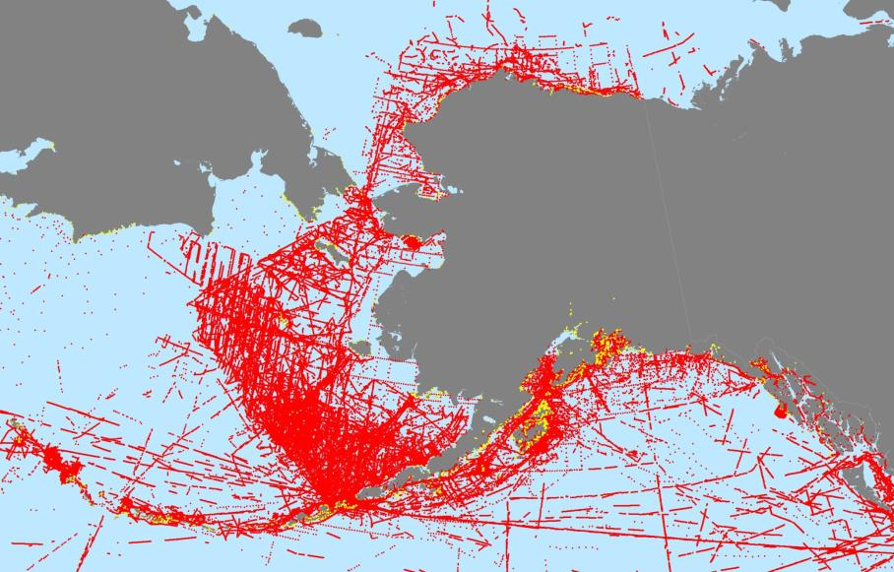
Red: North Pacific Pelagic Seabird Database
Yellow: Seabird Information Network Colony Catalog

Slide 7
Important Bird Areas, 2009

Slide 8
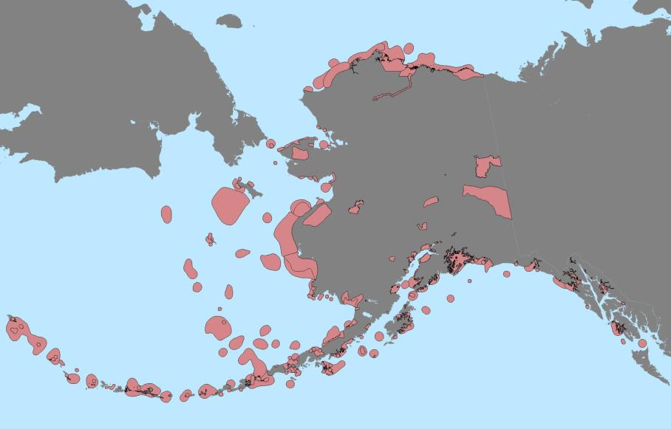
Important Bird Areas, 2013

Slide 9
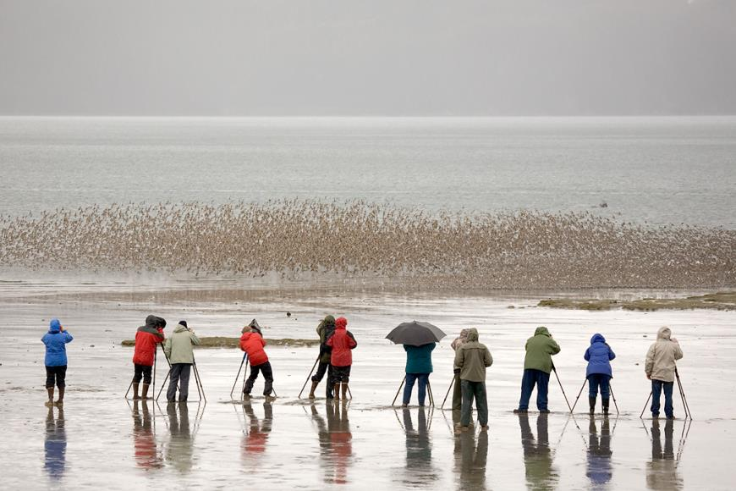
Survey Types
Photo Credit: Milo Burcham

Slide 10
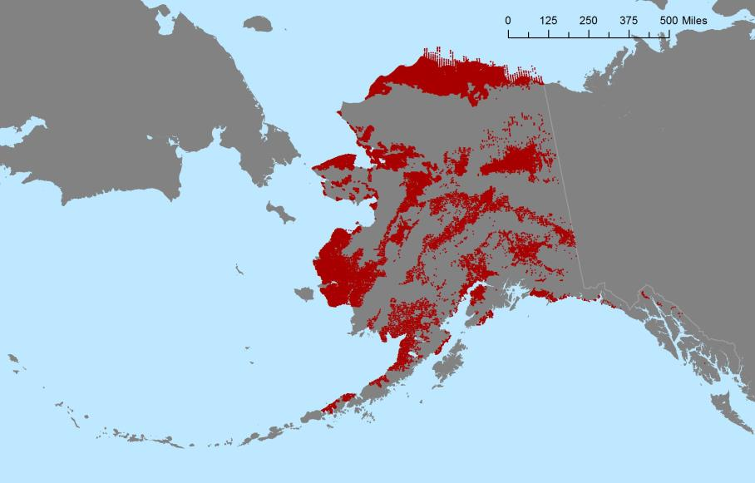
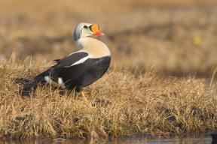
Red: Aerial Transect Point Data
Aerial waterbird surveys
Many years of overlapping data
Large survey extent
Known survey area boundaries
Photo Credit: Milo Burcham

Slide 11
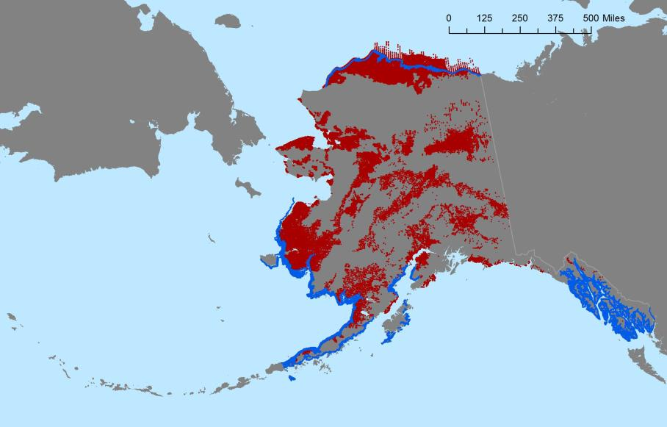
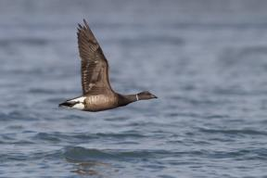
Blue: Shoreline Census Point Data
Aerial waterbird surveys
Many years of overlapping data
Large survey extent
Exact survey boundaries unknown
Photo Credit: Milo Burcham

Slide 12
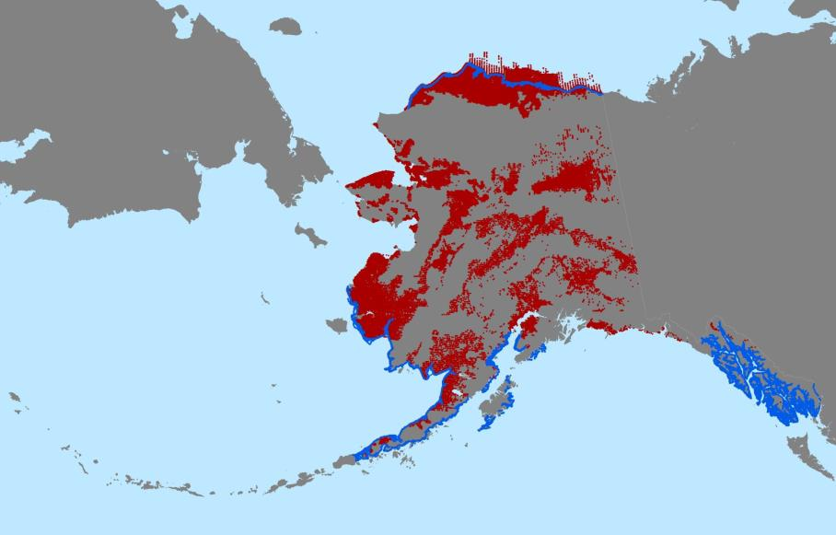
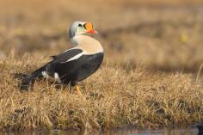

Transect and Shoreline Survey Point Data

Slide 13
List of Data Sources (Transects)
Alaska Expanded Aerial Waterfowl Survey | 1989-2008
Arctic Coastal Plain Breeding Pairs | 1992-2006
Arctic Coastal Plain Shorebird Surveys | 2010-2012
Arctic Coastal Plain Waterbird Surveys | 2007-2010
Arctic Coastal Plain Yellow-billed Loon Survey | 2003-2004
Beaufort Sea Nearshore/Offshore Surveys | 1999-2001
Black Scoter Population Aerial Survey | 2004-2008
Copper River Dusky Canada Goose Database | 1986-2008
National Park Service Shoreline Surveys | 2006-2013
North Slope Eider Surveys | 1992-2006
PRISM Shorebird Survey | 2002-2008
Seward Yellow-billed Loon Survey | 2005-2007
South-central Alaska Loon Surveys | 2001-2003
Southeast Alaska Nearshore Survey | 1997-2002
Alaska Trumpeter Swan Survey | 2005
Western Alaska Common Eider Surveys | 2006-2008
White Fronted Geese Breeding and Molting Aerial Survey | 1994-2012
Wrangell Aerial Waterfowl Surveys | 2007
Yukon Delta Coastal Zone Geese, Swan, and Crane Surveys | 1985-2008
Yukon Delta Coastal Zone Waterbird Surveys | 1988-2008

Slide 14
List of Data Sources (Shoreline Census)
Lower Cook Inlet Steller's Eider and Merganser Survey | 2004-2005
Arctic Coastal Plain Molting Sea Duck | 1998-2003
Kodiak Survey | 2001-2010
Southeast Alaska Survey | 1997-2002
Southwest Alaska Emperor Goose Survey | 1999-2011
Southwest Alaska Steller’s Eider Survey | 1997-2012

Slide 15
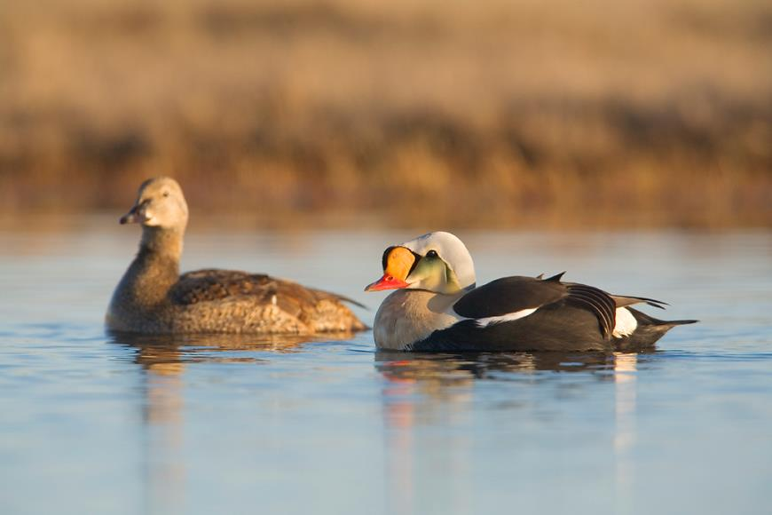
Analysis Methods
Photo Credit: Milo Burcham

Slide 16

Transect Point Data: Analysis

Slide 17

Transect Point Data (1994)

Slide 18
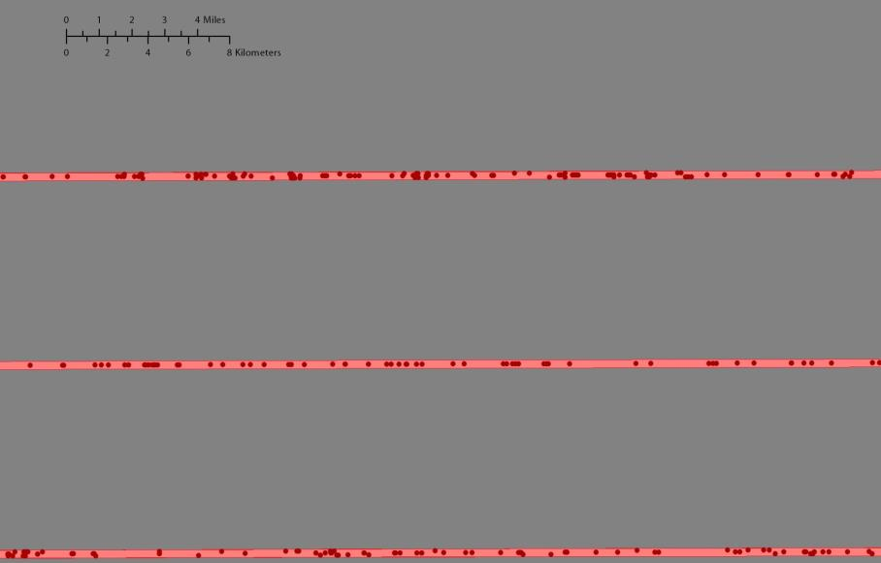
Transect Point Data (1994)

Slide 19
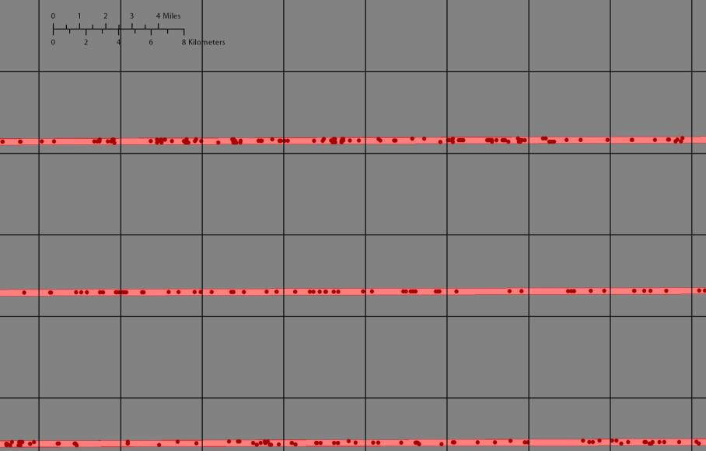
Transect Point Data (1994)

Slide 20
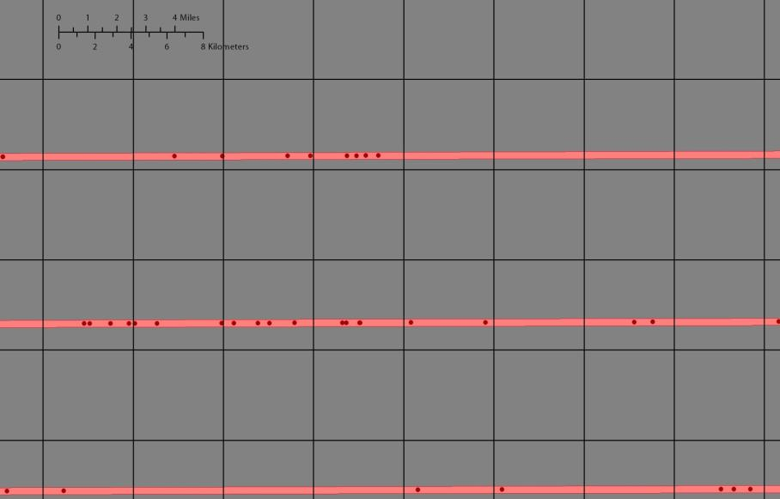
Transect Point Data (1994, Long-tailed Duck)
0
3
3
7
0
0
0
0
7
4
10
6
4
0
3
0
1
0
0
0
2
1
0
5

Slide 21
Transect Point Data (1994, Long-tailed Duck)
0
1.53
1.53
3.57
0
0
0
0
3.56
2.04
5.09
3.05
2.04
0
1.53
0
0.51
0
0
0
1.02
0.51
0
2.54

Slide 22
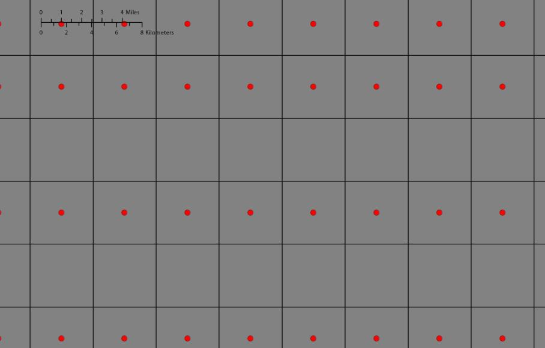
Transect Point Data (1994, Long-tailed Duck)
0
1.53
1.53
3.57
0
0
0
0
3.56
2.04
5.09
3.05
2.04
0
1.53
0
0.51
0
0
0
1.02
0.51
0
2.54

Slide 23
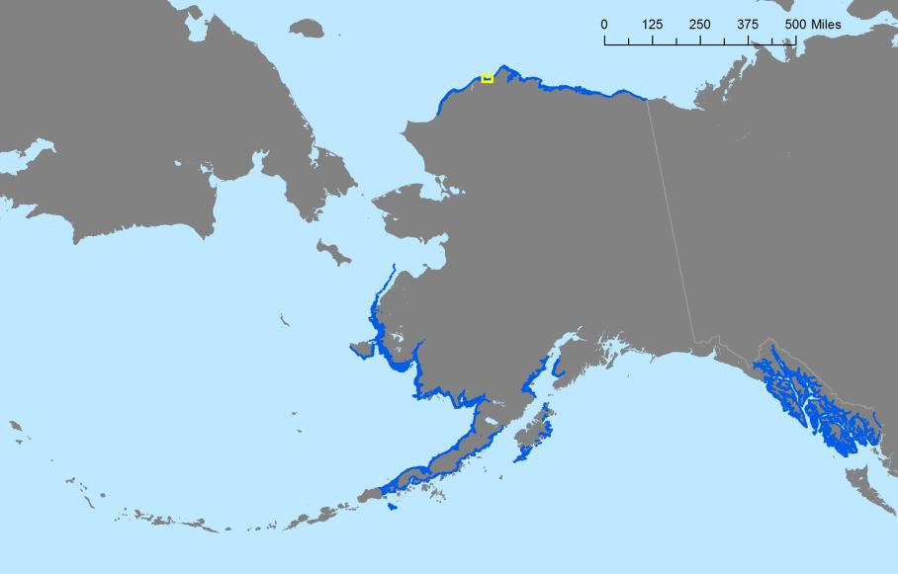
Shoreline Point Data: Analysis

Slide 24
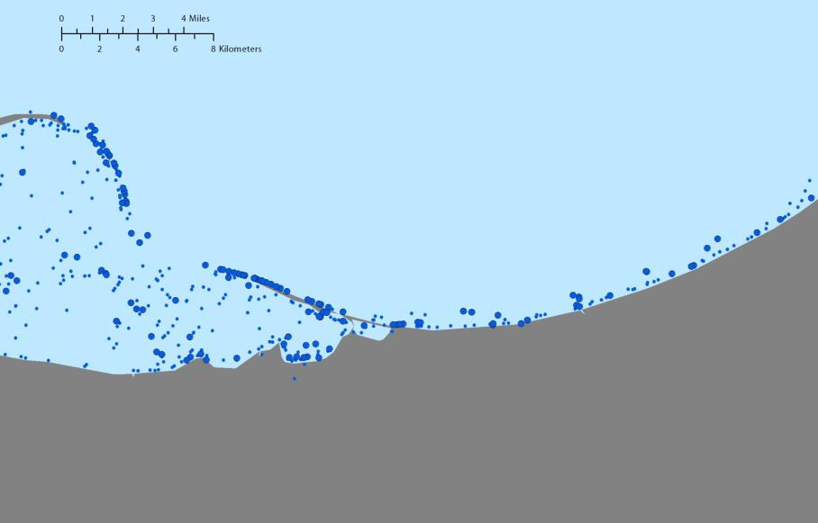
Shoreline Point Data (2002)

Slide 25
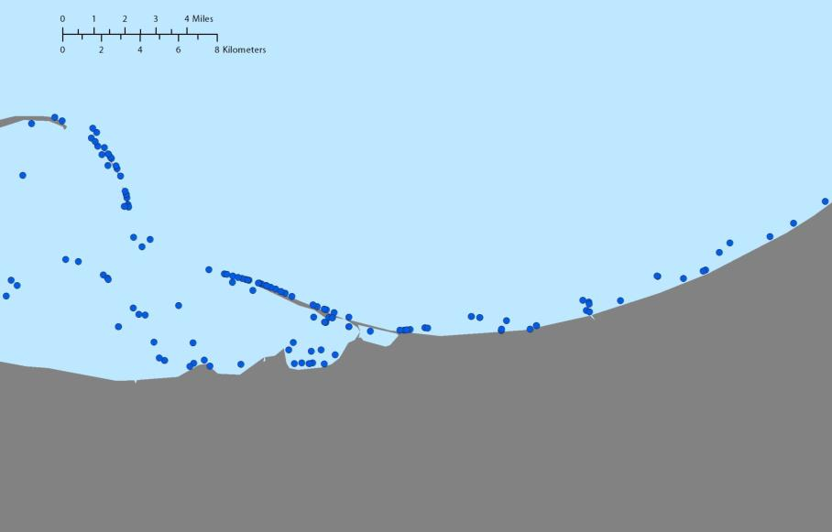
Shoreline Point Data (2002)

Slide 26
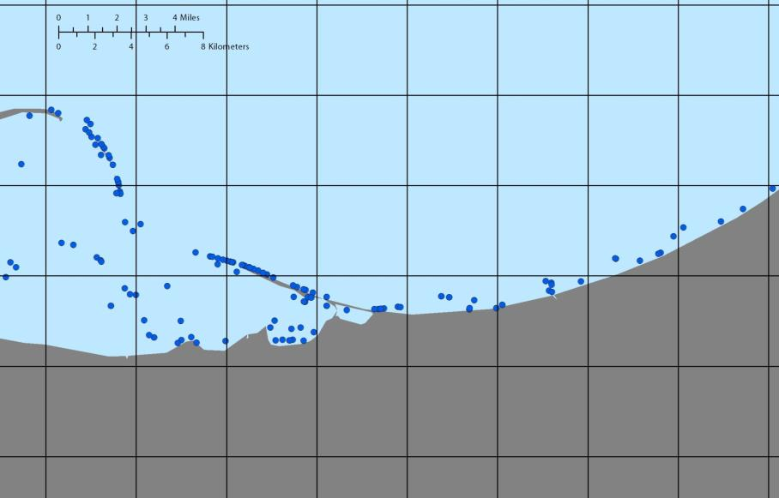
Shoreline Point Data (2002)

Slide 27
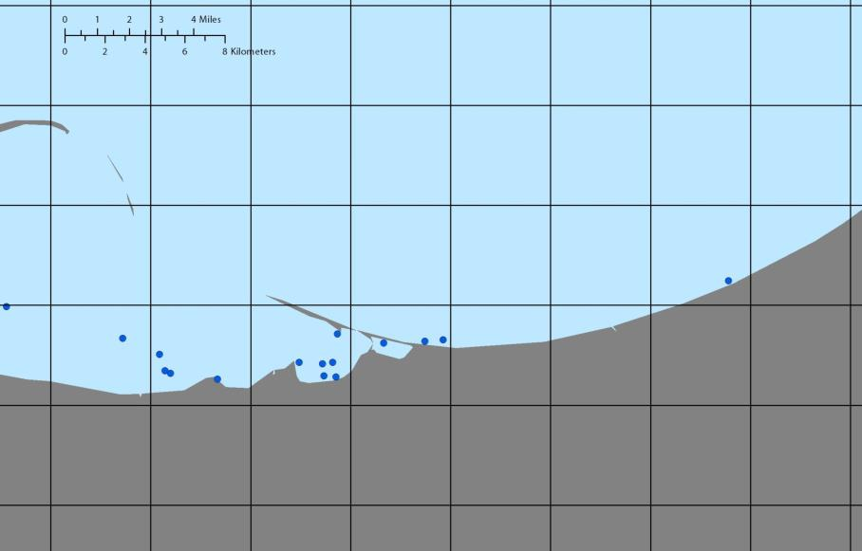
Shoreline Point Data (2002, Long-tailed Duck)
12
40
770
675
22

Slide 28
Shoreline Point Data (2002, Long-tailed Duck)
0
0
0
0
0.48
0
1.6
30.8
27
0.88
0
0

Slide 29

Shoreline Point Data (2002, Long-tailed Duck)
0
0
0
0
0.48
0
1.6
30.8
27
0.88
0
0

Slide 30
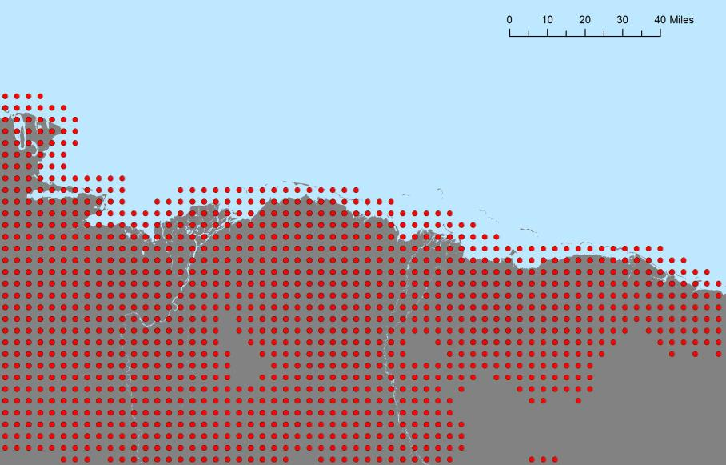
North Slope Interior Transect Data

Slide 31
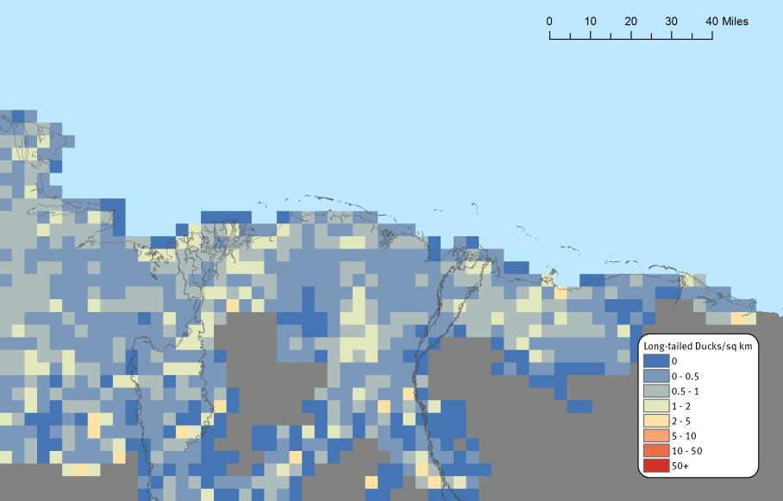
Long-tailed Duck Point to Raster (Interior)

Slide 32
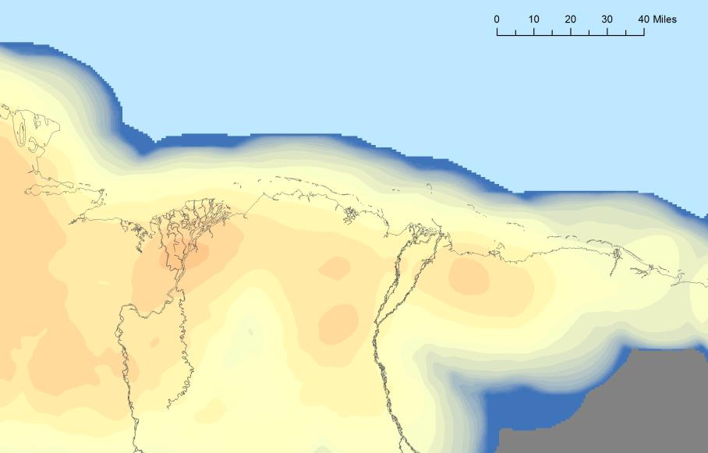
Long-tailed Duck Moving Window Analysis (Interior)

Slide 33
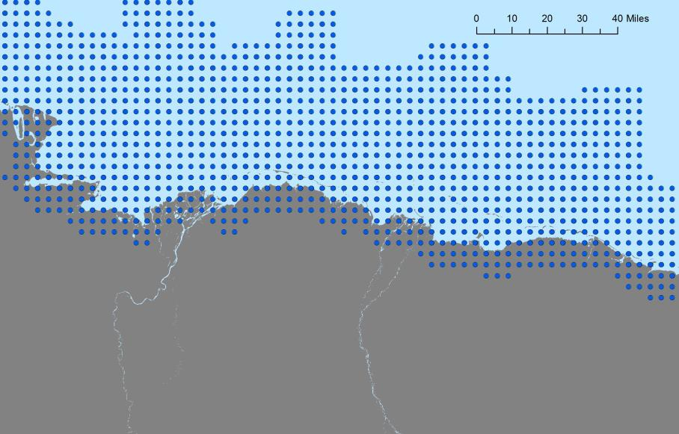
North Slope Coastal Survey Data

Slide 34
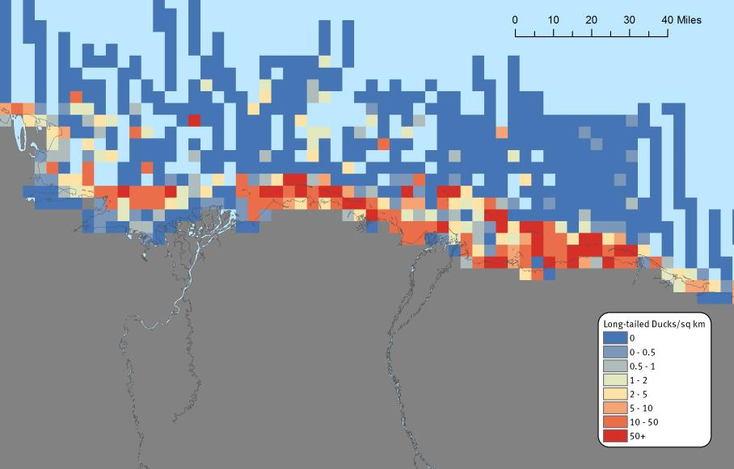
Long-tailed Duck Moving Window Analysis (Coastal)

Slide 35
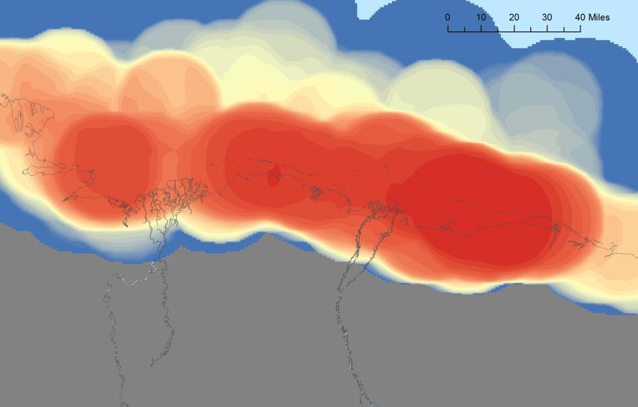
Long-tailed Duck Globally Significant Populations (Coastal)

Slide 36
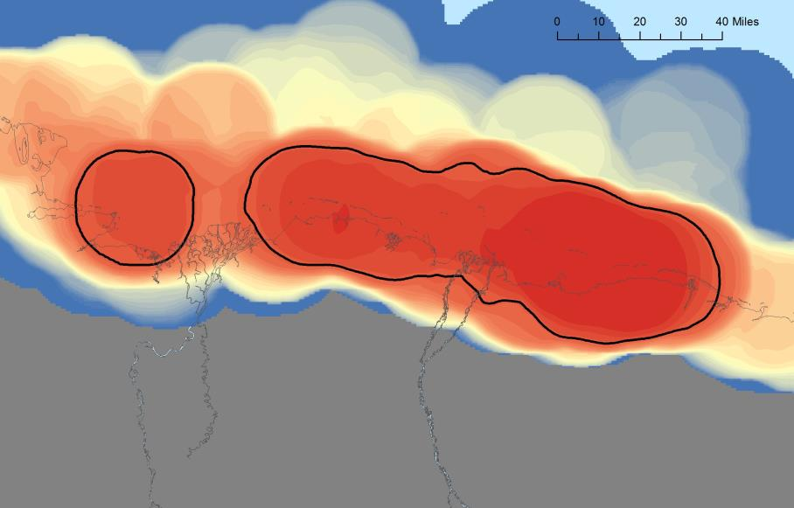
Long-tailed Duck Globally Significant Populations (Coastal)
14,468 Birds
148,853 Birds
>
10,000 Birds
>
10,000 Birds
Potential Global IBA
Potential Global IBA

Slide 37
Long-tailed Duck Globally Significant Populations (Coastal)

Slide 38
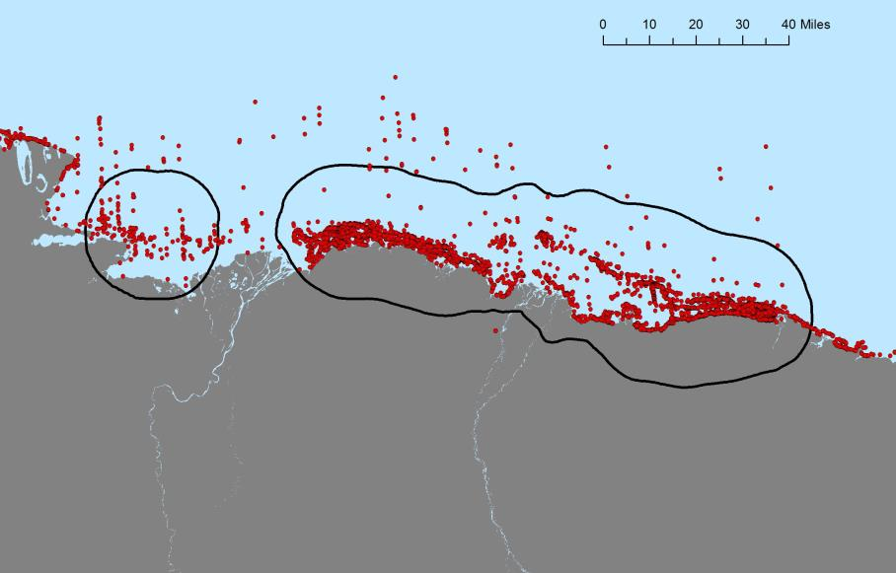
Long-tailed Duck Globally Significant Populations (Coastal)

Slide 39
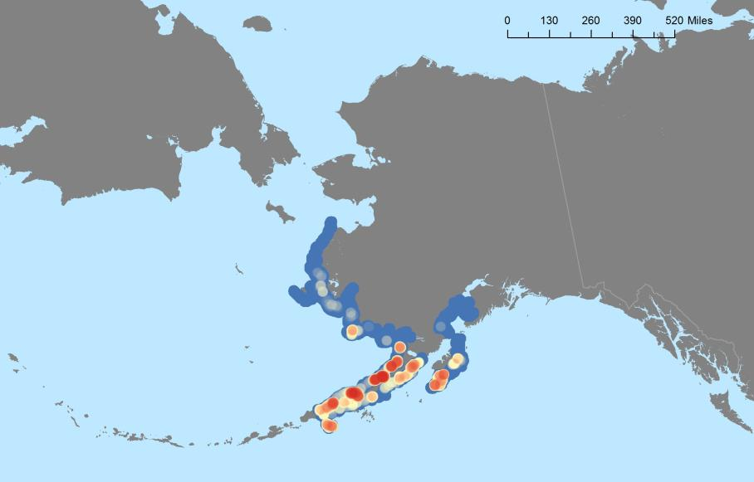
Alaskan Emperor Goose Analysis (Coastal, Spring)

Slide 40

Emperor Goose Globally Significant Populations (Coastal)

Slide 41
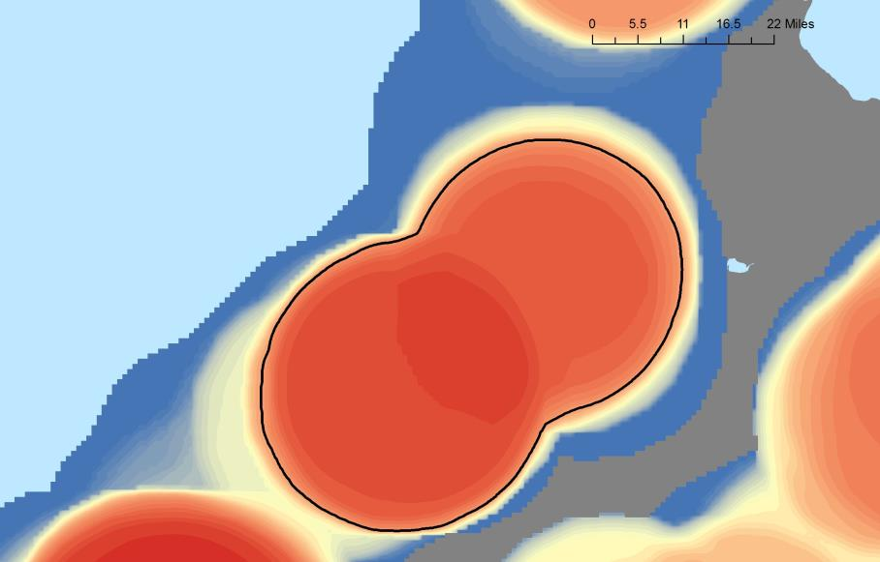
Emperor Goose Globally Significant Populations (Coastal)

Slide 42
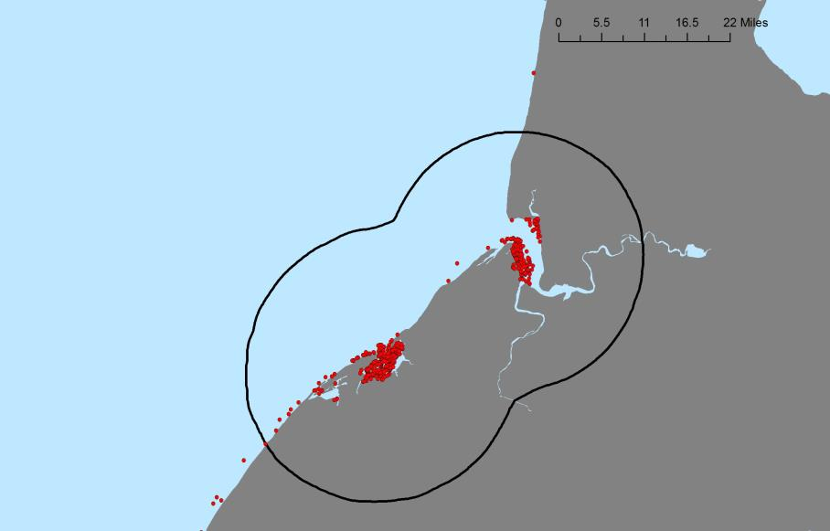
Emperor Goose Globally Significant Populations (Coastal)

Slide 43
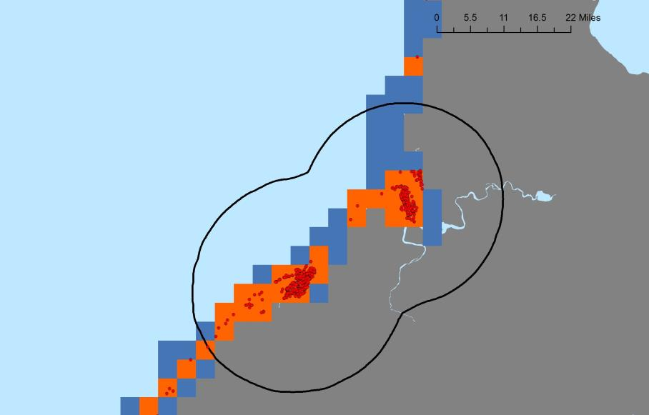
Emperor Goose Globally Significant Populations (Coastal)

Slide 44

Emperor Goose Globally Significant Populations (Coastal)

Slide 45

Emperor Goose Globally Significant Populations (Coastal)

Slide 46
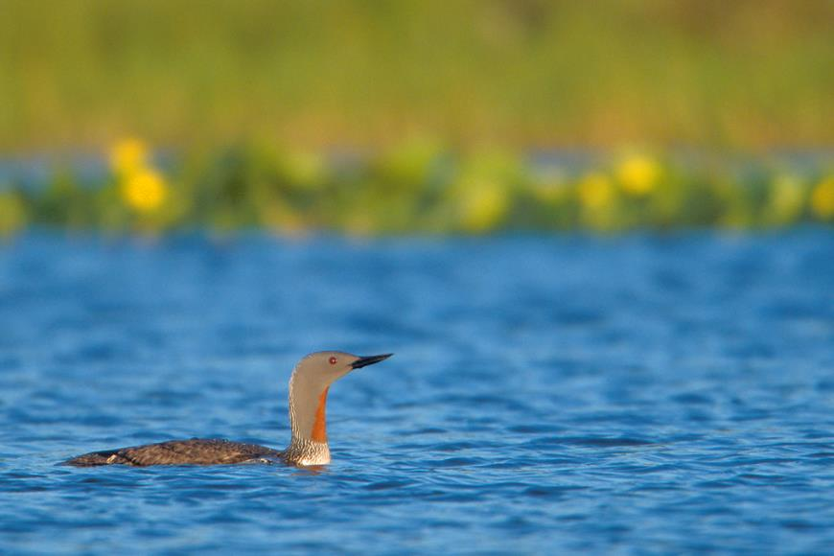
Results
Photo Credit: Milo Burcham

Slide 47
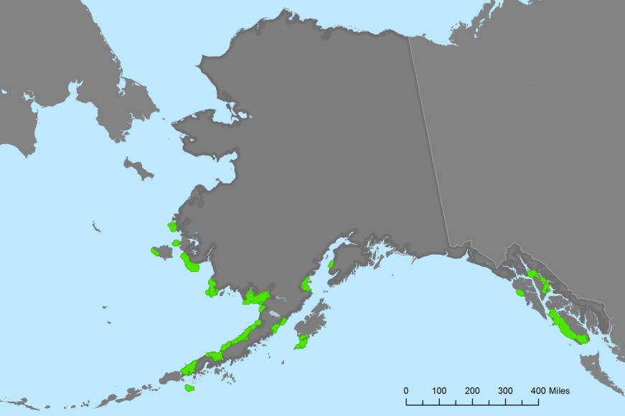
All Coastal IBAs (Spring)

Slide 48
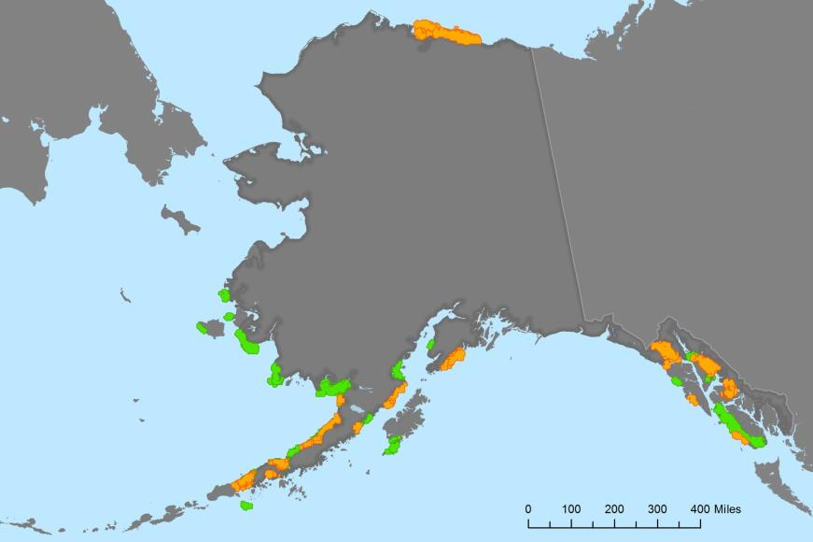
All Coastal IBAs (Fall)

Slide 49
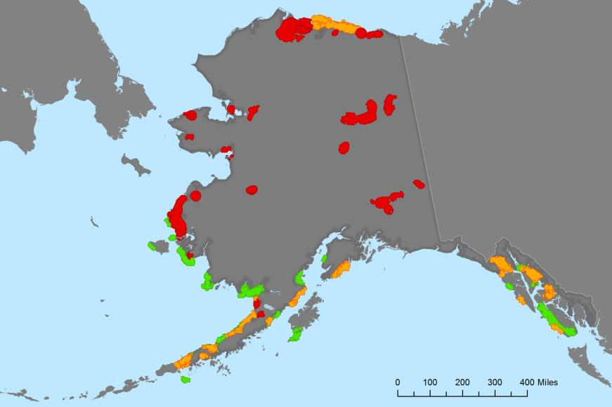
All Interior IBAs

Slide 50
Validation: Repeated Presence and Persistence
Validation:
>=10 high density observations
>=2 high density years

Slide 51
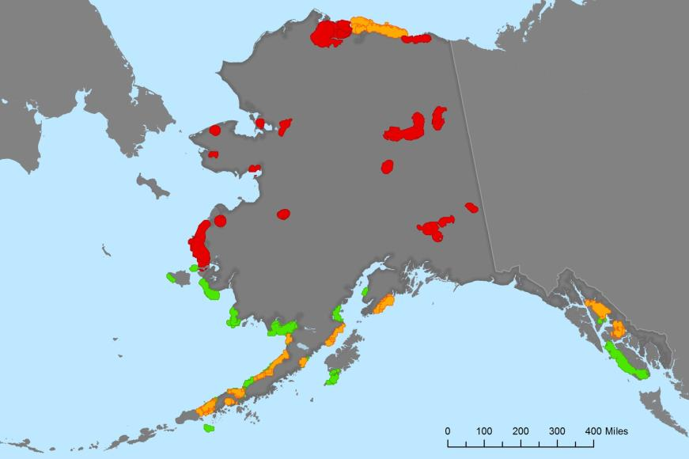
Validation: Repeated Presence and Persistence

Slide 52
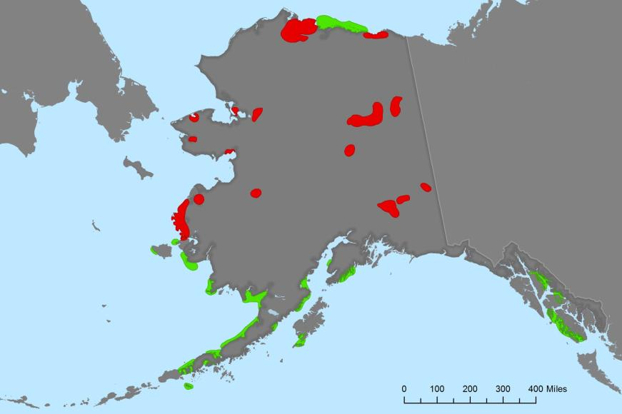
Final Interior/Coastal IBA Results

Slide 53
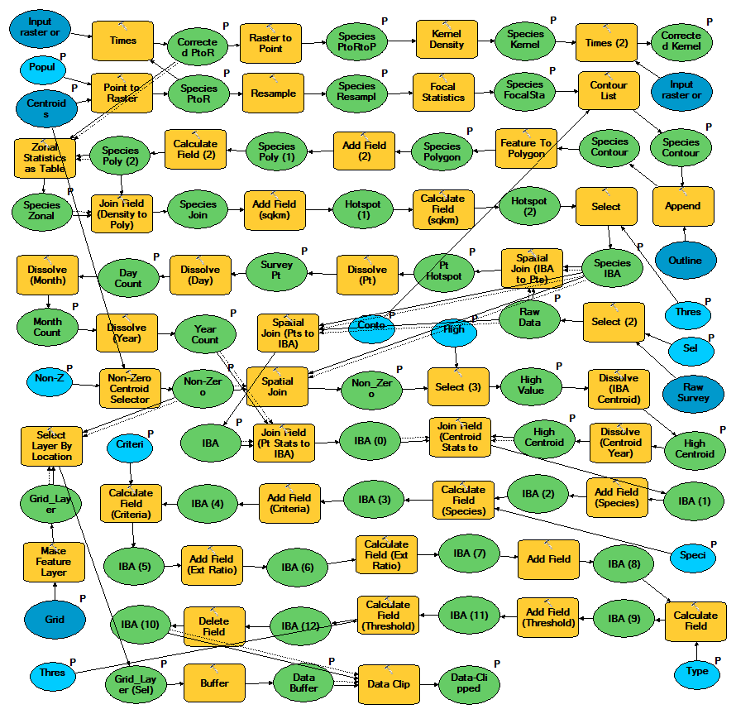
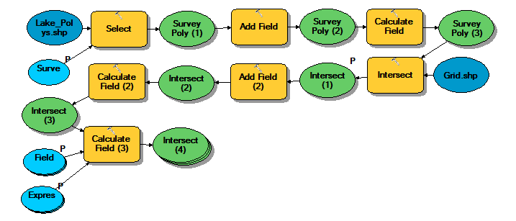
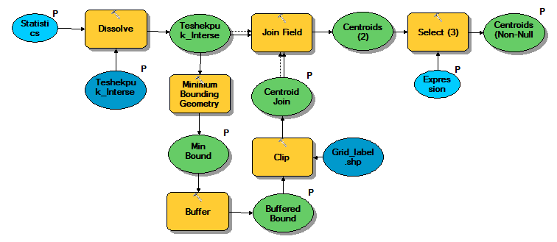
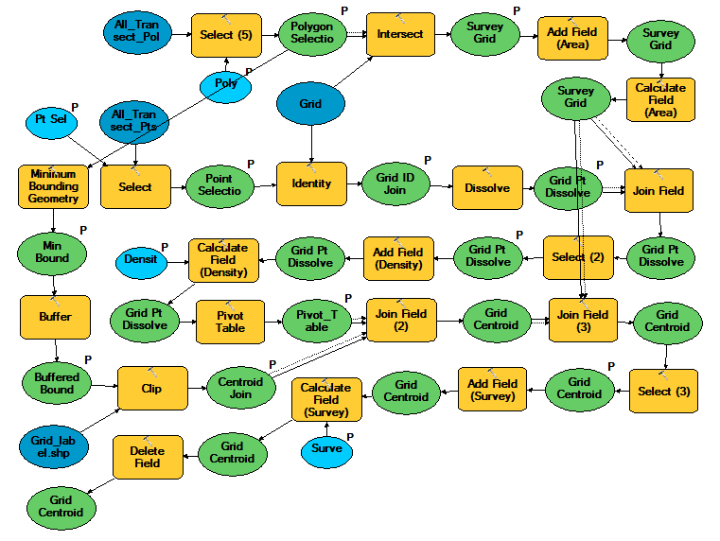
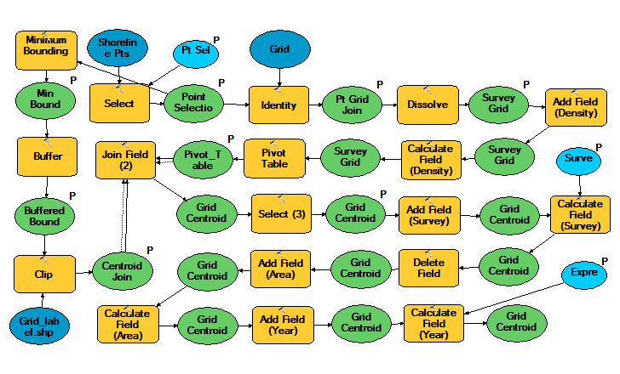
ModelBuilder

Slide 54
Final Interior/Coastal IBA Results

Slide 55
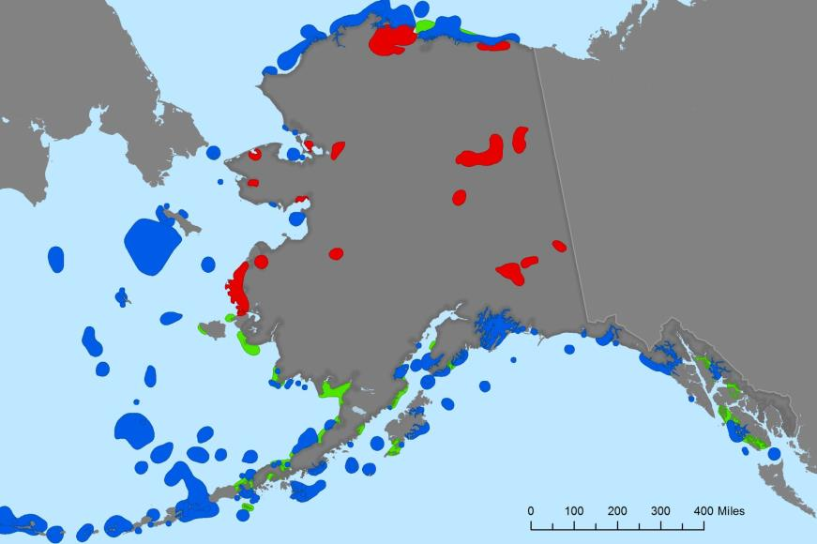
Interior, Coastal, and Marine IBAs

Slide 56
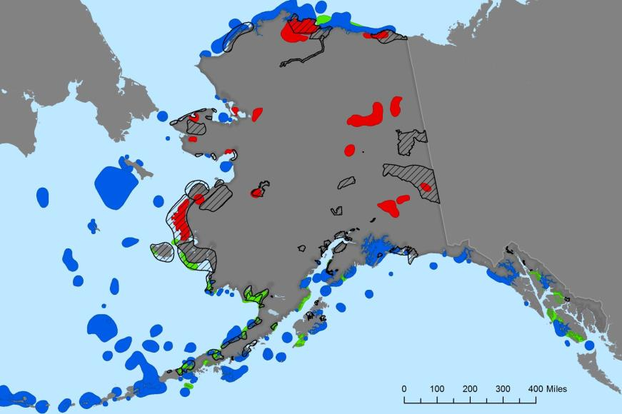
Interior, Coastal, Marine, and Existing IBAs

Slide 57
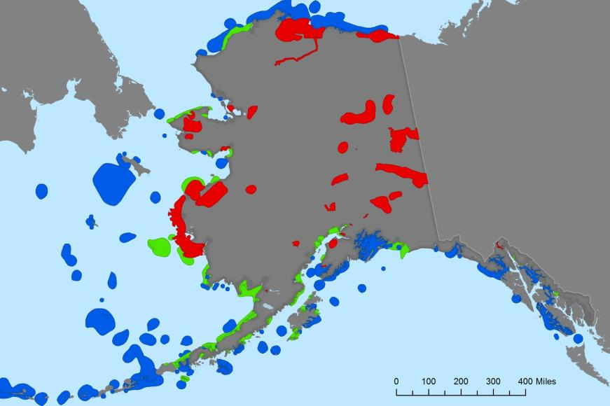
Final IBAs

Slide 58
Species Totals
Species | Global IBA Threshold | Coastal (Fall) | Coastal (Spring) | Interior (Breeding)
American Golden Plover | 2,000 | 0 | 0 | 15,124
Black-bellied Plover | 2,000 | 0 | 0 | 17,382
Baird's Sandpiper | 520 | 0 | 0 | 3,641
Black Brant | 2,960 | 93,306 | 52,877 | 20,788
Black Oystercatcher | 100 | 1,374 | 126 | 0
Black Scoter | 4,100 | 23,865 | 48,607 | 31,644
Emperor Goose | 742 | 58,938 | 47,655 | 15,855
Glaucous Gull | 7,190 | 28,378 | 14,594 | 82,653
Greater White-fronted Goose | 13,180 | 4,551 | 0 | 153,164
Glaucous-winged Gull | 5,700 | 165,651 | 4,788 | 2,614
King Eider | 5,500 | 62,881 | 258,069 | 5,345
Long-billed Dowitcher | 5,000 | 0 | 0 | 27,944
Long-tailed Duck | 10,000 | 189,086 | 22,653 | 23,503
Mew Gull | 3,000 | 5,503 | 4,291 | 27,347
Pelagic Cormorant | 460 | 7,916 | 3,762 | 0
Red-necked Grebe | 450 | 437 | 125 | 2,790
Red-throated Loon | 400 | 1,014 | 116 | 7,974
Stellar's Eider | 1,800 | 52,886 | 90,372 | 204
Surf Scoter | 4,000 | 48,104 | 9,165 | 4,343
Trumpeter Swan | 462 | 0 | 0 | 6,831
Tundra Swan | 2,032 | 203 | 0 | 48,670
White-winged Scoter | 1,900 | 32,541 | 15,364 | 35,407
Yellow-billed Loon | 160 | 354 | 0 | 1,903
Total |  | 1,125,307 | 793,576 | 732,470

Slide 59
Percent of Estimated North American Population
Species | Global IBA Threshold | Coastal (Fall) | Coastal (Spring) | Interior (Breeding)
American Golden Plover | 2,000 |  |  | 7.6
Black-bellied Plover | 2,000 |  |  | 8.7
Baird's Sandpiper | 520 |  |  | 7.0
Black Brant | 2,960 | 31.5 | 17.9 | 7.0
Black Oystercatcher | 100 | 13.7 | 1.3
Black Scoter | 4,100 | 5.8 | 11.9 | 7.7
Emperor Goose | 742 | 79.4 | 64.2 | 21.4
Glaucous Gull | 7,190 | 4.0 | 2.0 | 11.5
Greater White-fronted Goose | 13,180 | 0.4 |  | 11.6
Glaucous-winged Gull | 5,700 | 29.1 | 0.8 | 0.5
King Eider | 5,500 | 11.4 | 46.9 | 1.0
Long-billed Dowitcher | 5,000 |  |  | 5.6
Long-tailed Duck | 10,000 | 18.9 | 2.3 | 2.4
Mew Gull | 3,000 | 1.8 | 1.4 | 9.1
Pelagic Cormorant | 460 | 17.2 | 8.2
Red-necked Grebe | 450 | 1.0 | 0.3 | 6.2
Red-throated Loon | 400 | 2.5 | 0.3 | 19.9
Stellar's Eider | 1,800 | 29.4 | 50.2 | 0.1
Surf Scoter | 4,000 | 12.0 | 2.3 | 1.1
Trumpeter Swan | 462 |  |  | 14.8
Tundra Swan | 2,032 | 0.1 |  | 24.0
White-winged Scoter | 1,900 | 17.1 | 8.1 | 18.6
Yellow-billed Loon | 160 | 2.2 |  | 11.9

Slide 60
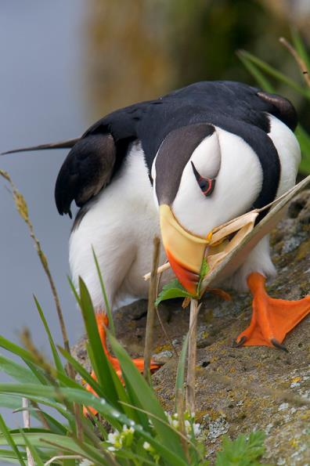
A Closer Look
Photo Credit: Milo Burcham

Slide 61

Questions?
Melanie Smith and Nathan Walker
Audubon Alaska
July 11, 2014
Photo Credit: Milo Burcham

