Slide 1
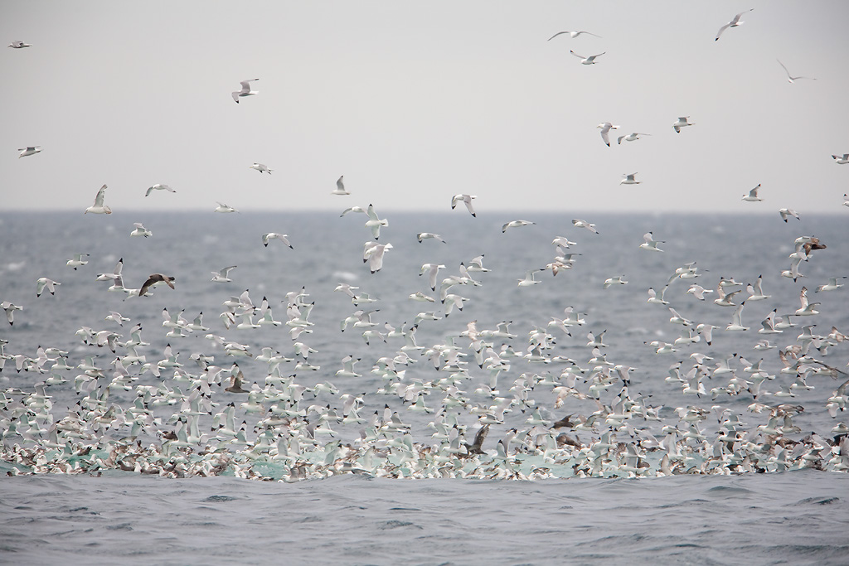
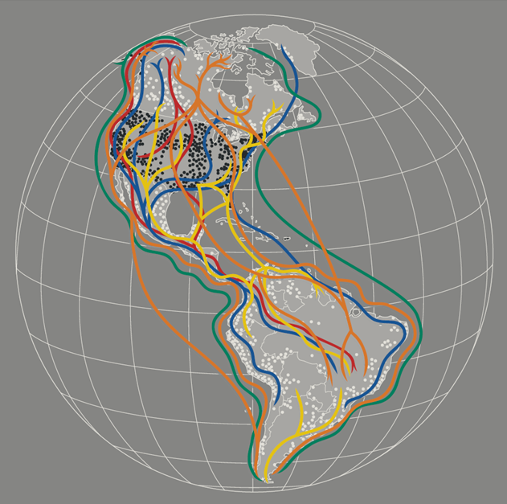
Data to Design: Identifying Important Bird Areas and Seabird Connectivity in the Alaskan Arctic
Melanie Smith, Audubon Alaska
image: Milo Burcham

Slide 2
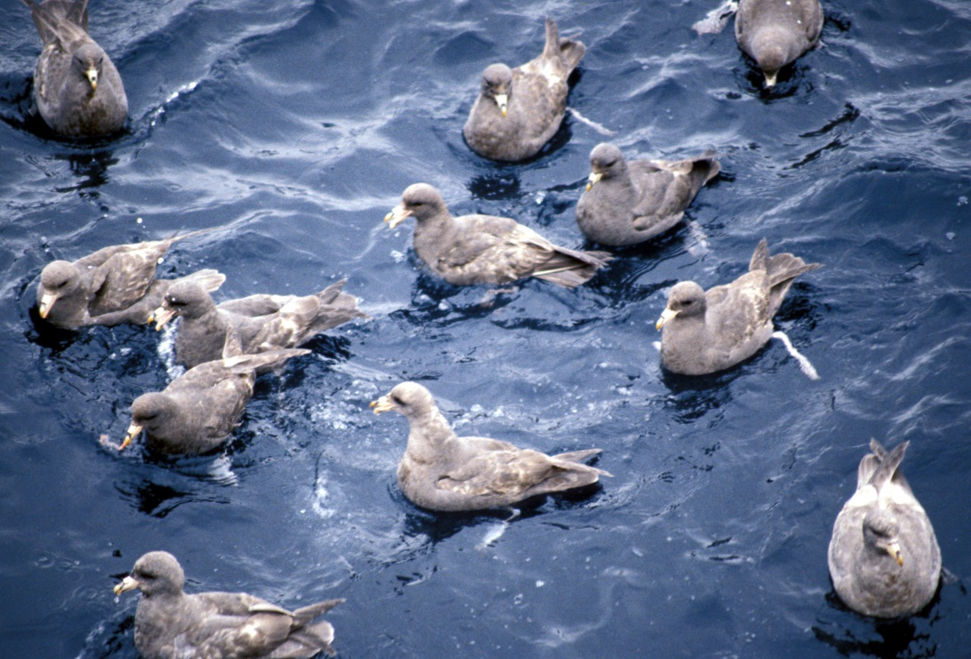
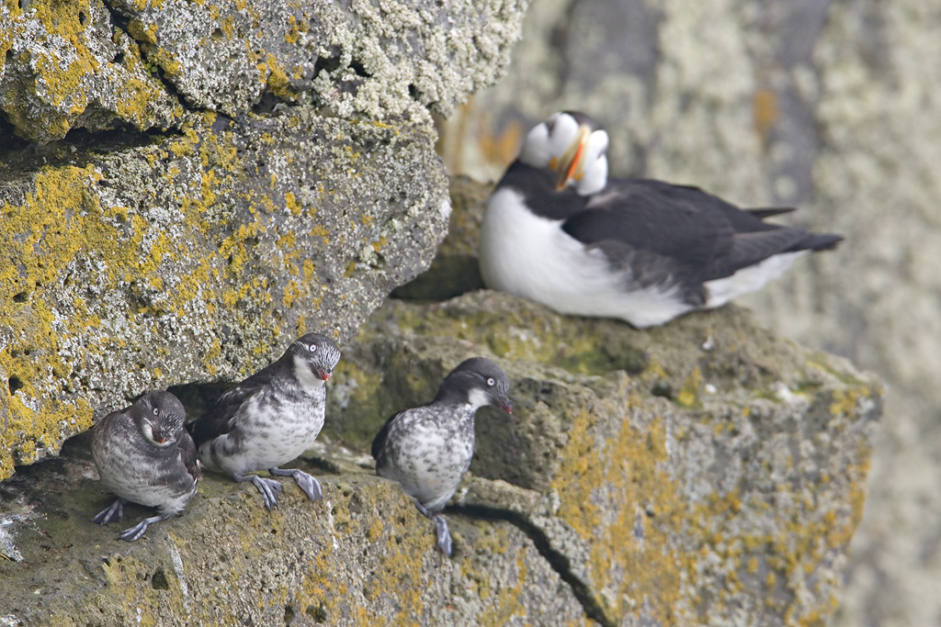
image: Milo Burcham
Overview
  Process from data to designing Important Bird Areas (IBAs)
  Three main analyses for seabird data
  Challenges related to connectivity

Slide 3
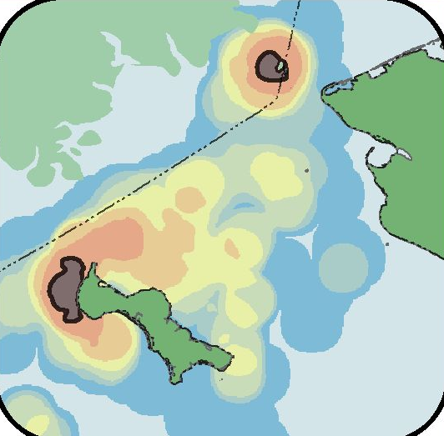
Data to Design
Data Gathering
Identify available data
Acquire and organize
Data Synthesis
Spatial analysis
Draw area boundaries
Conservation Design
Composite maps
Connectivity

Slide 4
Data to Design
Data Gathering
Identify available data
Acquire and organize
Data Synthesis
Spatial analysis
Draw area boundaries
Conservation Design
Composite maps
Connectivity

Slide 5

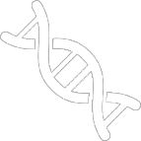
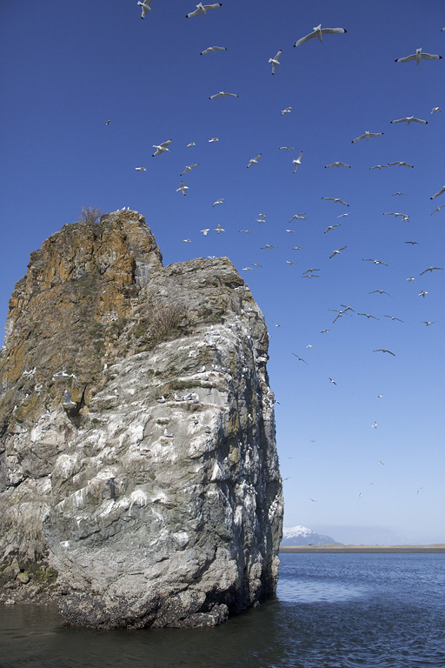
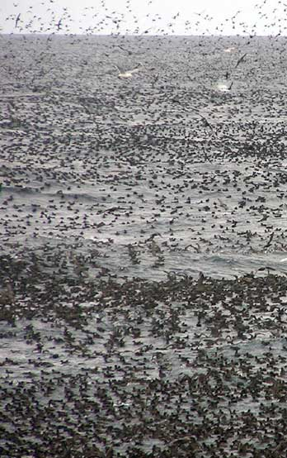
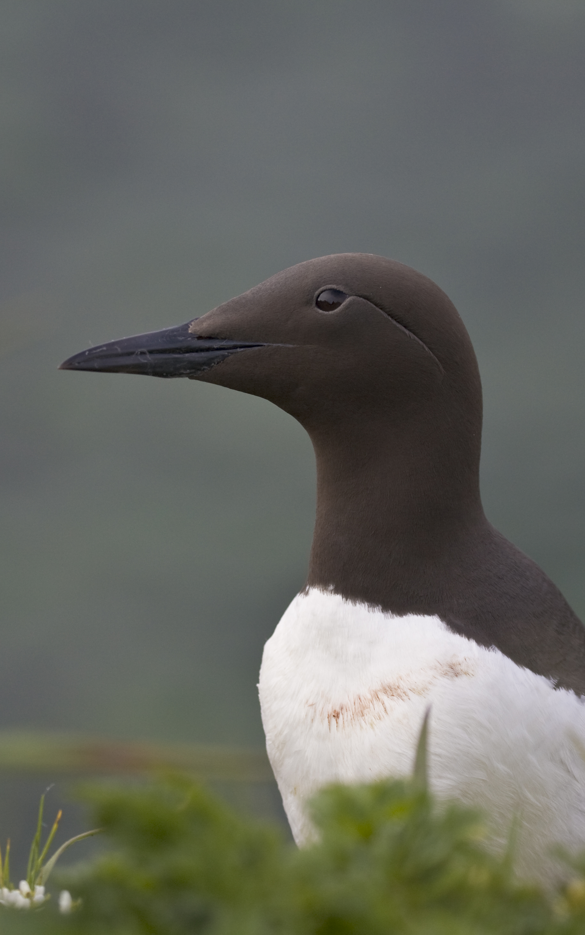
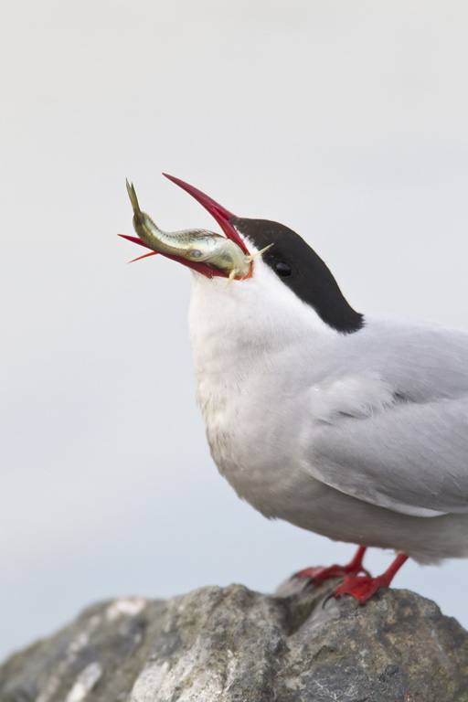

Identify Available Data
:)
Colony
Census count
Survey Transects
Ship-based
Aerial
Telemetry
PTT
GPS
Geolocator
Expert
Ecological, local, traditional knowledge
Genetic
Genetic markers
Isotopes
images: Milo
Burcham, USFWS

Slide 6
Connecting the Annual Cycle
 | Colony | Survey | Tracking
Breeding | x | x | x
Foraging | x | x | x
Staging |  | x | x
Molting |  | x | x
Wintering |  | x | x
Important Bird Areas =
1% or more of global or biogeographic population OR
Congregation of species of special concern

Slide 7
Data to Design
Data Gathering
Identify available data
Acquire and organize
Data Synthesis
Spatial analysis
Draw area boundaries
Conservation Design
Composite maps
Connectivity

Slide 8
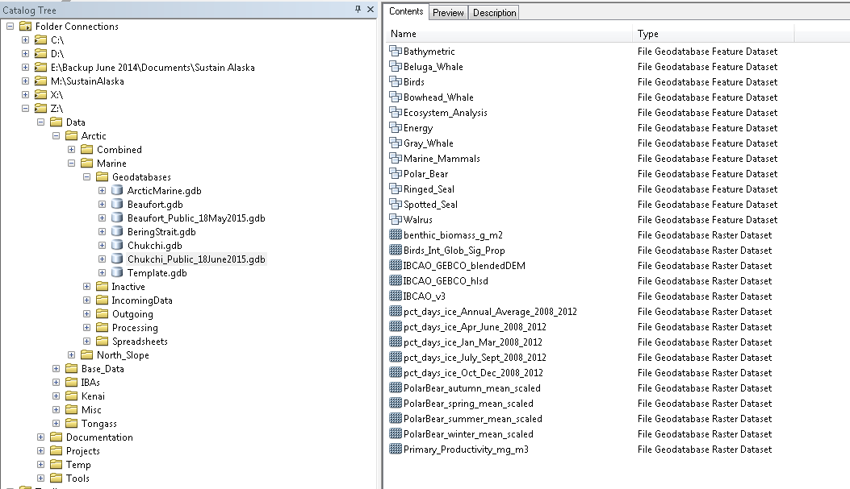
Acquire and Organize
Bird Friendly Communities
  In the Audubon Network there are many innovative programs.
  In Chicago alone, where the first Lights Out program originated, researchers estimate that the initiative saves the lives of more than 10,000 migratory land birds each year.
  Challenge is to develop a cohesive strategy that is compelling and fundable.
Survey Transect
Telemetry
Colony

Slide 9
Data to Design
Data Gathering
Identify available data
Acquire and organize
Data Synthesis
Spatial analysis
Draw area boundaries
Conservation Design
Composite maps
Connectivity
Analytical approaches
Foraging radius
Survey data
Tracking data

Slide 10
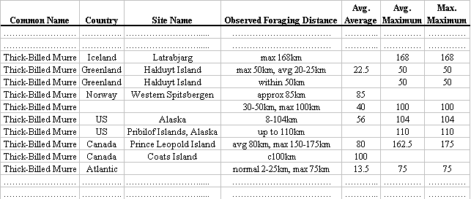
Spatial Analysis
Foraging Radius Approach
Soanes et al. 2016, Biological Conservation

Slide 11
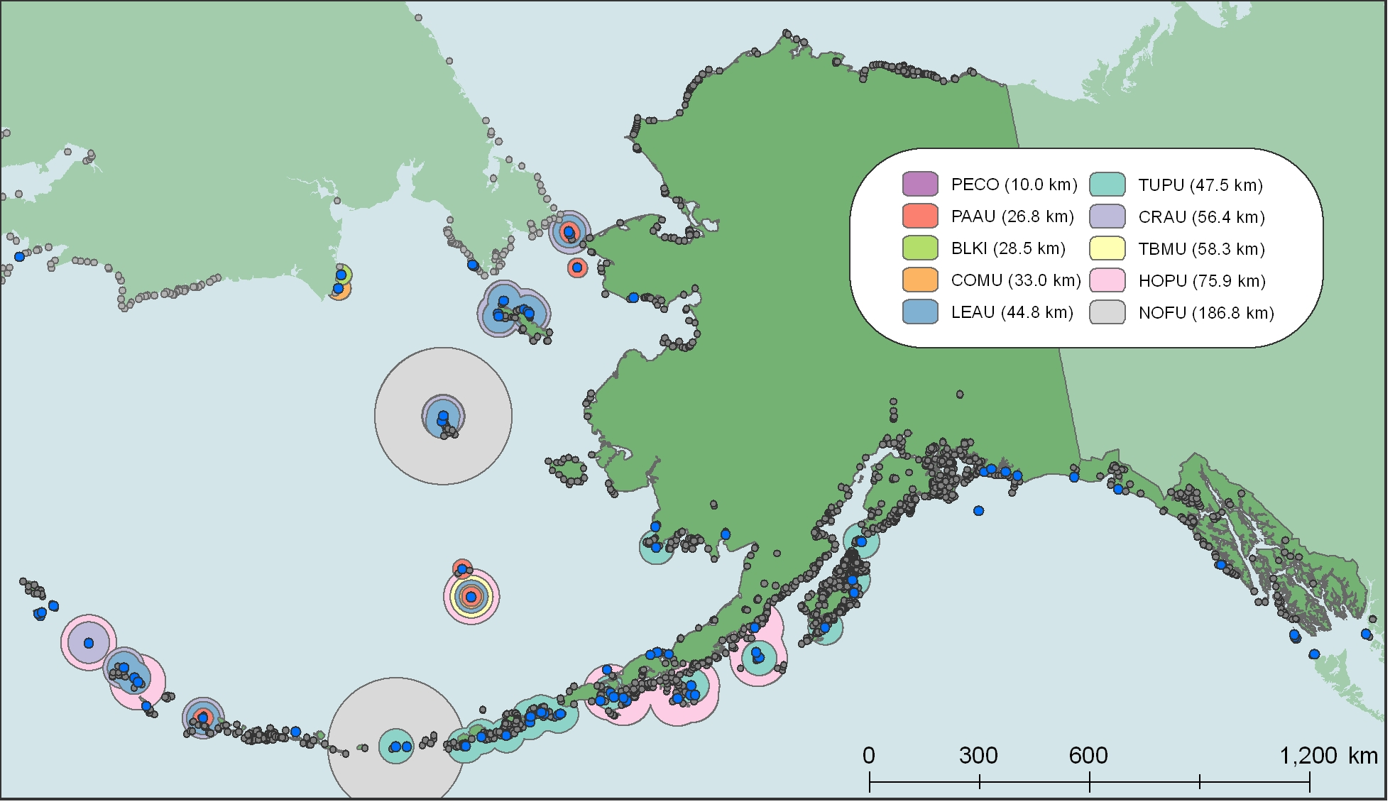
Spatial Analysis
COLONY FORAGING DISTANCE BUFFERS
The average foraging radius for all seabird species listed in the BLI database

Slide 12
Data to Design
Data Gathering
Identify available data
Acquire and organize
Data Synthesis
Spatial analysis
Draw area boundaries
Conservation Design
Composite maps
Connectivity
Analytical approaches
Foraging radius
Survey data
Tracking data

Slide 13
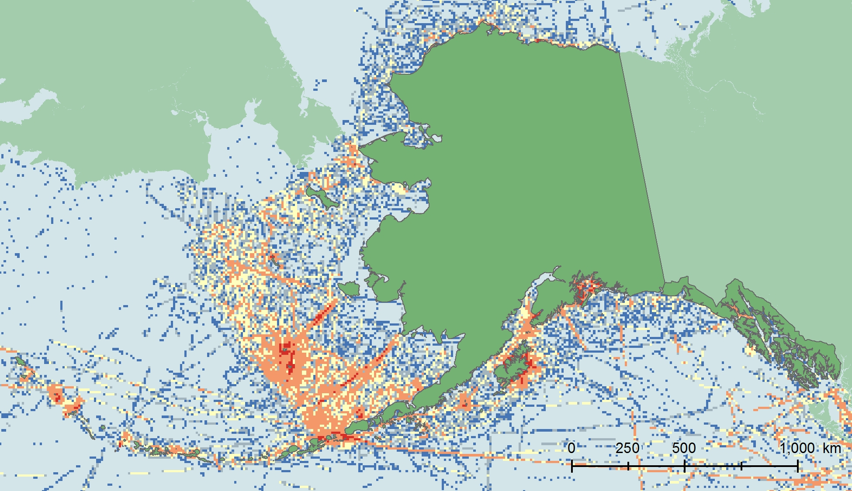

Spatial Analysis
Survey Data Approach
Smith et al. 2014, Biological Conservation

Slide 14
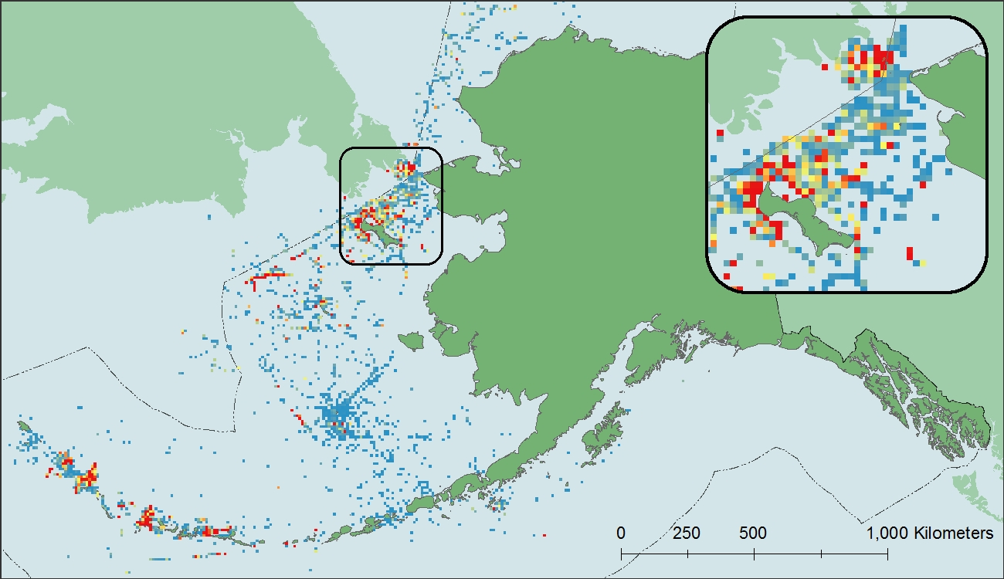
Spatial Analysis
PRESENCE
The distribution of Crested Auklet data

Slide 15
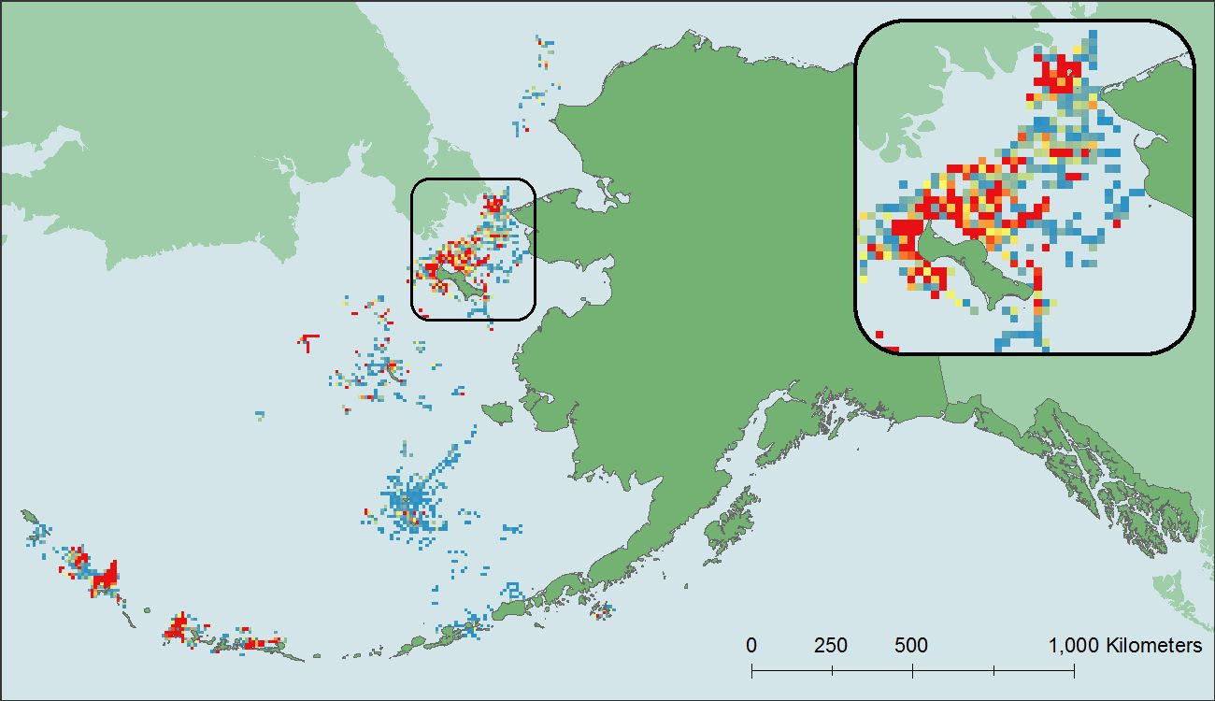
Spatial Analysis
PERSISTENT, ADJACENT
Data that will be used for hotspot analysis of Crested Auklets

Slide 16
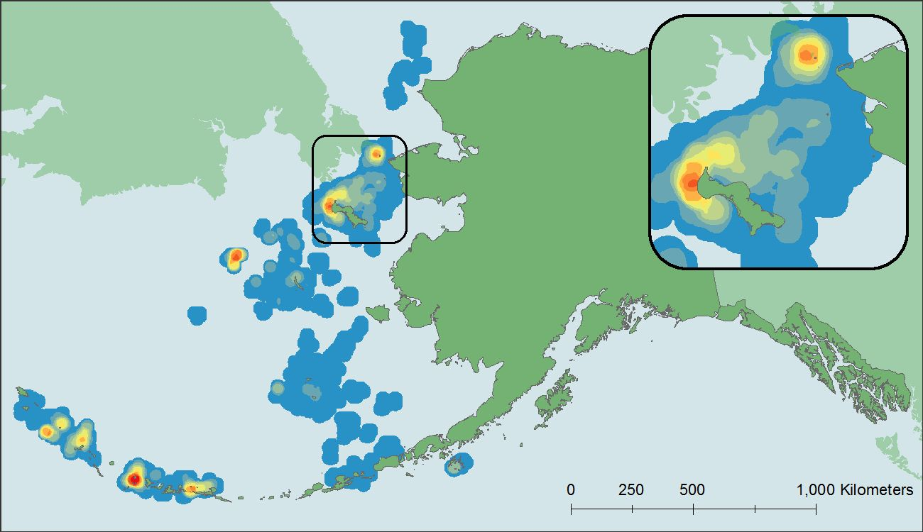
Spatial Analysis
ANALYZE LOCAL ABUNDANCE
Results of the hotspot analysis for Crested Auklet

Slide 17
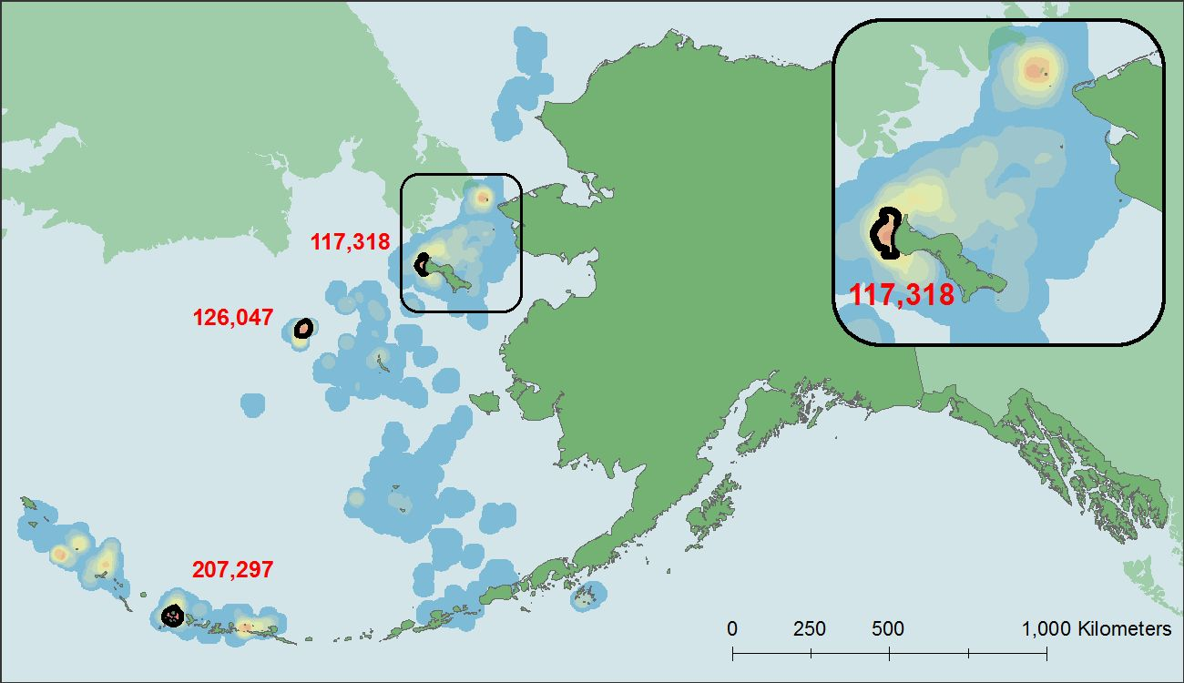
Spatial Analysis
VALIDATE IBAs
Adequate abundance, repeated high use, multi-year persistence

Slide 18
Data to Design
Data Gathering
Identify available data
Acquire and organize
Data Synthesis
Spatial analysis
Draw area boundaries
Conservation Design
Composite maps
Connectivity
Analytical approaches
Foraging radius
Survey data
Tracking data

Slide 19
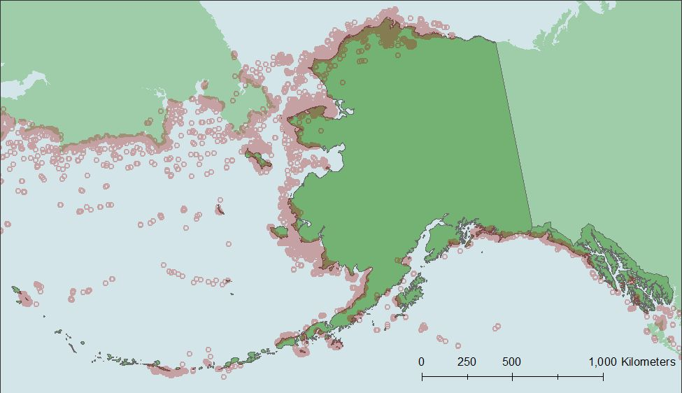
Spatial Analysis
Tracking Data Approach
Lascelles et al. 2016, Diversity and Distributions

Slide 20
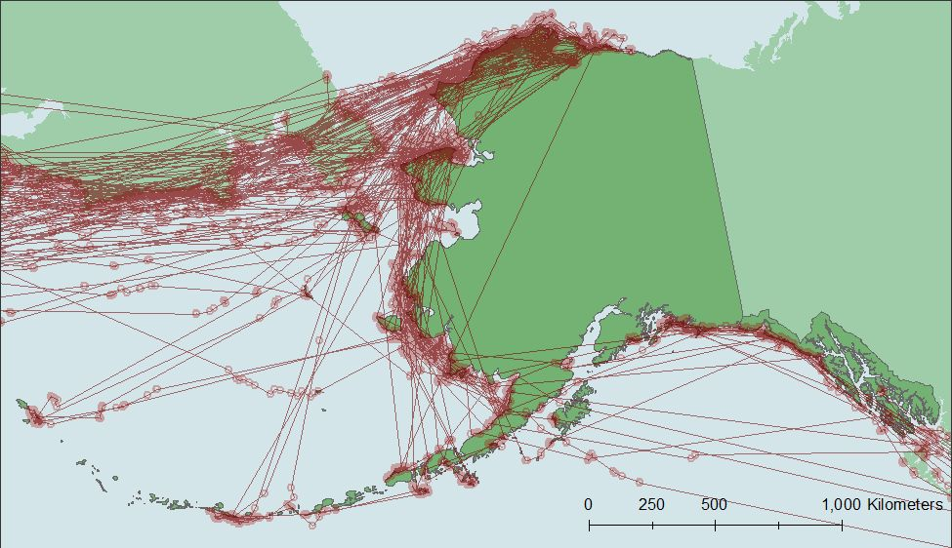
Spatial Analysis
CONNECT TRIPS
Map trips by individual, combine for population-level overview

Slide 21
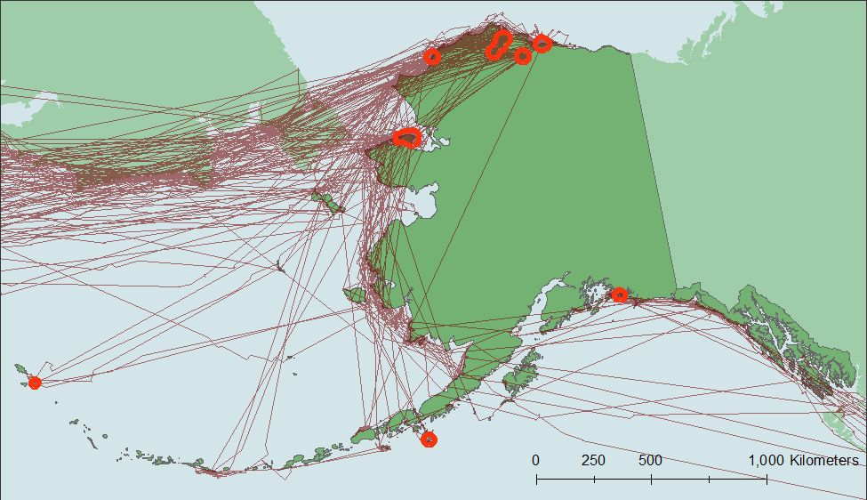
Spatial Analysis
IDENTIFY IBAs
Validation steps to ensure representation of population patterns

Slide 22
Data to Design
Data Gathering
Identify available data
Acquire and organize
Data Synthesis
Spatial analysis
Draw area boundaries
Conservation Design
Composite maps
Connectivity

Slide 23
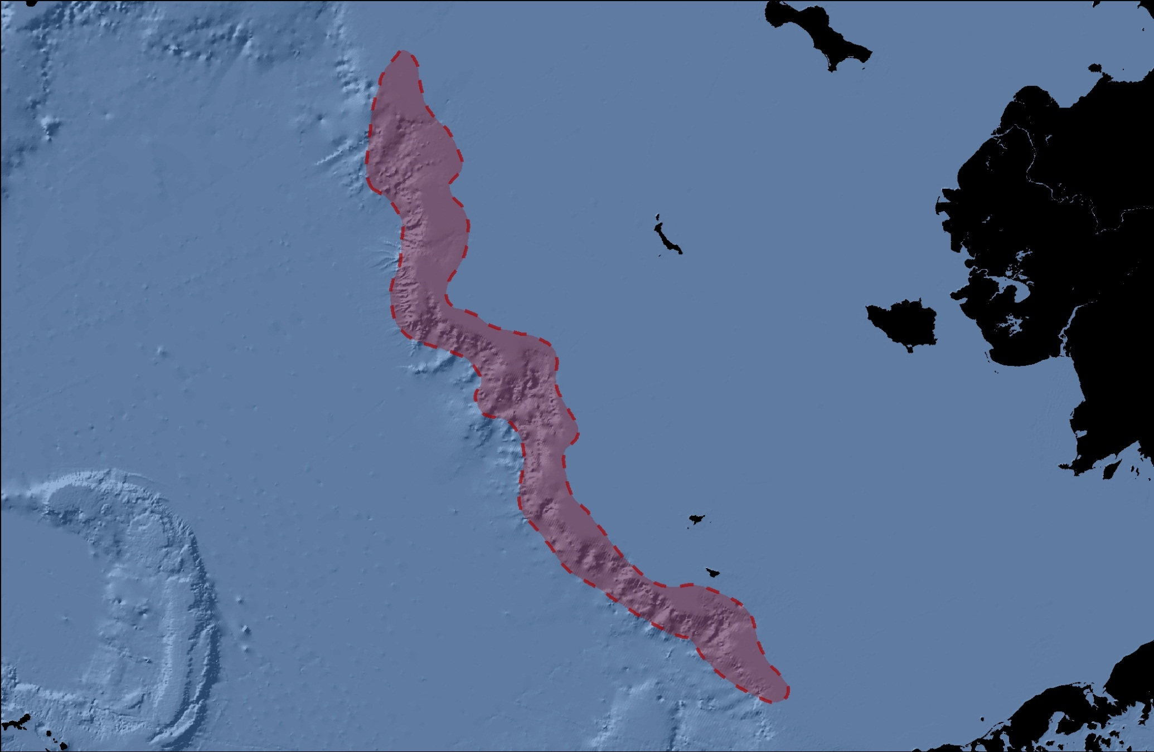
:)
Drawing Area Boundaries
Bering Sea Shelf Break
Expert Drawn

Slide 24
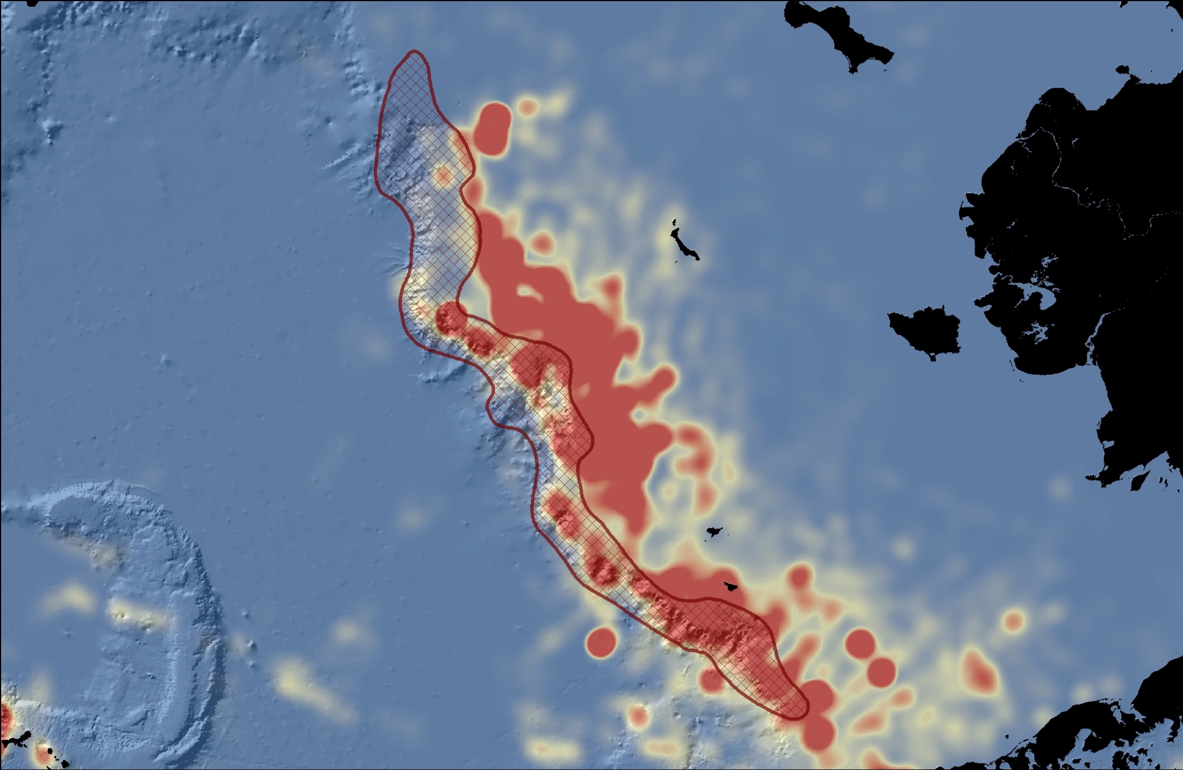
:)
Drawing Area Boundaries
Bering Sea Shelf Break
Expert Drawn (survey data comparison)

Slide 25
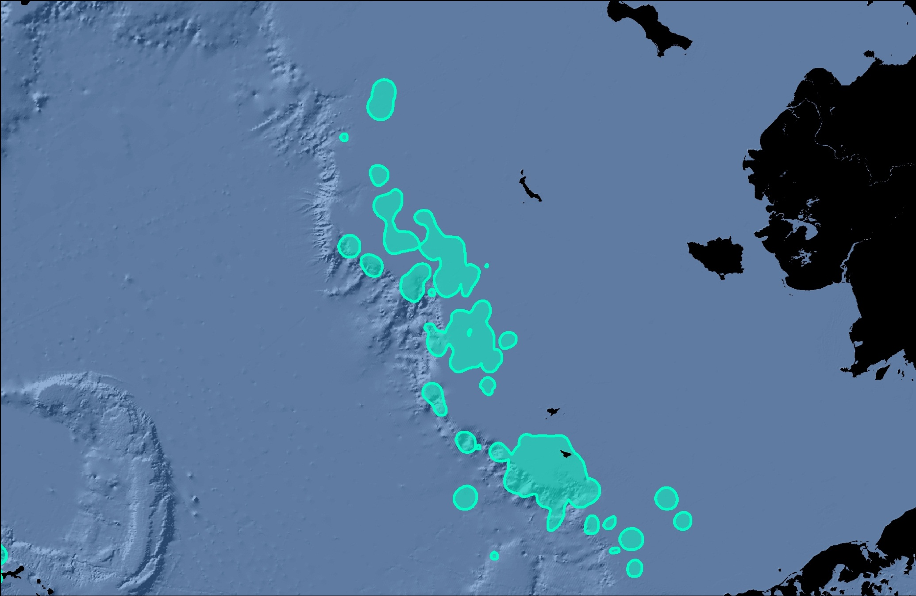
Drawing Area Boundaries
Bering Sea Shelf Break
Top Quantile

Slide 26
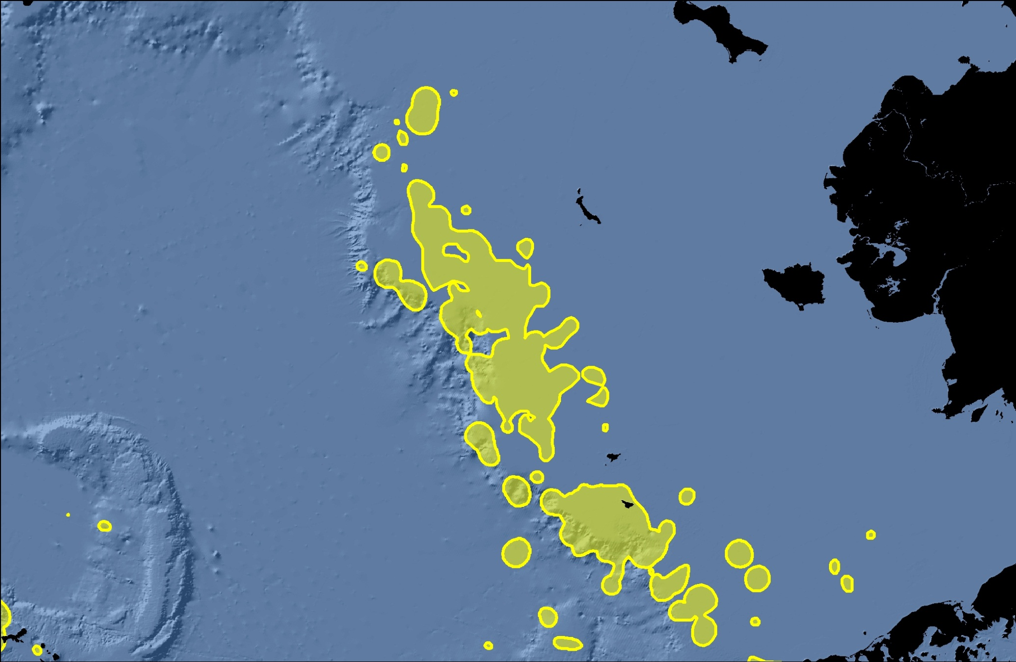
Drawing Area Boundaries
Bering Sea Shelf Break
4x Average Density

Slide 27
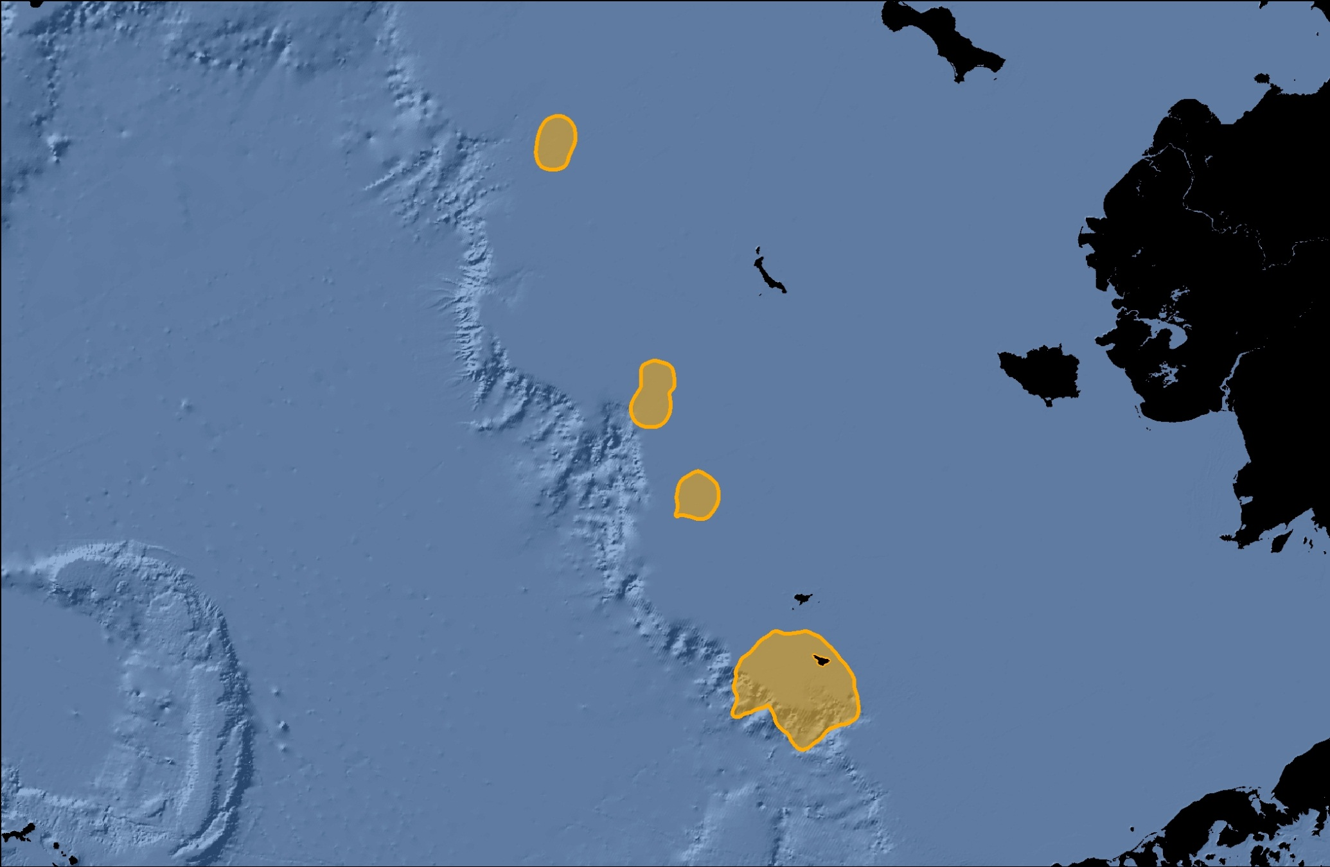
Drawing Area Boundaries
Bering Sea Shelf Break
Moving Window

Slide 28
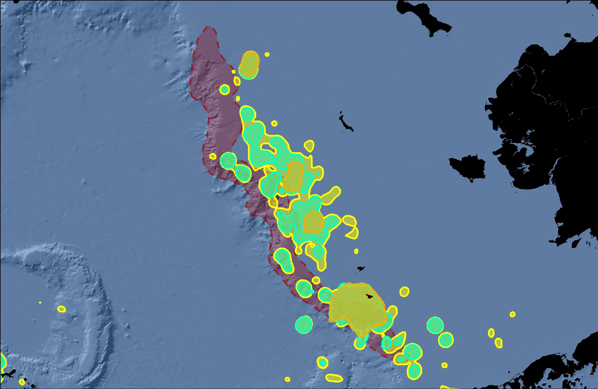
:)
Drawing Area Boundaries
Bering Sea Shelf Break
Moving Window

Slide 29
Data to Design
Data Gathering
Identify available data
Acquire and organize
Data Synthesis
Spatial analysis
Draw area boundaries
Conservation Design
Composite maps
Connectivity

Slide 30
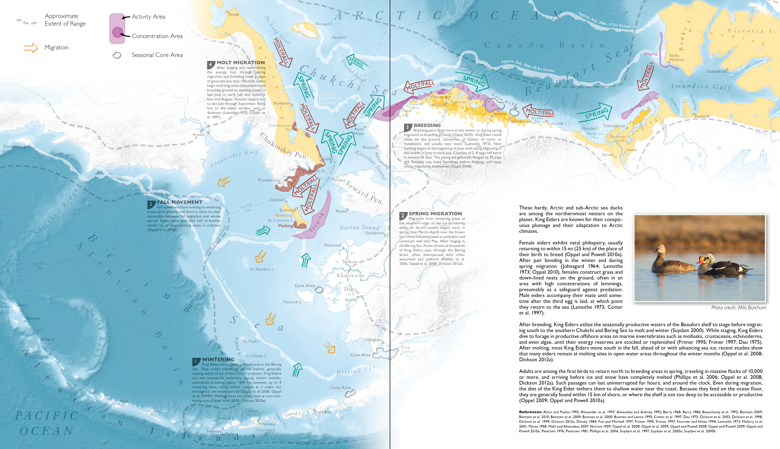
:)
Composite Maps
King Eider
Composite Mapping Approach
Smith et al. 2017, Ecological Atlas of the Bering, Chukchi, and Beaufort Seas

Slide 31
Data to Design
Data Gathering
Identify available data
Acquire and organize
Data Synthesis
Spatial analysis
Draw area boundaries
Conservation Design
Composite maps
Connectivity

Slide 32


Connectivity is difficult to define
Dynamic conditions
  Daily to decadal variability
  Shifting ice, productivity
Focus on the most predictably occupied areas
CONNECTIVITY CHALLENGES
image: Melanie Smith/USFWS

Slide 33
Connectivity is difficult to define
Drawing boundaries
  Marine environment lacks clear boundaries
  Methods produce different lines
Experiment with methods and be aware of their implications for conservation area design
CONNECTIVITY CHALLENGES
image: Melanie Smith/USFWS

Slide 34
Connectivity is difficult to define
Species behave differently
  Colonial seabirds tied to breeding colonies
  Destination-oriented migrants with predictable stopovers
  Pelagic wanderers following food
Blend multiple data types and methods
Look at the annual cycle holistically to identify connections
CONNECTIVITY CHALLENGES
image: Melanie Smith/USFWS

Slide 35
Data to Design: Identifying Important Bird Areas and Seabird Connectivity in the Alaskan Arctic
???
Melanie Smith, Audubon Alaska
image: Milo Burcham

